Slide 1
Next Generation of Learning
Inspire a Culture of Innovation That Results in Significant Improvement in Student Outcomes
Dr. Andrew Shean, Chief Learning Officer,
Penn Foster Group

Slide 2
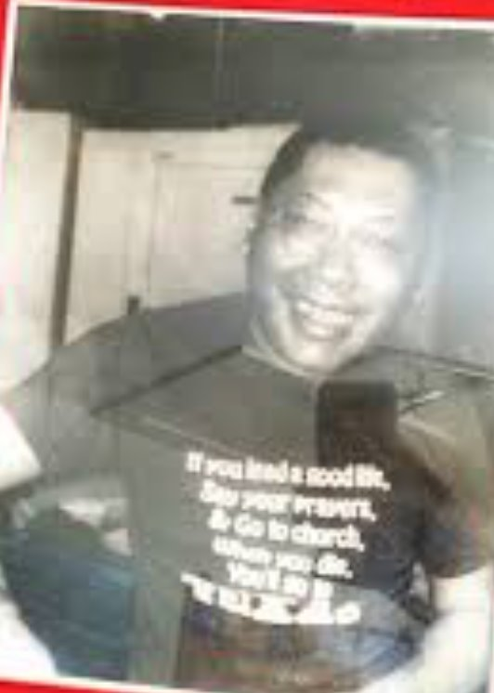
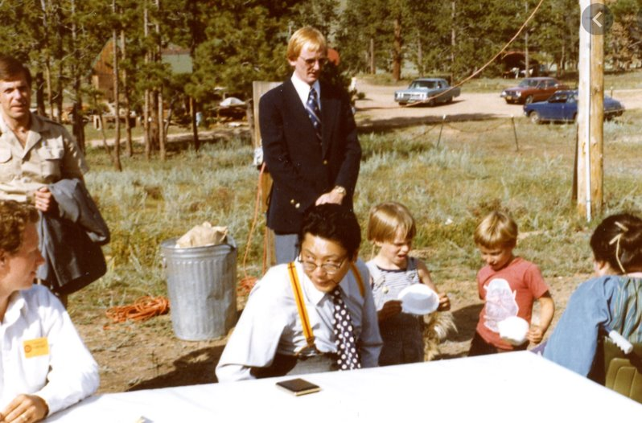

Slide 3


Slide 4

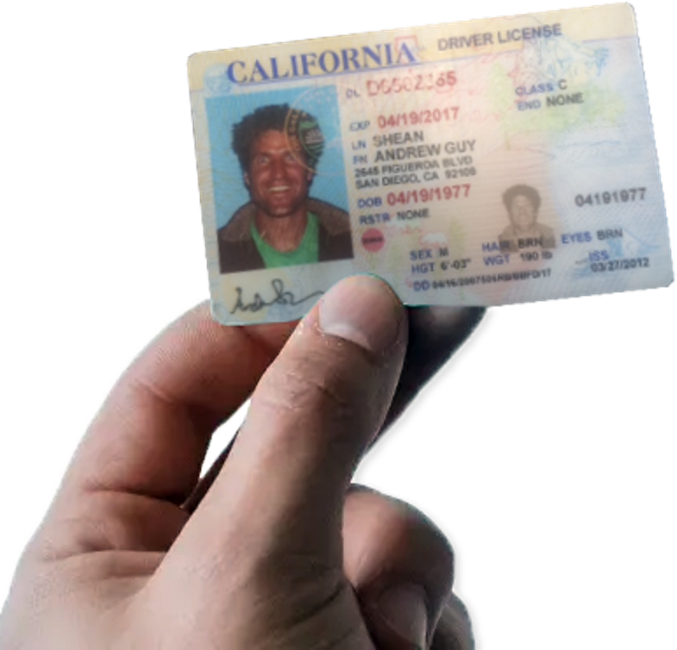
Notes:
‹#›

Slide 5
​“What is worth learning is worth learning well.” ​
-Alfred North Whitehead ​
Notes:
If you learn nothing else, get curious….favorite professor….Dr. Levine….make you think…leave quotes on the wall…record him and watch.

Slide 6









We found that most of the piloted interventions failed to meaningfully improve retention & progression…
Employers
Federal Agencies &
Not-for-Profit
Colleges
  Attract motivated workers
  Retain employees longer
  Fill in-demand roles
  Provide quality education to complement their wrap-around services
  Prepare participants for higher wage work
  Recruit more students
  Sponsor high school diplomas in their communities

Slide 7



Growth in key learner retention metrics over time proves that we're already on the right track
Growth 2021-2024: all programs, all learners
Platinum Learner Retention Metrics
Completed First Course in 30 Days
+ 12 ppts | 33% increase
+ 4 ppts | 5% increase
+ 3 ppts | 9% increase
+ 1 ppt | 5% increase
+ 3 ppts | 23% increase
+ 2 ppts | 9% increase
Exam Active Rate 0-30 Days
Exam Active Rate 61-90 Days
Exam Active Rate 151-180 Days
12-month Completion Rate
24-month Completion Rate

Slide 8
“If you have more than three priorities, you do not have priorities”
-Collins

Slide 9

1
Durable Skill:
Critical Thinking
2
Design Shifts &
Data Insights
3
AI & Humans:
Point of Need Support

Slide 10
“Happy families are all alike; every unhappy family is different in its own way.” ​
- Anna Karenina Principle

Slide 11

Durable Skill:
Critical Thinking

Slide 12
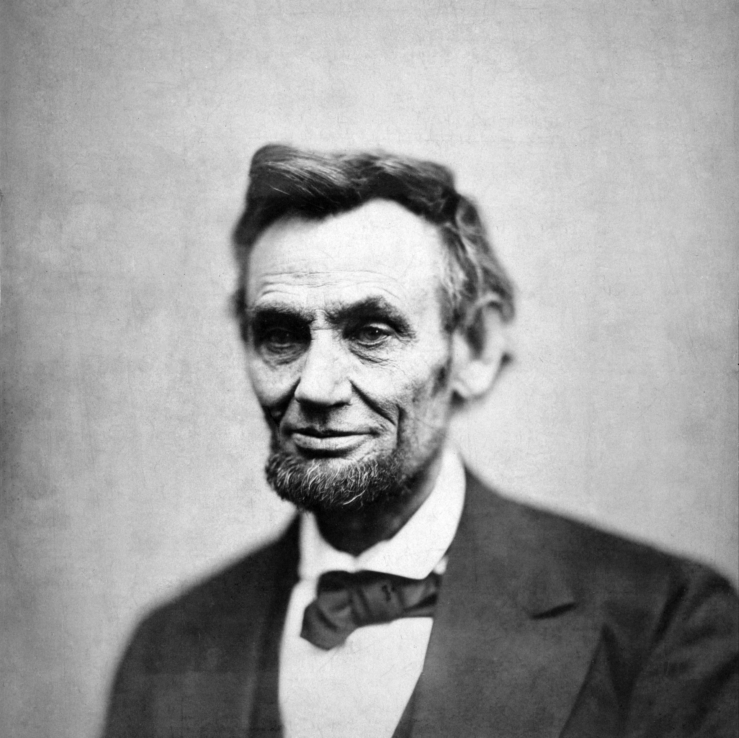
Why Critical Thinking?
"Don’t believe everything you read on the internet"
- Abraham Lincoln
Notes:
Higher education professors it may be number #1….WASC, regional accreditor, top standards…
Welcome…you chose well!
I promise to make all your wildest educational dreams come true.

Slide 13
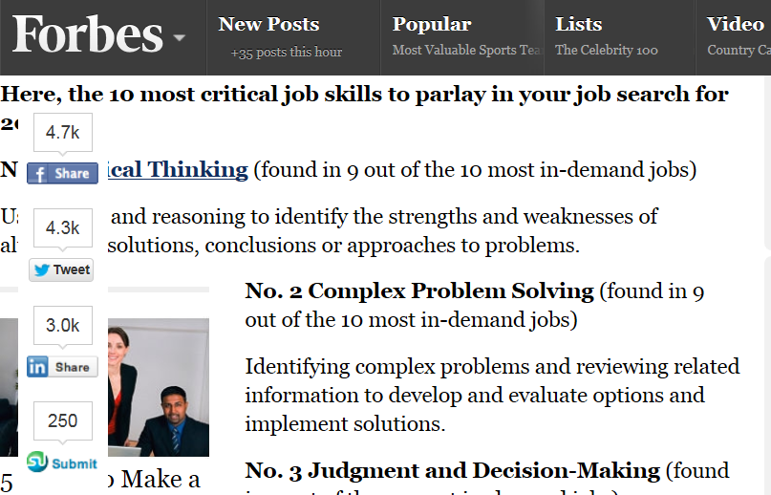
Notes:
Develop degree programs we invite various employers and leaders…ask them the type of skills…EQ and CT #1.

Slide 14
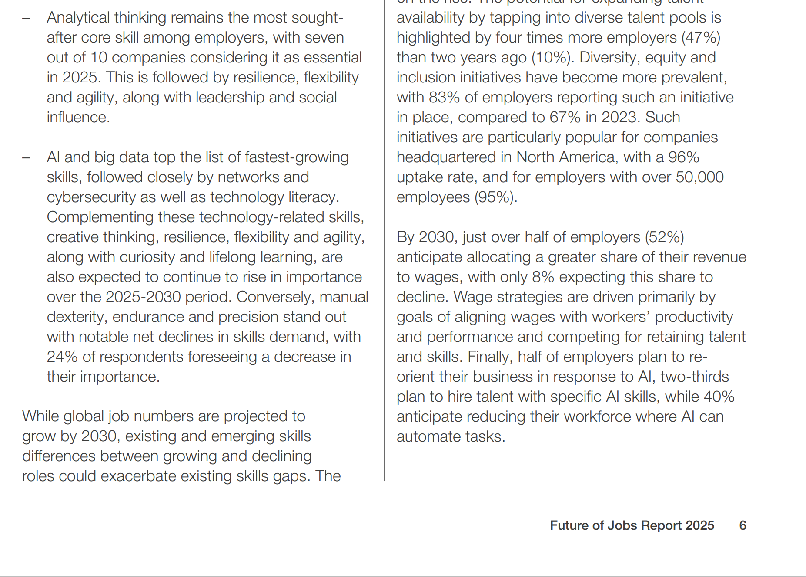

Slide 15
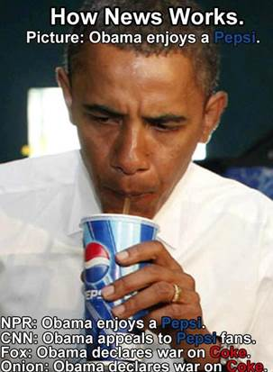

Slide 16
This is WHY…
The top 10 jobs in 2030 will be jobs that did not even exist 5 years ago.
Today’s students will have an average of 10-14 jobs by age 38.
There are 31 billion Google queries each month.
As Keeling (2004) articulated in Learning Reconsidered: A Campus-Wide Focus on the Student Experience, “…knowledge is no longer a scarce – or stable – commodity. (It) is changing so rapidly that specific information may become obsolete before a student graduates and has the opportunity to apply it” (p. 4).
Notes:
STEM for last point….so what are the implications? Changing information, changing jobs….new jobs we cannot even fully comprehend, e.g., robot handler.

Slide 17
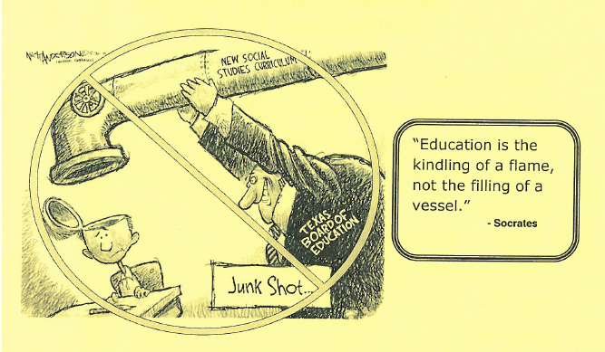
Notes:
Favorite books Road We Make by Walking….Restlessness. Wonder. Dr. Levine moment makes you think….electricity. Not junk shot…not information in, information out, dump the memorization on in the trash the day after quiz learning, And its hard, with standards, tests, and limited time that sometimes can cause us to think about curriculum with a be a mile wide and an inch deep approach. But try not to…somehow.
Sir Kenneth Robinson Schools Kill Creativity? Watch it…so good!

Slide 18
What Is
Critical Thinking?

Slide 19
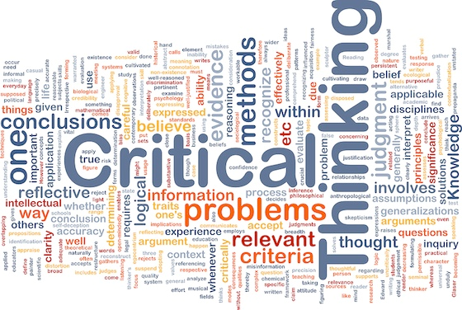
Why Critical Thinking?
Notes:
Higher education professors it may be number #1….WASC, regional accreditor, top standards…
Welcome…you chose well!
I promise to make all your wildest educational dreams come true.

Slide 20
“The essence of critical thinking is evaluation ... the process by which we test claims and arguments and determine which have merit and which do not ... critical thinking is a search for answers, a quest.”
-Dr. Rod Sims

Slide 21
Another Perspective
Critical thinking is the art of analyzing and evaluating thinking with a view to improving it.
Paul & Elder, 2009

Slide 22

Brookfield’s Theory
Identifying and challenging assumptions.
Challenging the importance of context.
Trying to imagine and explore alternatives.
Reflective Skepticism.

Slide 23
How?
Ask Great Questions!

Slide 24
“Questions can be like a lever you use to pry open the stuck lid on a paint can. . . . If we have a short lever, we can only just crack open the lid on the can. But if we have a longer lever, or a more dynamic question, we can open that can up much wider and really stir things up. . . . If the right question is applied, and it digs deep enough, then we can stir up all the creative solutions.”

Slide 25

What is an Input,
What is an Output?
Respond to Two Peers

Slide 26

How Do You Ask A
Great Question?

Slide 27
Questions That Could Be Asked:
Knowledge
Comprehension
Application
Analysis
Synthesis
Evaluation

Slide 28
Bloom’s Taxonomy:
http://faculty.washington.edu/krumme/guides/bloom.html
http://www.ihr.org/jhr/v17/v17n6p19_reparations.html

Slide 29

Discussion Questions
Take A
Look…
A short online article from the Institute for Historical Review
No End in Sight: Germany Has Paid Out More Than $61.8 Billion in Third Reich Reparations
http://www.ihr.org/jhr/v17/v17n6p19_reparations.html

Slide 30
Crafting Discussion Questions
Who or what is the JCC?
In the 1990’s, how much did the JCC pay out to individual claimants?
What do you think might happen in the discussion thread when you ask this type of question?

Slide 31
Crafting Discussion Questions
Analysis: Delve deeper into the subject
The article states that “most of those who were alive during the Second World War are now dead”—meaning the perpetrators of war crimes are themselves long gone from Germany—and that the process of reparation may be “bottomless.”
Should Germany be required to make good on damages for the past, and should there be a limit to the reparations? Use what you have learned from this unit to support your position. Respond to two of your peers’ postings, and describe how their opinions align (or do not align) with yours. What are some possible arguments that could be made to contradict their reasoning?

Slide 32

Crafting Discussion Questions
Evaluation:
  What implications does Germany’s reparation requirement have for the issue of reparation to African Americans?
  Are the fundamental violations of human rights the same? What issues are different?
Again, support your opinion with what we have learned in this unit. Read and respond to the posts of two other students, offering a constructive perspective on their positions. For example, is there any evidence from the article they could consider to further support their point of view?

Slide 33

Recipe For a Great Discussion
Emotional appeal
Set the scene
Ask a great question
Write a question that goes somewhere
Variety is key

Slide 34
Dewey said: “…when it becomes cast in a mold and runs in a routine way does it lose its educative power.”
A. Quotes/Image Analysis
B. Multimedia
C. Debate
D. Case Studies / Scenarios
E. Quotes
F. Concept Maps
There are many ways to construct an engaging and varied line of questioning. Here are a few you might consider:

Slide 35

Debate
A few years at a top-tier management consulting firm is often more valuable than an MBA from an elite institution.
  Point of view A: Agree/why?
  Point of view B: Disagree/why?
Notes:
Change the question….a few years teaching with a great mentor is more valuable than a college degree in education…?

Slide 36
EXP 105 redesign & engagement –
Critical Thinking Question (Week 4, Discussion 2)
 | Pre (25 sections) | Post (25 sections)
Total number of students | 609 | 581
Total number of minutes of engagement | 68,156 | 85,754
Average number of minutes of engagement per student | 111.91 | 147.59 | 31.88% increase in engagement

Slide 37
“Science is built of facts the way a house is built of bricks; but an accumulation of facts is no more science than a pile of bricks is a house.”
-Henri Poincare

Slide 38

THE
Design Lab
The Pillars of Learning Design

Slide 39
Theoretical Underpinnings: Literature Review
Situated Learning – (Participation in Community of Practice)
(Lave & Wenger, 1991)
Motivation, Engagement and Thriving in User Experience (METUX)
(Peters et al., 2018)
Principles of Multimedia Learning
(Mayer and Clark, 2011)
  The model provides a framework grounded in psychological research based on human-computer interaction in respect to how technology designs support or undermine basic psychological needs, thereby increasing motivation and engagement, and ultimately, improving user wellbeing.
  Based on Self Determination Theory (Deci & Ryan, 2000)
    Autonomy
    Competence
    Relatedness
  Coherence Principle
  Signaling Principle
  Redundancy Principle
  Spatial Contiguity Principle
  Temporal Contiguity Principle
  Segmenting Principle
  Pre-training Principle
  Modality Principle
  Multimedia Principle
  Personalization Principle
  Voice Principle
  Image Principle
  (cognitive load, interaction principles, patterning)
  Jean Lave and Etienne Wenger argue that learning is necessarily situated, a process of participation in communities of practice, and that newcomers join such communities via a process of ‘legitimate peripheral participation’—or learning by immersion in the new community and absorbing its modes of action and meaning as a part of the process of becoming a community member.

Slide 40

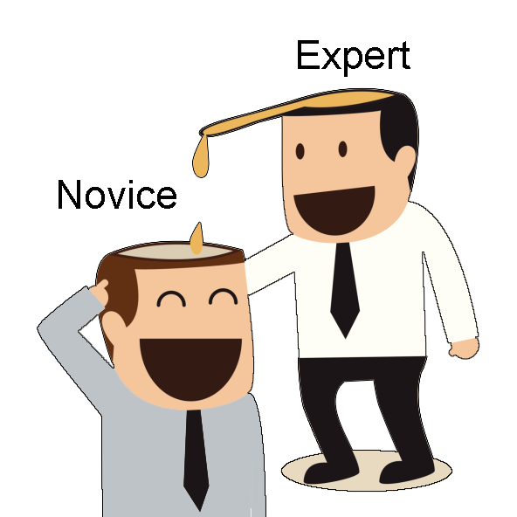

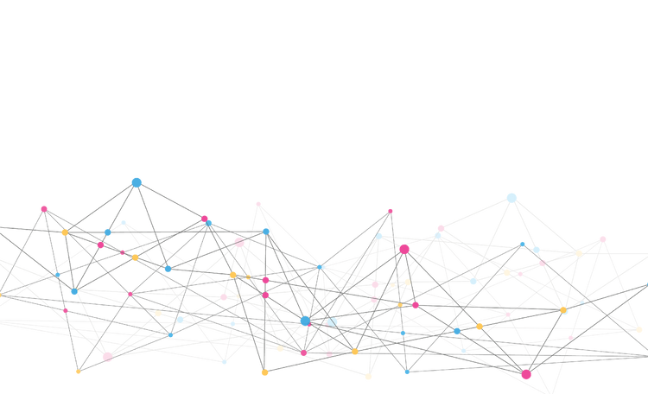
Learning is MORE than Information Transfer.
Learning isn’t remembering.
CONFIDENTIAL
PENN FOSTER GROUP

Slide 41
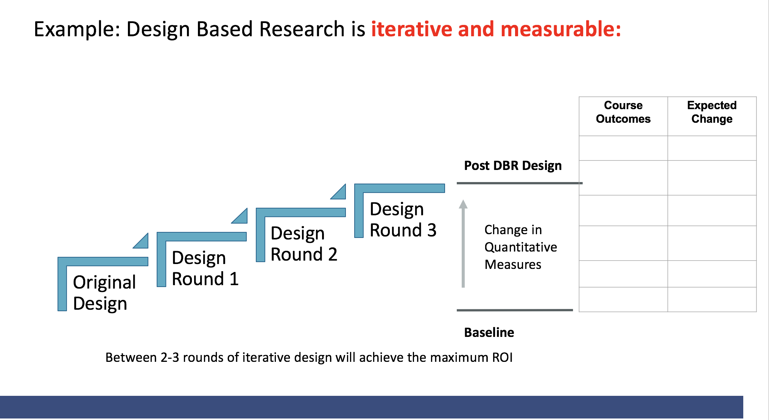
Insights: Model Course Project Analysis Framework
Purpose: Test and scale evidence-based design approaches

Slide 42
We mashed all these ideas together and….

Slide 43
Transitioning from Learning 1.0 to 2.0: Moving from passive to active, and content centered to learner centered approaches
Here are five key characteristics of each:
  Content Centered > Human Centered
    Distributing content as the fulcrum of learning design > Empowering students as the fulcrum of learning design
  Abstract Learning > Situated or Authentic Learning
    Out of context reading and lectures > Observing, interacting, problem solving embedded in real world contexts
  Passive Learning > Active Learning
    Students learn by memorizing > Students learn by doing
  Objective Competence > Skills Mastery
    Identify, define, examine > Demonstrate, acquire skill
  Static Learning > Dynamic Learning (think differentiation)
    Everyone gets the same curriculum > Curriculum based on students' schemas / prior knowledge*
Notes:
*flexible learning materials or personalized feedback, can enhance engagement.

Slide 44
Content Centric
  Content and types of content (textbooks, text, reading, video, practice) are the fulcrum of learning design
Approach:
  What do we want to use to teach students this idea, concept?
  Every course has buckets [introduction, content, review, exam]
  Intro, content, discussion, discussion, assignment
Learner Centric
  The learner and their experience (feeling) and the experience are the fulcrum of learning design
Approach:
  What do we want learners to feel in this experience?
  What do we want learners to gain from this experience?

Slide 45
We Found That Most of the Piloted Interventions Failed to Meaningfully Improve Retention & Progression…
Pilot | Hypothesis | Intervention | Results
E | Learners struggle to make progress after SYP, would benefit from outreach | Call to remind learners they have access to support and answer any questions | The treatment group was no more likely to complete their next exam than the control group.
A | Learners need extra support at the beginning of a program to develop successful habits | Call to coach on successful habits, with promise of follow up to gauge effectiveness | Little to no change in both KPIs, % of learners who logged in after receiving a call and % of learners who completed their next exam.
B | Learners who pause between courses need reminder to log back in and start next course | Call to acknowledge learners’ desire to pause between courses but remind that waiting too long has risks | No discernible results, partially due to an issue that resulted in very few students being called, and which went undetected until it was too late.
G | Learners struggle to make time for learning because of competing priorities for time | Call aimed at inquiring about / understanding what gets in the way of learning | A statistically significant, albeit small improvement in the no. of login days for learners in the treatment group.
I | Learners need their own positive learning behavior reinforced | Call to congratulate and ask learners to reflect on why they were successful | Significant positive change in both KPIs. 27 ppts increase in next exam completion rate, and they took their next exam in half as many days.
C | Learners would benefit from a one-to-one guided onboarding | Call to walk learners through the platform and address existing questions | Not conclusive, due to small sample size, and should be tested again in higher volume program.
D | Learners who perform poorly on an exam would benefit from a motivating call | Call to remind learners its natural not to ace every exam with tips on how to re-engage with content | Negative result in core KPI, fewer learners in the treatment group attempted the next exam vs the control.

Slide 46
Transitioning from Learning 1.0 to 2.0
Here are five key characteristics of each:
  Content Centered > Human Centered
    Distributing content as the fulcrum of learning design > Empowering students as the fulcrum of learning design
  Abstract Learning > Situated or Authentic Learning
    Out of context reading and lectures > Observing, interacting, problem solving embedded in real world contexts
  Passive Learning > Active Learning
    Students learn by memorizing > Students learn by doing
  Objective Competence > Skills Mastery
    Identify, define, examine > Demonstrate, acquire skill
  Static Learning > Dynamic Learning (think differentiation)
    Everyone gets the same curriculum > Curriculum based on students' schemas / prior knowledge*

Slide 47

Safety Patrol
Notes:
‹#›

Slide 48

Role of Patrol at Signalized Intersections
  Only police officers or adult crossing guards can stop vehicles. Patrol members have specific duties based on their posts.
Duties of patrol members:
  Stand on the sidewalk, at least one step back from the curb and midway between crosswalk lines
  Watch traffic flow and children approaching
  At red lights, signal students not to enter the intersection by holding arms down at 45-degree angle to the body
  At green lights, determine all approaching traffic has stopped before allowing students to cross
  Check traffic in all directions for a suitable gap and then permit children to cross
  Before the light changes back to red, return to the outstretched arms position to prevent children from being caught in the middle of the intersection
Notes:
While she was excited, I was terrified.
HOW WERE THEY GOING TO MAKE MY KID FOCUS AND LEARN SOMETHING SO IMPORTANT
https://centralpenn.aaa.com/sites/default/files/2019-07/opsmanual.pdf

Slide 49
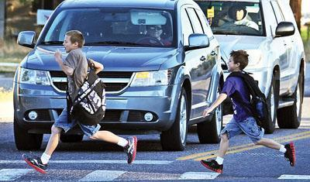
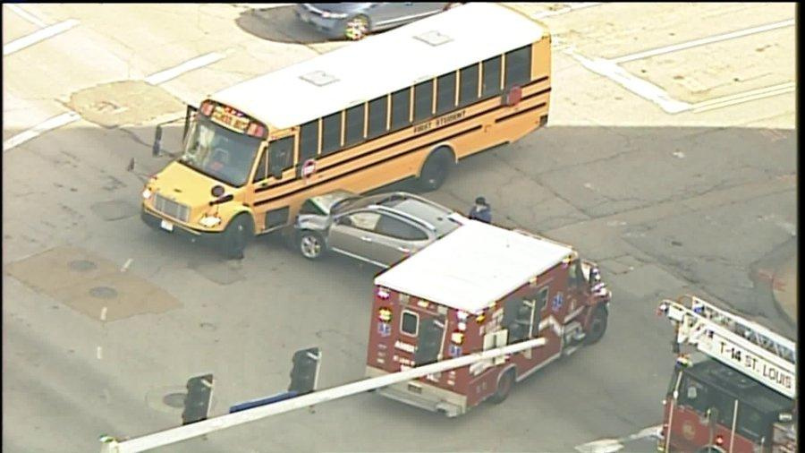
Context Matters
“In theory, theory and practice are the same.
In practice, they are not.”
-Einstein

Slide 50

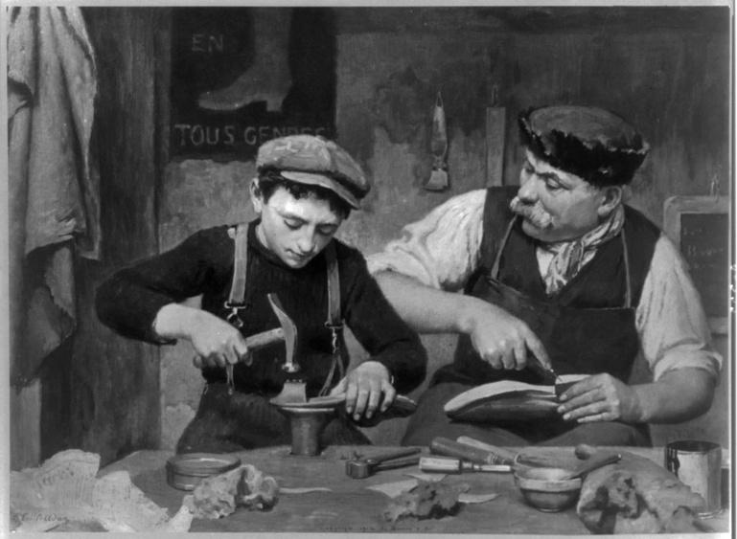
Legitimate Peripheral Participation
“The central issue in learning is becoming a practitioner,
not learning about practice.”
- Brown & Duguid, 1991
Notes:
‹#›

Slide 51
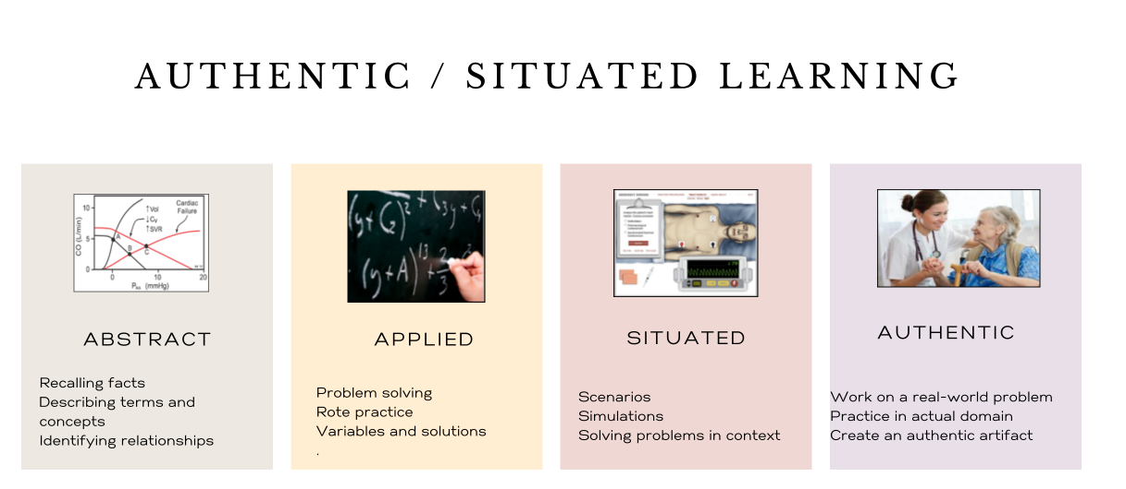
Authentic Situated Learning
Better AI advances makes shifting to right even more important…
Notes:
‹#›

Slide 52



Situated or Authentic Learning Experience Examples:
Marketing
Data Literacy
Psychology
  Go to any store and observe the way the shelves are organized. Chronicle what your eye goes to first - it is the least expensive.....etc. Chronicle your observations and then use course resources to analyze why. It's your store now, what would you do differently?
  Identify a problem you have and either download an app or manually keep track of data about yourself (beginning of the course).
  In the end you will conduct an analysis on your own data and determine if you solved a problem
  You will act as a psychologist for either a famous person or a movie character. Using footage or other evidence of your patient's behavior as well as the DSM-V, diagnose your patient. Back up your diagnosis with evidence. Recommend a therapeutic route including medications for your patient.

Slide 53
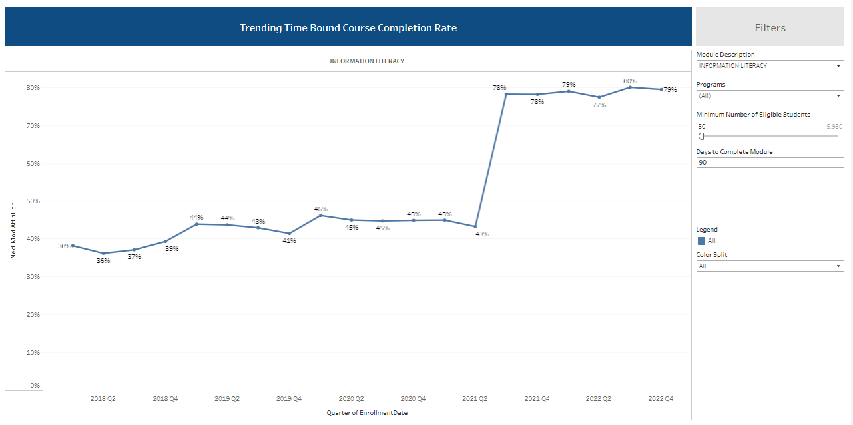
Performance jumped up in Q3 2021 largely due to design shifts
LOOK HERE
Notes:
‹#›

Slide 54
Transitioning from Learning 1.0 to 2.0
Here are five key characteristics of each:
  Content Centered > Human Centered
    Distributing content as the fulcrum of learning design > Empowering students as the fulcrum of learning design
  Abstract Learning > Situated or Authentic Learning
    Out of context reading and lectures > Observing, interacting, problem solving embedded in real world contexts
  Passive Learning > Active Learning
    Students learn by memorizing > Students learn by doing
  Objective Competence > Skills Mastery
    Identify, define, examine > Demonstrate, acquire skill
  Static Learning > Dynamic Learning (think differentiation)
    Everyone gets the same curriculum > Curriculum based on students' schemas / prior knowledge*

Slide 55
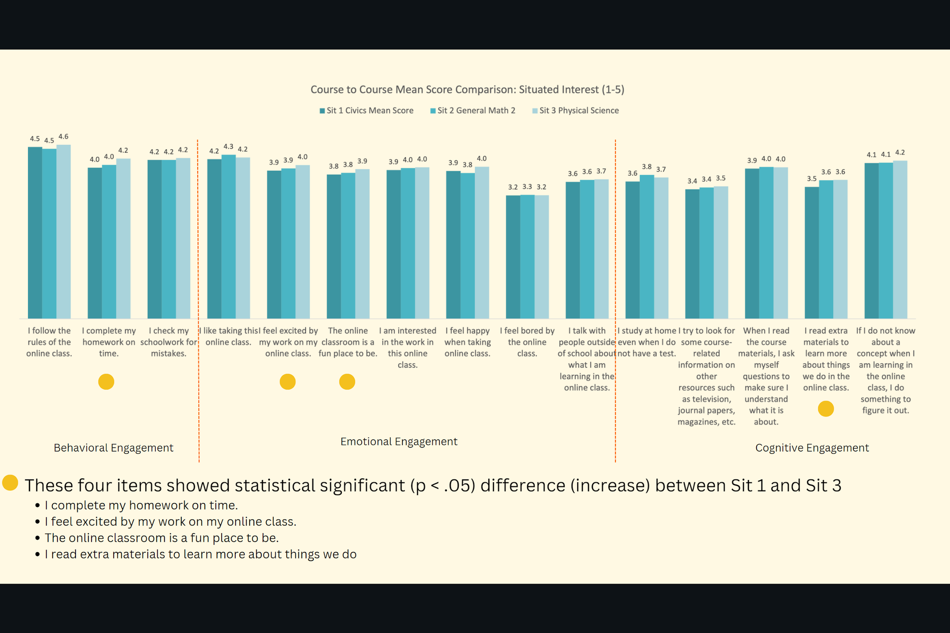
Notes:
‹#›

Slide 56
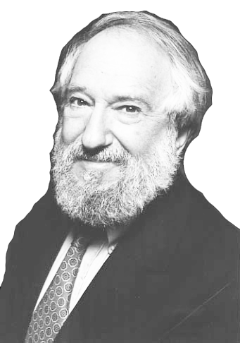
“Every maker of video games knows something that the makers of curriculum don't seem to understand. You'll never see a video game being advertised as being easy. Kids who do not like school will tell you it's not because it's too hard. It's because it's—boring” ​
- Seymour Papert, Founder of Constructionism
Notes:
gamification and storytelling can cater to diverse motivations and learning needs

Slide 57
Passive Learning
Active Learning
Students Learn by Memorizing
Students Learn by Doing
read, watch, listen, view
ask, create, do, decide
20%
80%

Slide 58
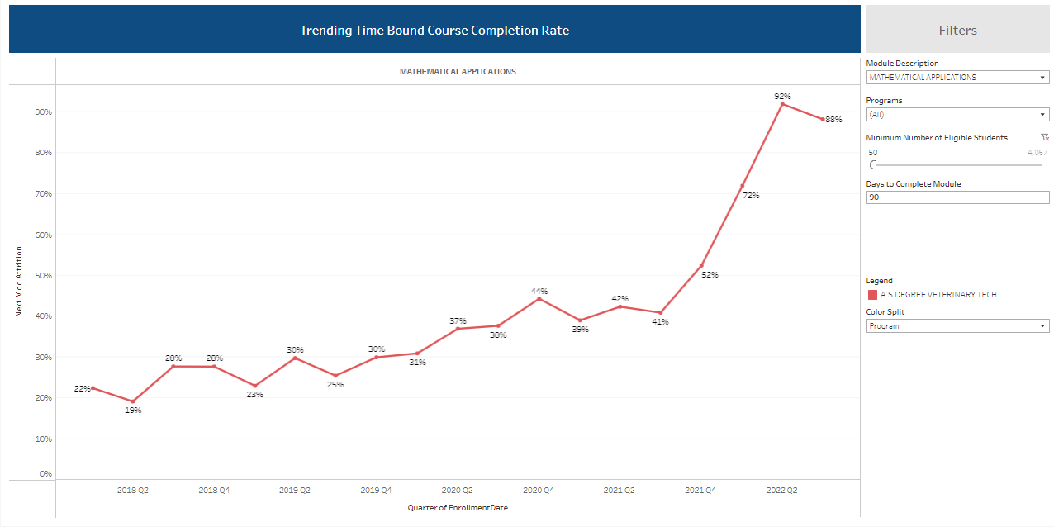
We’ve seen a consistent improvement in retention is this course
LOOK HERE

Slide 59
Transitioning from Learning 1.0 to 2.0
Here are five key characteristics of each:
  Content Centered > Human Centered
    Distributing content as the fulcrum of learning design > Empowering students as the fulcrum of learning design
  Abstract Learning > Situated or Authentic Learning
    Out of context reading and lectures > Observing, interacting, problem solving embedded in real world contexts
  Passive Learning > Active Learning
    Students learn by memorizing > Students learn by doing
  Objective Competence > Skills Mastery
    Identify, define, examine > Demonstrate, acquire skill
  Static Learning > Dynamic Learning (think differentiation)
    Everyone gets the same curriculum > Curriculum based on students' schemas / prior knowledge*

Slide 60


Objective Competency
Skills Mastery
Identify, define, examine
  Generally for us to help align Curriculum
  behind the scenes (content centered)
  Not in a format that students can add to their portfolio/resume
Demonstrate, acquire skill
  Learner centered
  Explicit and defined
  In a form that learners can add
  to their portfolio/resume

Slide 61
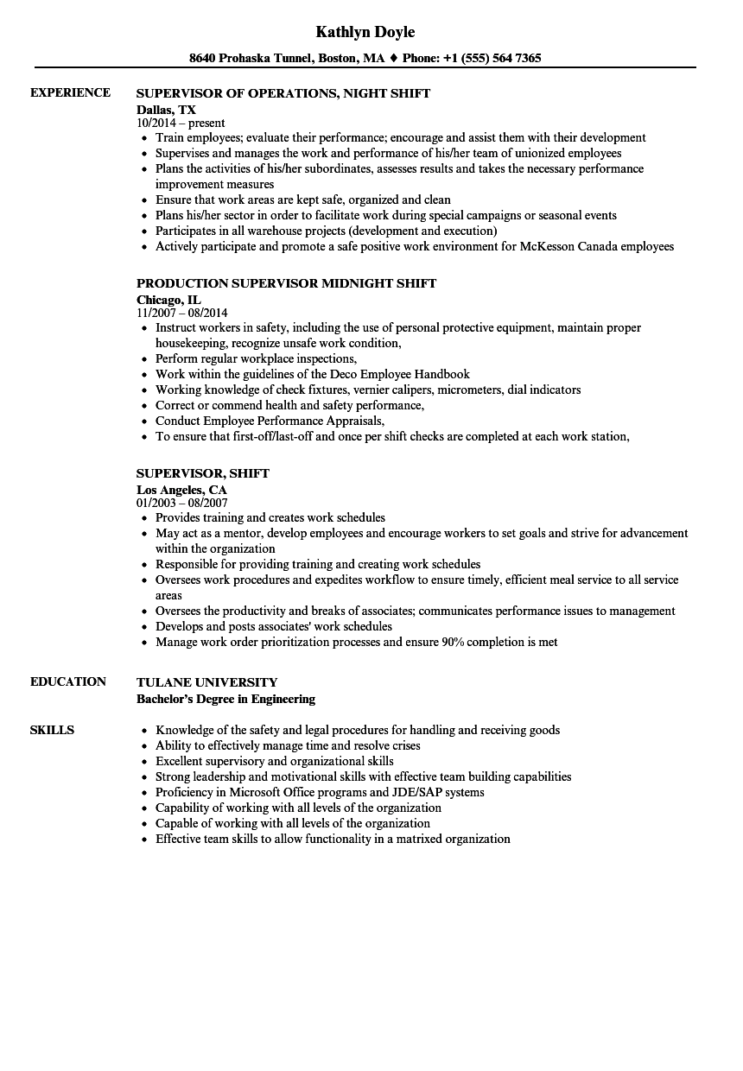
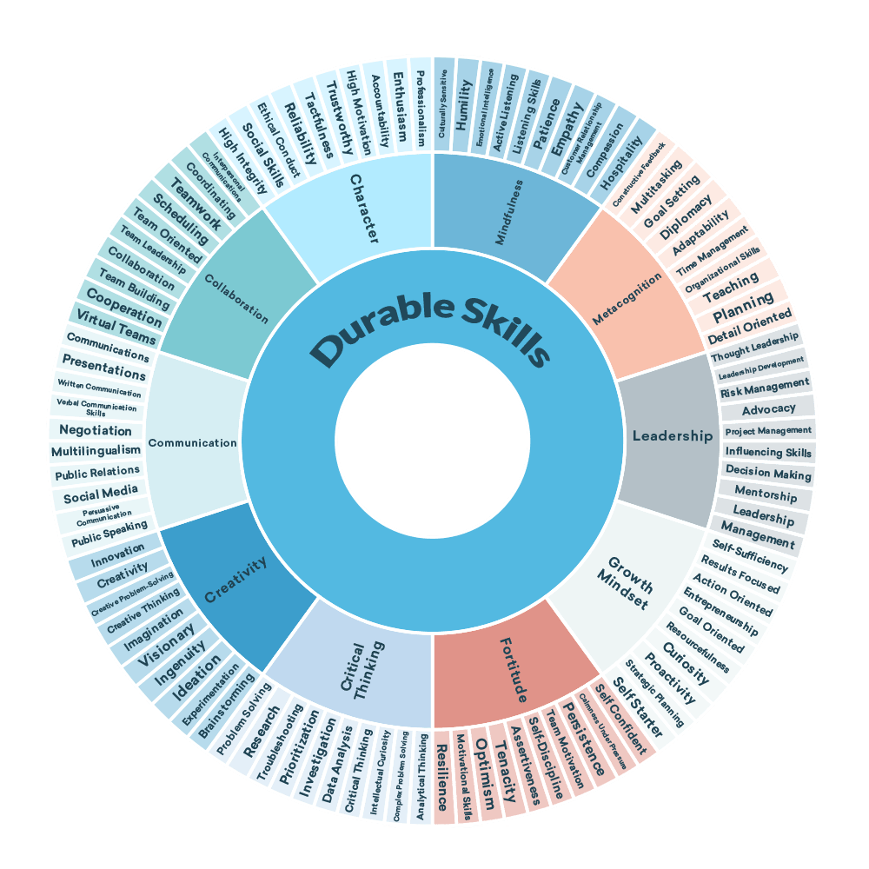
Notes:
‹#›

Slide 62
Now, you’ll revisit your response to the scenario. You’ll apply the following skills in this exercise:
Critical Thinking

Slide 63
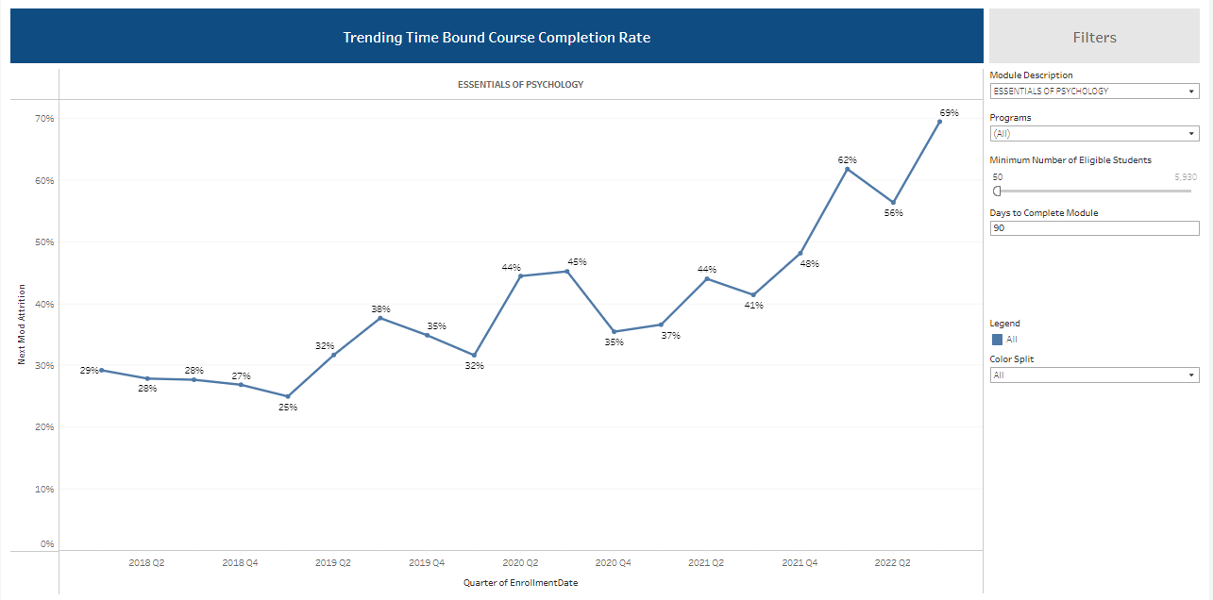
Performance has been steadily trending upward.

Slide 64
Transitioning from Learning 1.0 to 2.0
Here are five key characteristics of each:
  Content Centered > Human Centered
    Distributing content as the fulcrum of learning design > Empowering students as the fulcrum of learning design
  Abstract Learning > Situated or Authentic Learning
    Out of context reading and lectures > Observing, interacting, problem solving embedded in real world contexts
  Passive Learning > Active Learning
    Students learn by memorizing > Students learn by doing
  Objective Competence > Skills Mastery
    Identify, define, examine > Demonstrate, acquire skill
  Static Learning > Dynamic Learning (think differentiation)
    Everyone gets the same curriculum > Curriculum based on students' schemas / prior knowledge*

Slide 65
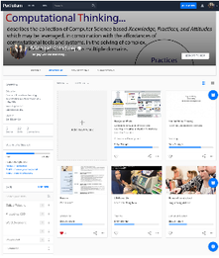

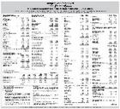

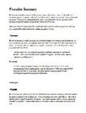
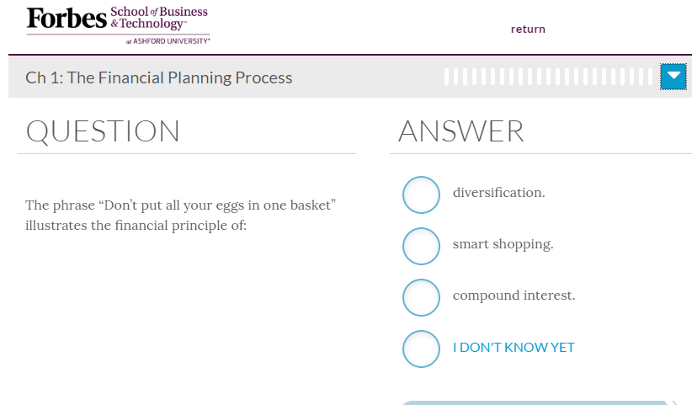


Week 1
Week 2
Week 3
Week 4
Week 5
Scenarios and Interactivities
Faculty Mentorship
Scenarios and Interactivities
Faculty Mentorship
Scenarios and Interactivities
Faculty Mentorship
Scenarios and Interactivities
Faculty Mentorship
Scenarios and Interactivities
Faculty Mentorship
Project
Immersive Business Simulation- Situating application within a realistic context.
Learning Support Layers
Adaptive Platform
On Demand Tutoring
Faculty
Notes:
Adaptive mixed with a project based learning partner

Slide 66
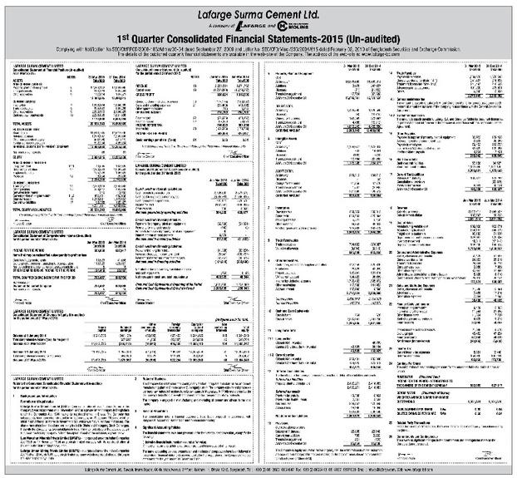
Integrating Adaptive Meaningfully
Skill Building Practice
Financial Evaluation
Compare and Contrast potential acquisitions
Project Based Learning Deliverable
Evaluate corporate health
Identify financial metrics

Slide 67



Our new learning model (LAADS) aims to create a more engaging learning experience, thereby improving academic performance, persistence and completion rates
L
Learner-Centered – designing for our learner vs designing for the content
Goals of this pedagogy
A
Authentic – learning that is situated in the occupation you are training for
01
Improve academic performance
A
Active – learn by doing (more practice, less reading)
02
Improve course completion rates
Differentiated – learning that is personalized vs one-size-fits-all
03
Improve persistence rates
D
04
Improve velocity (time to complete)
S
Skill-Based – aligned to the skills learners need to get hired and succeed on the job

Slide 68
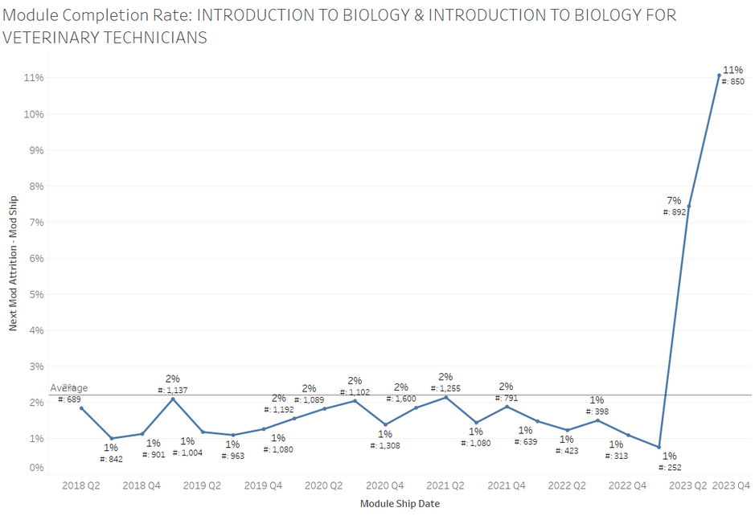
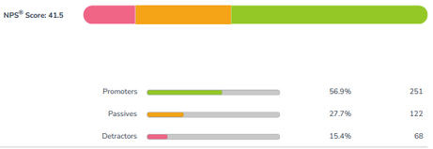
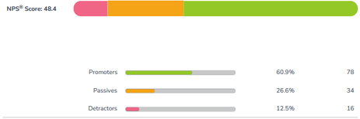
Revised Biology course showing great outcomes
Multi-phase revision starting in Feb and completed in Oct
Mod | Description | Launch date
SCI120LA | Original
SCI120LB | Research paper removed | 2/23
SCI120LC | Proctor removed | 4/7
SCI121LA | Phase 1 design shifts | 4/28
SCI121LB | Phase 2 design shifts | 7/14
SCI121LC | Phase 3 design shifts | 10/16
  NPS up 7 pts
  60-day completion rate up 10% pts
  Feedback up in every category for course experience on end of course survey
  Twice as many learners report “no additional features necessary” to help them learn better in the course
  % of learners needing to reach out to PF for assistance down 16% pts
NPS Old Course 41
NPS New Course 48
15%
28%
57%
12%
27%
61%

Slide 69






ENGAGEMENT & PROGRESSION
Completion Rates
DNT001
DNT002
73%
Pre-Revision
92%
Post-Revision
39%
Pre-Revision
60%
Post-Revision
Post-revision completion rates reflect date range from 2/1/2024-8/1/2024.

Slide 70

The initial pilot of this model in the first two courses of our PF Dental Assistant program
has proven that we know how to dramatically improve the learning experience
Results of pilot in Intro to Dental Assistant & Dental Terminology, Anatomy, and Charting, measured 5 months after the launch of these revised courses
Improve Academic Performance
Improve Course Completion Rates
Course | Avg Grade (before) | Avg Grade (after)
Intro to Dental Assistant | 84% | 89%
Dental Terminology, Anatomy, and Charting | 80% | 90%
Course | Comp % (before) | Comp % (after)
Intro to Dental Assistant | 73% | 92%
Dental Terminology, Anatomy, and Charting | 39% | 60%
Improve Persistence Rates¹
Improve Velocity (time to complete)
Persistence Rate (before)
Persistence Rate
(after)
Days to Complete (before)
Days to Complete (after)
Not available
97%
28
23
[1] Persistence rate represents that proportion of learners who complete the course and begin their next course in the program

Slide 71
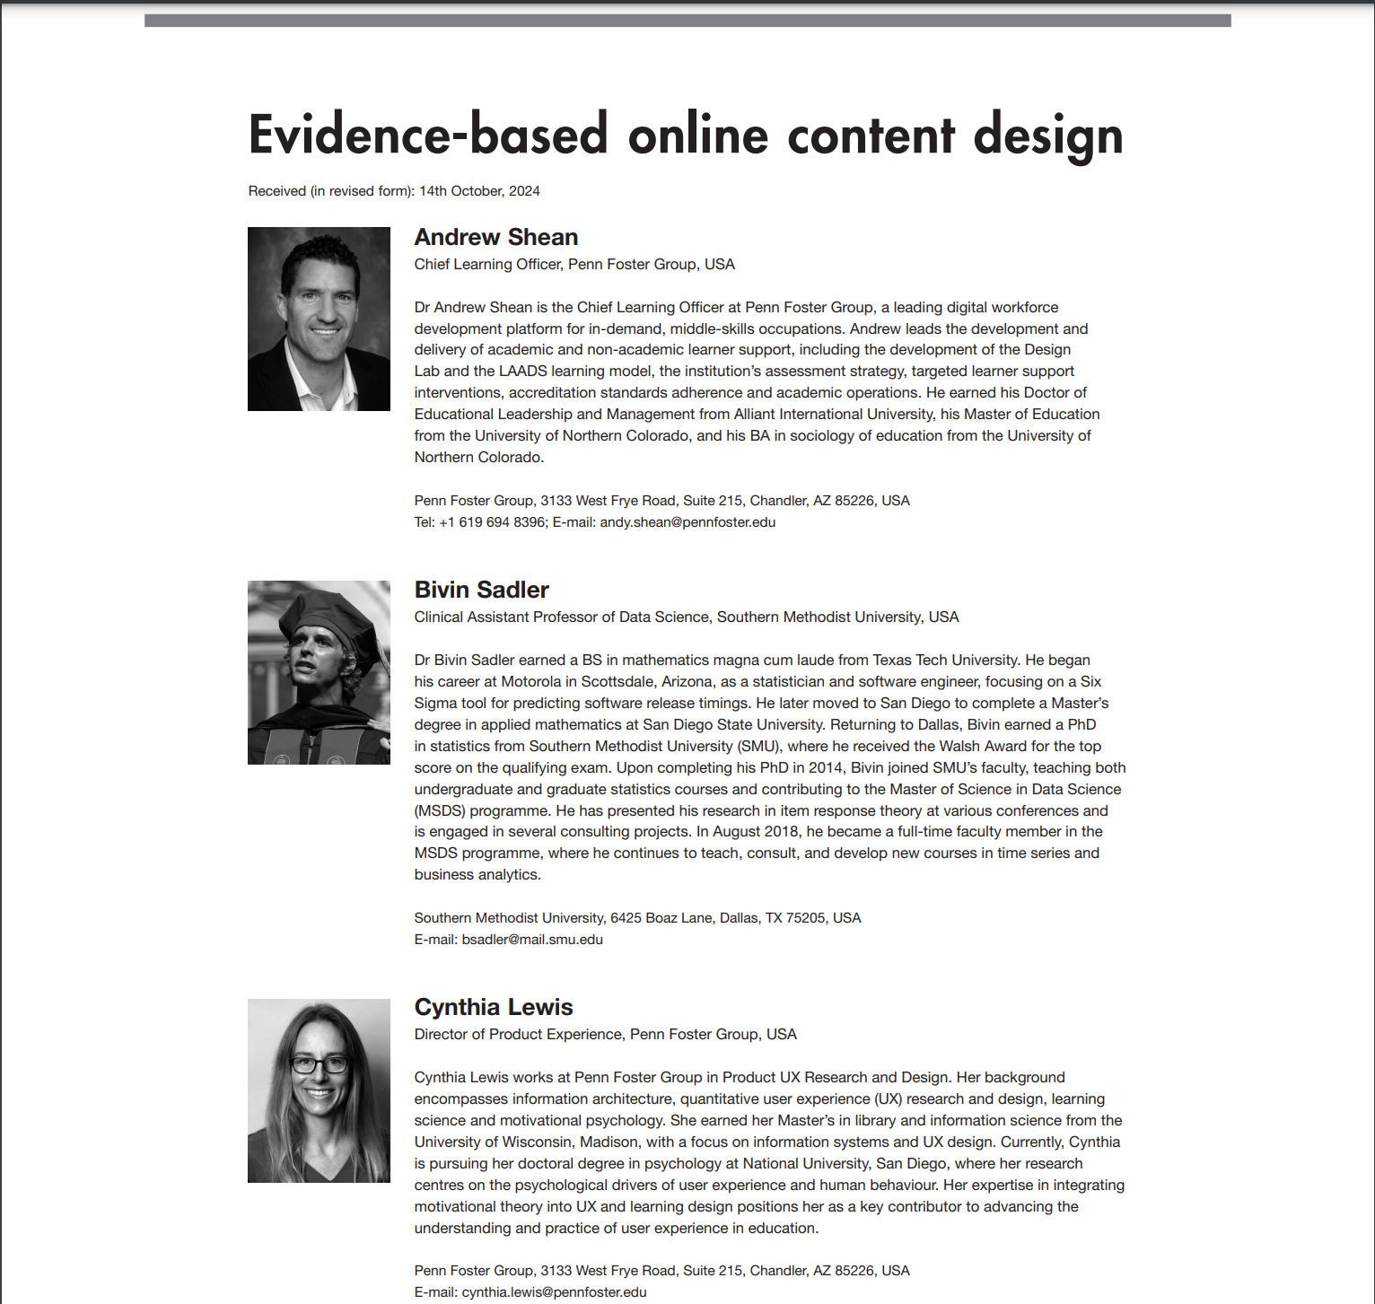
Advances in Online Education: Peer Review Journal Article
(March, 2025)

Slide 72
Two Key Takeaways

Slide 73
“Improvement in Post Secondary Education will require converting teaching from a ‘solo sport’ to a community based research activity.”
-Herbert Simon Nobel Laureate

Slide 74


Slide 75
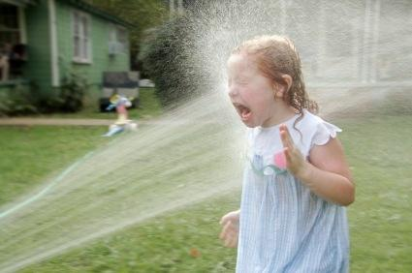

Slide 76
“Applying transactional solutions to transformational challenges typically results in increased effort without better outcomes.”
-Tony Frontier
Notes:
So...what is your strategic frame? Why not point of need support?

Slide 77

Examples of Point of Need Support:
Leading students through the steps of the writing process while offering rubric-based feedback on drafts (see example)
Encouraging students to check their understanding of procedural and application-based skills and tasks (see example)
Creating worked examples with feedback/AI score (see example)
Engaging with individual students on deeper learning questions like why, what if, and how...or even inquiry style QA on a topic of interest
Helping students link what they are learning to their goals, their lives, and the things they are interested in, e.g., why do I need to learn this?

Slide 79

Discussion
Notes:
‹#›

Slide 80
Thank You!

