Slide 1
Using AI in the Accounting Classroom to Enhance Student Engagement and Learning
Dr. Phyllis Okrepkie
Florida Institute of Technology

Slide 2
History of AI
1950s-60s: The field formally began with the 1956 Dartmouth Conference. Early researchers like Alan Turing, John McCarthy, and Marvin Minsky established foundational concepts and developed programs that could solve mathematical problems and play games.
1970s-80s: This period saw the rise of expert systems and knowledge-based approaches, attempting to encode human expertise into rule-based systems.
1990s-2000s: Machine learning gained prominence, with algorithms that could learn from data rather than following explicit programming.
2010s: Deep learning emerged as a breakthrough approach, using neural networks with many layers to process complex data. This led to significant advances in image recognition, natural language processing, and other domains.
2020s: Large language models and multimodal systems capable of understanding and generating various types of content became mainstream.

Slide 3
What is Generative AI?
Generative AI refers to artificial intelligence systems that can create new content rather than simply analyzing or classifying existing data. These systems learn patterns from training data and then generate novel outputs that reflect those patterns while introducing variations.
The most notable examples include:
Large Language Models (LLMs) that generate text
Image generation models like DALL-E, Midjourney, and Stable Diffusion
Audio generation systems for music and speech
Video generation models

Slide 4
What can Generative AI Do?
Computer Vision
  Identifying objects, people, and actions in images
  Medical image analysis for disease detection
  Quality control in manufacturing
  Facial recognition and emotion detection
Creative Applications
  Generating artwork in various styles
  Composing music
  Creating game environments and characters
  Designing architectural layouts

Slide 5
What can Generative AI Do? – con’t
Natural Language Processing
  Translation between languages
  Summarizing documents
  Answering questions based on provided information
  Writing creative content like stories or poetry
Decision Support
  Predicting stock market trends
  Recommending products based on user preferences
  Diagnosing diseases based on symptoms and test results
  Optimizing supply chains and logistics

Slide 6
Consumer Facing AI Systems
ChatGPT (OpenAI): Arguably the most popular AI with over 100 million weekly active users, available in free and subscription (Plus) versions
Claude (Anthropic): Known for thoughtful responses and safety features, available via web interface, API, and through integrations
Gemini (Google): Google's AI assistant integrated into search and various Google products
Copilot (Microsoft): Microsoft's AI assistant built into Windows, Office products, and Edge browser
Canva: AI powered graphic design tool that allows users to create presentations, logos, banners, etc.
DeepL: Provides translation services using artificial neural networks
Poe: Is an AI chatbot aggregator that allows users to create custom bots or access existing models
Sources: 60 Most Popular AI Tools Ranked (Feb 2025) www.explodingtopics.com, ClaudeAI, retrieved 4-1-25 https://claude.ai

Slide 7
How Are Publishers Using AI?

Slide 8

AI-Powered Tools for Learning

Slide 9




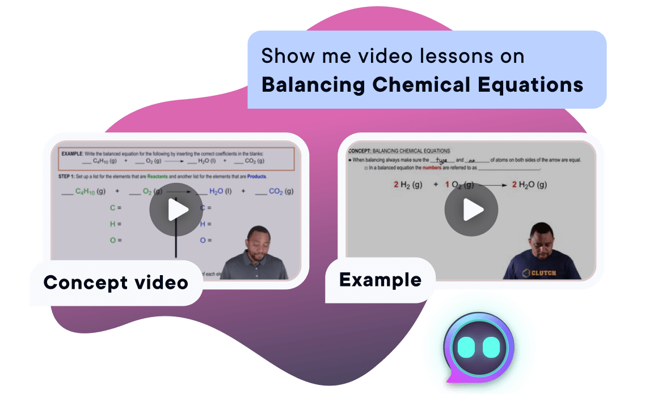
AI-powered study tools
MyLab & Mastering
eTextbooks in Pearson+
Study Prep in Pearson+
In August 2023, Pearson became the first major higher education publisher to integrate generative AI study tools into its proprietary academic content to enable better teaching and learning experiences.
Personalized homework help
Simplified explanation
Productive practice
AI Skills Modules
AI Assignments
AI Simulations
Instant explanations
On-demand summaries
Choose your own practice
AI-generated flashcards*
Image capabilities
Step-by-step guidance
AI-powered video lessons
Extra practice questions
Syllabus upload
Our AI-powered tools are always ready to support your students with trusted, expertly vetted guidance, making learning efficient, accessible, and reliable whenever they need it most.
Increase engagement in assigned materials
Enable opportunities for personalized learning
Provide trusted support, available 24/7
Safe space to practice and refine "AI literacy" skills
9
*Select titles.

Slide 10

AI-Powered Tools for
Teaching

Slide 11

AI-powered tools for teaching
AI-powered instructor tools
AI-powered instructor tools help educators focus on what matters most.
Pearson's AI-powered instructor tools are here to revolutionize the way instructors create assignments, quizzes, and tests in MyLab®.
Spend less time on administrative tasks and more time connecting with students.
Our AI instructor tool is available 24/7 to assist you with assignment creation to increase efficiency.
Our AI instructor tool helps optimize your workflow.
Filter through hundreds of questions in a fraction of the time.
Instantly review, adjust, and assign with ease.
Input a simple prompt – let AI handle the rest.
Gives you more time to focus on teaching and engaging with students.
11

Slide 12


Slide 13
What AI do I Use?
Claude from Anthropic

Slide 14
What Can Claude 3.7 Sonnet Do?
Engage in natural, nuanced conversations on a wide range of topics
Generate high-quality written content in various formats (essays, stories, code, emails, etc.)
Analyze and extract insights from text
Assist with problem-solving across domains like mathematics, science, and programming
Create structured content like tables, lists, and formatted text
Help with creative writing, brainstorming, and idea generation
Explain complex concepts in accessible ways
Generate visualizations like charts and diagrams using code
Answer questions based on Claude’s training (with knowledge up to October 2024)
Maintain context throughout long conversations
Adapt my tone and style based on user preferences

Slide 15
How Have I Used AI?

Slide 16
Generate high-quality written content
Challenge: Available case studies may not be relevant to your student population – Tailoring a case to a specific degree program can increase student engagement.
Example: Introductory Financial accounting class with non-business students – most students are in an aviation management program (with flight)
Solution: Create a custom case study
  Prompt:
  - Write a case study about a recent college graduate with a pilot’s license who wants to start an air transport business. The student will need to buy a plane, find hanger space, plan expenses to run the business, and find customers.
  - Provide an example solution for the case

Slide 17
Sample Case - Claude
Sky High Transport: Air Transport Business Case Study
Background:
Sarah Chen, a recent graduate from Florida Institute of Technology with a BS in Aviation Management with Flight, holds a commercial pilot's license with multi-engine rating and instrument certification. With 500 flight hours logged, she aims to establish an air transport business serving the southeastern United States, focusing on both cargo and passenger charter services.
Learning Outcomes:
  Financial panning and capital requirements
  Market analysis and customer segmentation
  Operational risk assessment
  Business scalability and growth planning

Slide 18
Sample Case – ChatGPT
Case Study: Financial Accounting for SkyLink Air Transport
Background:
SkyLink Air Transport is a small aviation company specializing in regional cargo and passenger transport. Established in 2020, the company operates out of a mid-sized airport and has a fleet of three aircraft: two small cargo planes and one passenger aircraft. SkyLink provides essential air services to remote areas, ensuring the delivery of time-sensitive goods such as medical supplies and perishable items. The company’s revenue comes from freight contracts, ticket sales, and charter services.
Learning Outcomes:
This case study is designed to help students:
Apply fundamental accounting principles in a real-world aviation business context.
Understand the classification and recording of financial transactions.
Prepare and analyze key financial statements.
Develop financial decision-making skills based on financial data.

Slide 19
Analyze and extract insights from text
Challenge: Staying current in the field – never enough time to read
Example: Found a great article – no time to read it
Ievsieieva, O., Matskiv, H., Raiter, N., Momot, O., & Shysh, A. (2024). The Use of Big Data in Corporate Accounting and Data Analysis: Opportunities and Challenges. Data & Metadata, 3, 1–14. https://doi.org/10.56294/dm2024430
Solution: Have AI read the article for you, then decide if you will take the time to read it
  Prompt: Analyze the attached article (pdf) and list any insights gained

Slide 20
Analyze and Extract - Example
Main Themes and Findings (abbreviated)
Big Data Transforming Accounting: Big Data is fundamentally restructuring corporate accounting, shifting it from traditional compliance-focused approaches to more dynamic, predictive analytics-based methods.
Financial Forecasting Improvements: Big Data enhances financial forecasting accuracy by analyzing historical data, market trends, and consumer behavior patterns, resulting in more comprehensive financial predictions.
Evolution in Risk Management: There's a shift from reactive to proactive risk management through Big Data analytics, with real-time monitoring and predictive capabilities enabling earlier risk detection and mitigation.
Key Implementation Challenges:
  Data governance and quality assurance issues
  Skills gap in data analytics expertise
  Data privacy and ethical concerns
  Integration difficulties with existing accounting systems
  High technological infrastructure requirements

Slide 21
Analyze and Extract – Example, con’t
Emerging Technologies: AI, machine learning, and blockchain are expected to further revolutionize accounting by automating complex tasks, enhancing predictive capabilities, and improving security in financial transactions.
Regulatory Compliance: Frameworks like GDPR and CCPA significantly impact how organizations handle financial data, creating additional complexity for Big Data implementation.
Skills Evolution: The accounting profession is evolving to require specialized data analytics skills, prompting changes in education and professional development.
Strategic Decision-Making: Big Data analysis provides valuable insights for strategic business decisions around investments, market expansions, and product developments.
Research Directions: Future research will likely focus on integrating unstructured data sources and developing advanced analytical tools to handle Big Data's complexity.
Ethical Considerations: As Big Data analytics advance, there's increasing need to address ethical implications and potential biases in data-driven decision-making.

Slide 22
Create structured content like tables, lists, and formatted text
Challenge: Helping students to complete work in the proper order and not miss any steps
Example: Prepare the trial balance, adjusting entries, adjusted trial balance, and financial statements.
Prompts:
create a list of the steps to take prepare the trial balance worksheet, make adjusting entries, prepare adjusted trial balance and to prepare the financial statements. include a list of typical adjusting entries and identify common mistakes that are made.

Slide 23
Accounting Cycle: Trial Balance to Financial Statements - Example
Step 1: Prepare the Trial Balance Worksheet
Step 2: Make Adjusting Entries
Step 3: Prepare the Adjusted Trial Balance
Step 4: Prepare Financial Statements
  Income Statement
  Statement of Retained Earnings
  Balance Sheet
  Statement of Cash Flows
Example Adjusting Entries
Common Mistakes to Avoid

Slide 24
Accounting Cycle: Income Statement – Example Checklist
Income Statement
  [ ] Identify all revenue, expense, gain, and loss accounts
  [ ] Transfer revenue/gain account balances to the income statement credit column
  [ ] Transfer expense/loss account balances to the income statement debit column
  [ ] Calculate the subtotal for revenues and gains
  [ ] Calculate the subtotal for expenses and losses
  [ ] Calculate net income (revenue - expenses) or net loss (expenses > revenue)
  [ ] Record net income/loss on the appropriate side to balance the columns

Slide 25
Generate high-quality written content in various formats
Challenge: Providing guidance as students read a chapter, try to identify what is important, and summarize information
Example: Chapter on Fraud, Internal Control and Cash – Where to begin?
Prompt:
  prepare a basic overview of how to reconcile petty cash followed by a basic petty cash reconciliation problem; create a PowerPoint presentation for this topic
  create a case study related to fraud, internal control, and cash control that is appropriate for an introductory accounting course; elaborate on the fraud triangle and on internal control principles; provide an overview of cash controls
  Create a practical problem for a student to perform a bank account reconciliation
  before the case information, add a basic outline for a bank reconciliation
  add an example problem with the solution before the exercise and provide instructor solutions for the exercise

Slide 26
Example Structured Content: Petty Cash
Petty Cash Reconciliation Overview
Petty cash is a small amount of cash kept on hand for minor expenses. Reconciling petty cash ensures the cash on hand matches your records. Here's how to do it:
Basic Petty Cash Reconciliation Process
  Establish the starting balance - Begin with your initial petty cash fund amount
  Collect all receipts - Gather receipts for all petty cash expenditures
  Count the remaining cash - Count all cash currently in the petty cash drawer/box
  Complete the reconciliation formula: Starting balance - Total expenses (from receipts) = Expected cash on hand
  Compare the expected cash amount with the actual cash counted
  Investigate discrepancies if the amounts don't match
  Replenish the fund back to the starting balance if needed

Slide 27
Example Structured Content: Petty Cash – con’t
Sample Petty Cash Reconciliation Problem
  Let's work through a basic reconciliation example:
  Your company maintains a petty cash fund with a standard balance of $200. You need to reconcile the fund at month-end. Here's what you find:
  Starting balance: $200.00
  Receipts collected:
    Office supplies: $24.75
    Coffee for meeting: $18.50
    Parking fees: $12.00
    Postage: $11.25
  Cash remaining in the drawer: $131.80
Followed by the reconciliation steps and solutions.
Students are provided with a problem to complete on their own
Instructor solutions are provided for review during class or distribution to students

Slide 28
Explain complex concepts in accessible ways
Challenge: Explaining accounting concepts to students in an introductory accounting classes
Example: Helping students to understand bond structure, interest rates, and pricing
Prompt: Explain bond pricing in simple terms for an introductory accounting class

Slide 29
Example: Complex Concept
Introductory Information:
How Bonds Are Priced
Bond pricing comes down to the relationship between three key elements:
1. Face Value
This is the amount printed on the bond (like $1,000) that will be paid back at maturity.
2. Coupon Rate
This is the annual interest rate the bond pays, expressed as a percentage of face value. If a $1,000 bond has a 5% coupon rate, it pays $50 in interest each year.
3. Market Interest Rate
This is the current rate investors expect to earn on similar investments. It constantly changes based on economic conditions.

Slide 30
Example: Complex Concept, con’t
The Basic Pricing Rule
When the market interest rate equals the coupon rate: The bond sells at face value (par)
When the market interest rate is higher than the coupon rate: The bond sells at a discount (below face value)
When the market interest rate is lower than the coupon rate: The bond sells at a premium (above face value)
Why This Makes Sense
Imagine you have a choice between:
A new bond paying 5% interest and an existing bond paying 3% interest
You'd only buy the existing 3% bond if it were cheaper (discounted), because why accept less interest unless you're paying less?
Conversely, if a bond pays 7% when new bonds only pay 5%, investors will pay extra (a premium) for that better interest rate.

Slide 31
Example: Complex Concept, con’t
Simple Example
Let's say a 3-year bond has:
Face value: $1,000
Coupon rate: 6% ($60 per year)
Scenario 1: Market interest rate is 6%
Bond price = $1,000 (par)
Scenario 2: Market interest rate rises to 8%
Bond price falls below $1,000 (discount)
Exact price: around $947 (the discount compensates for the below-market interest rate)
Scenario 3: Market interest rate falls to 4%
Bond price rises above $1,000 (premium)
Exact price: around $1,055 (the premium reflects the above-market interest rate)
Remember: Bond prices and interest rates move in opposite directions—when one goes up, the other goes down.

Slide 32
Generate visualizations like charts and diagrams using code
For example:
  Flowcharts
  Venn Diagrams
  Organizational Charts
  Mind Maps
Desired outcome: Flow chart depicting the lifecycle of a non-current asset
Prompts
  create a flow chart for recording the purchase, annual reporting, and sale of a non-current asset
  format the flow chart so that it can be printed or added to a powerpoint presentation

Slide 33
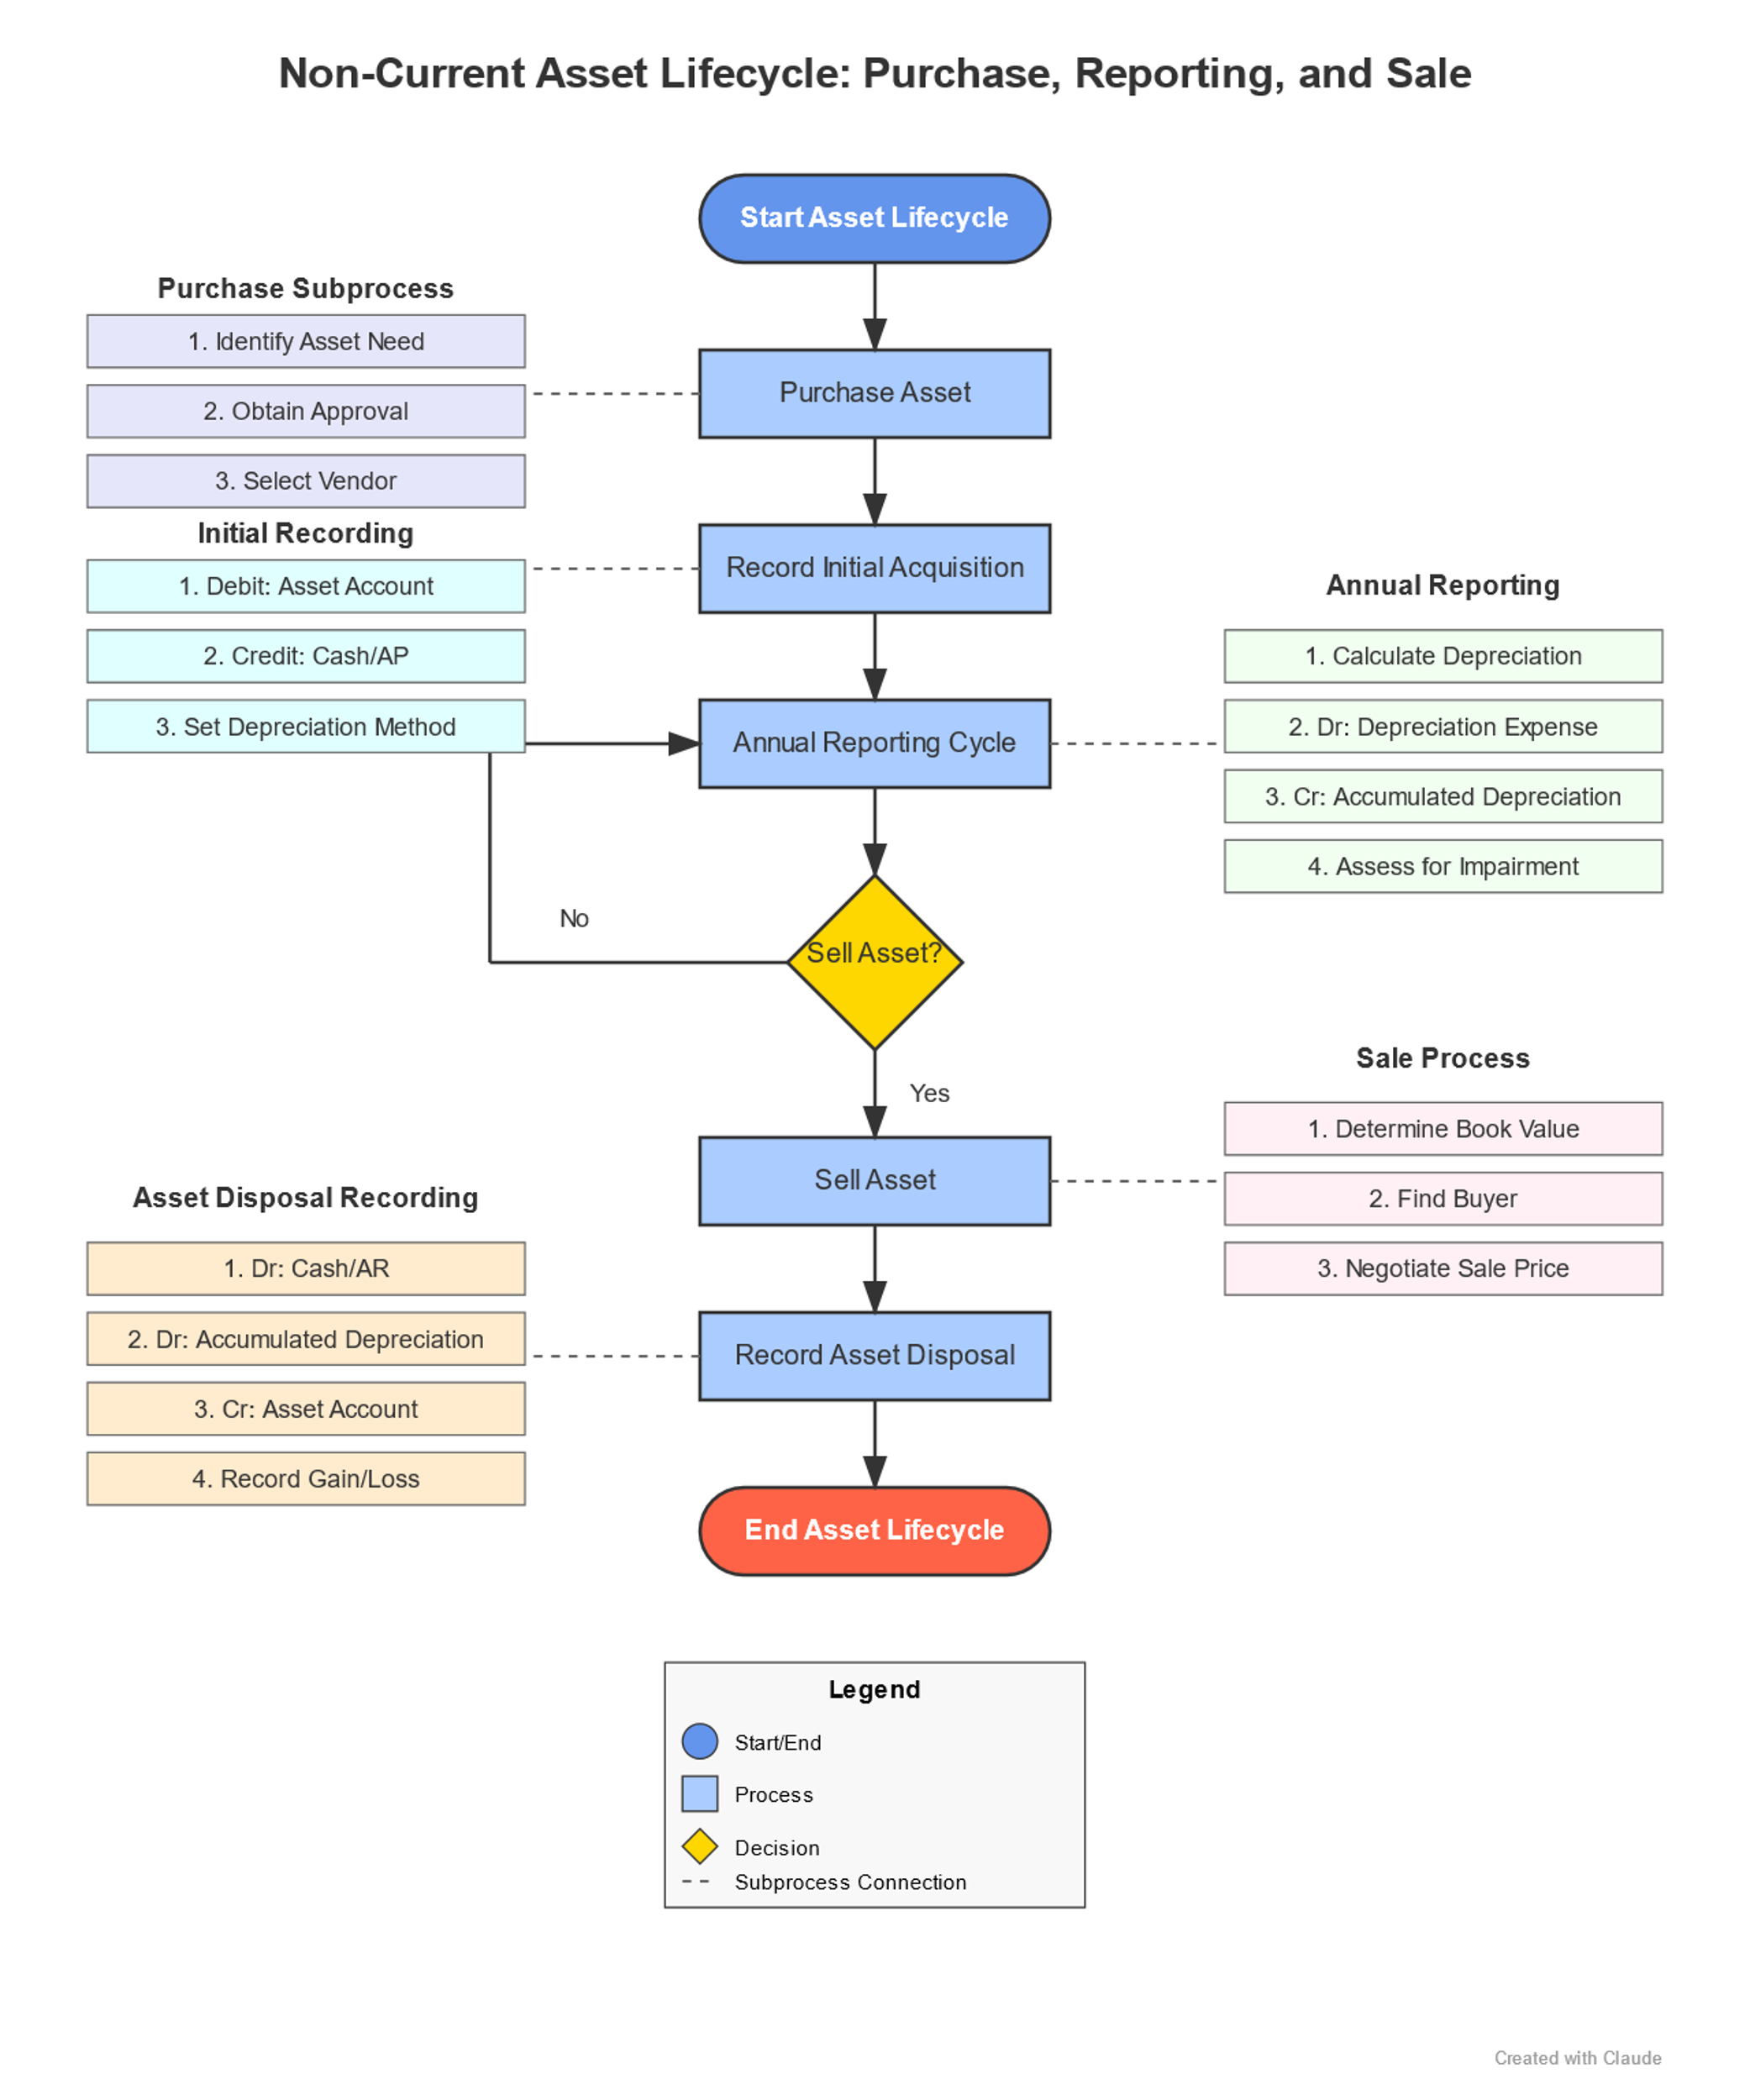

Slide 34
Other Uses – Pre and Posttest
Challenge: Encouraging students to focus on what is important in the chapter
Example: Chapters are long and students can be overwhelmed – common question is “what will be on the test?”
Develop the pretest first, then ask the AI to created a paired posttest.

Slide 35
Pretest Prompt
Prompt:
For an introductory financial accounting, college-level course - Create 20 multiple choice questions as a pretest that cover the following learning objectives - explain how to account for current liabilities, describe the major characteristics of bonds, explain how to account for bond transactions, explain how to account for long-term notes payable, discuss how liabilities are reported and analyzed, list different types of current liabilities, determine the issue price of a bond, account for bond transactions including issuance at a discount and at a premium, account for long-term notes payable, describe the accounting for a lease, distinguish between debt and equity financing. Ensure that each multiple-choice question contains an option for the correct answer. Provide instructor solutions with explanations.

Slide 36
Posttest Prompt
Prompt: Create a posttest with 20 multiple-choice questions that are paired with the questions in the pretest
Additional prompt: change the order of the questions in the posttest

Slide 37
Example Paired Questions and Explanations
Pretest
Posttest
Which of the following is NOT classified as a current liability?
A) Accounts payable
B) Unearned revenue
C) Current portion of long-term debt
D) Bonds payable due in 5 years
D) Bonds payable due in 5 years
Explanation: Current liabilities are obligations that are expected to be settled within one year or the normal operating cycle, whichever is longer. Bonds payable due in 5 years would be classified as a long-term liability since the obligation extends beyond one year.
Which of the following would be classified as a long-term liability?
A) Accounts payable due in 45 days
B) Sales tax collected but not yet remitted
C) Bonds payable maturing in 7 years
D) Wages payable to employees
C) Bonds payable maturing in 7 years
Explanation: Long-term liabilities are obligations that are due beyond one year from the balance sheet date. Bonds payable maturing in 7 years would be classified as long-term liabilities.

Slide 38
How Can Students Use AI?

Slide 39
Teach Students How to Use AI
What AI can and can't do
What school policy says AI should be used for
What your course policy says AI can be used for
How to correctly cite AI
How to write prompts that will return the desired result
Skepticism – AI's do not always return the correct information, students should always confirm what is returned

Slide 40
Examples of Ways that Students can Use AI as a Support Tool for Their Learning

Slide 41
Study Guides
Develop their own study guides
Review and vet a study guide created by the instructor
Review and vet a study guide created by other students
I have given students a study guide that I created with AI, they worked in groups to go through and confirm that the information matches the chapter and that nothing was missed. I made the corrections and posted the study guide to the class.

Slide 42
Selecting Journal Articles for a Research Paper
Step 1
Students identify the articles that they are interested in - For Claude the article needs to be in .pdf form
Step 2
Ask the AI to summarize the article in simple terms – sometimes the abstract is not helpful in determining if the article fits the topic
Ask the AI to analyze the article and provide relevant points
It is important to stress to students that the summary does not replace reading the articles, rather it helps them to sift through more articles to find the ones that are the best fit with their topic.

Slide 43
How have you used AI in your classes?

Slide 44
Conclusion

Slide 45
Historical Perspective: Wikipedia vs AI
Wikipedia was founded in 2001 – we taught students that Wikipedia shouldn't be used as a substitute for schoolwork, but a tool to allow them to do more.
AI has/will replace Wikipedia just as Wikipedia replaced encyclopedias.

Slide 46
Professional Skepticism
Professional skepticism is the ability to maintain a questioning attitude and critically assess information.
As the auditor uses professional skepticism when performing the audit, we must use professional skepticism when using an AI and we must teach our students to do the same.

Slide 47
Will AI Replace Higher Education?
The opportunity for AI to replace higher education or to allow us to make higher ed so much more is our choice.
The idea of mass customizaiton of education is at our fingertips.
We can either fight AI or embrace this new opportunity – the choice is ours.

Slide 48
Questions or Comments???

