Slide 1

WELCOME
Professional Development Program for Adjunct Faculty at Aspen University
“Addressing Barriers and Enhancing Engagement”
Dr. Daniel Zimmerman 4.5.2025
IACBE Conference- Indianapolis
www.aspen.edu

Slide 2

What People Think About When I Say Aspen University!

Slide 3
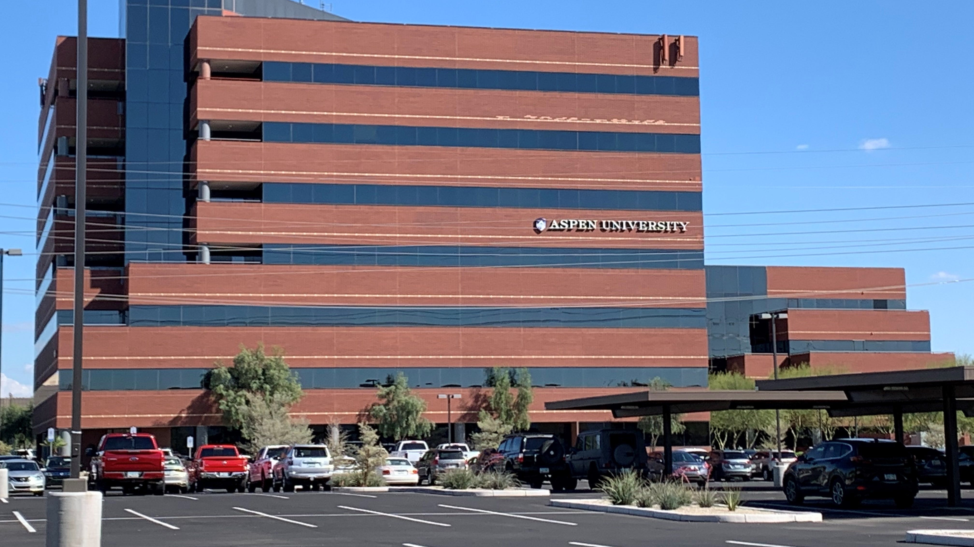
Aspen University – Phoenix, AZ

Slide 4
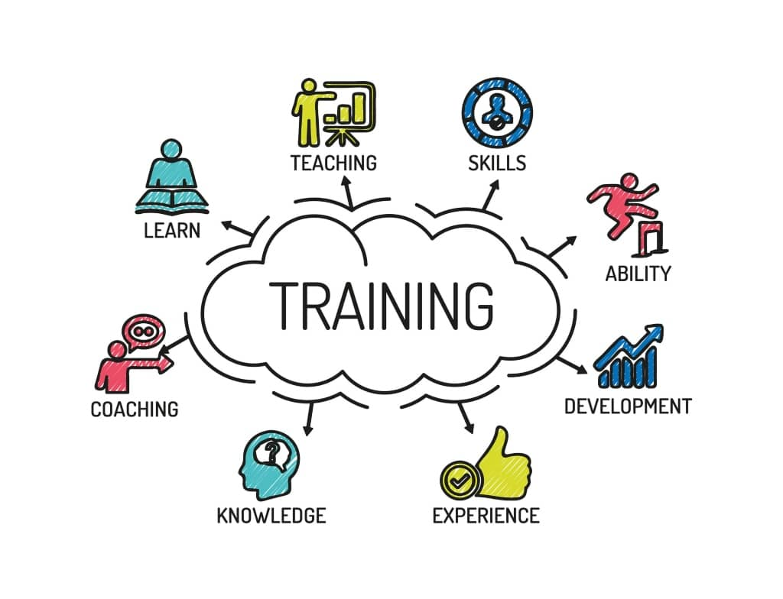
Why This Matters
“Professional development is not a perk. It’s a necessity.”

Slide 5

What is Your Definition of Professional Development?

Slide 6
Potential Answers
“Learning new teaching strategies to better serve my students.”
“Opportunities to grow in my field and stay current with trends in education.”
“Anything that helps me improve my online teaching skills and student engagement.”
“A way to sharpen my technical skills—like using new tools in the LMS or AI resources.”
“Formal or informal learning experiences that help me teach more effectively.”
“Access to resources, workshops, or training that make me feel more confident and connected as an instructor.”

Slide 7

Question?
When was the last time your adjunct faculty told you exactly what they needed to feel more supported, more engaged, and more empowered?
At Aspen, we decided to stop guessing—and start asking. What we discovered was eye-opening, but even more importantly, it was actionable.

Slide 8

High-Level Recommendations
Flexible Learning Formats
Financial Support and Awareness
Relevant and Targeted Content
Incentives and Recognition
Enhanced Communication
Continuous Feedback and Improvement

Slide 9

Top Barriers
Time Constraints
Scheduling Conflicts
Financial Limitations
Which one affects YOU the most?

Slide 10
Aspen’s Adjunct Faculty – By the Numbers
Over 250 total adjunct faculty
• 51 responded to the recent PD survey
• 20% response rate — strong engagement!

Slide 11
What We Heard: Faculty Voices
“I love that Aspen has a focus on professional development.”
“Evening or online sessions would help fit my schedule.”
“More communication about what’s available.”

Slide 12
Let’s Fix This- Now!
We listened. We learned.
Here are eight powerful ways to elevate professional development at Aspen and you can use this at your College or University.

Slide 13
1. Flexible Delivery Formats
Live + Asynchronous sessions
Short, microlearning modules
Recorded webinars for flexible access
Notes:
Host a monthly 30-minute “PD Power Lunch” via Zoom during lunchtime.
Provide a library of 10-minute microlearning videos on topics like “Using ChatGPT for Class Discussion Boards.”
Record live faculty webinars and post them in the LMS or faculty portal for flexible viewing.

Slide 14

For Example,
Host
Host a monthly 30-minute “PD Power Lunch” via Zoom during lunchtime.
Provide
Provide a library of 10-minute microlearning videos on topics like “Using ChatGPT for Class Discussion Boards.”
Record
Record live faculty webinars and post them in the LMS or faculty portal for flexible viewing.

Slide 15
2. Reduce Financial Barriers
Simplify reimbursement
Provide more internal funding opportunities

Slide 16

For Example,
Offer
Offer $150 micro-grants per term for faculty to attend online conferences or subscribe to teaching journals.
Provide
Provide free access to LinkedIn Learning or Coursera on topics like instructional design or emerging tech.
Simplify
Simplify the reimbursement process with a fillable one-page form linked from the LMS.

Slide 17

3. Relevant and Targeted Content

Slide 18

Relevant and Targeted Content
Create tracks like “Getting Started with Canvas”, “Grading Strategies for Adult Learners,” and “Culturally Responsive Teaching.”
1
Host AI in Teaching Roundtables showing how to use tools like GrammarlyGO, ChatGPT, or Turnitin AI detection.
2
Invite internal experts to lead “faculty-led Fridays” on topics such as student feedback loops or engagement hacks.
3

Slide 19

4. Incentives and Recognition
Launch a Faculty Excellence Badge Program—digital credentials for completing PD modules.
Spotlight faculty monthly in an internal newsletter or LinkedIn post.
Offer $25 Amazon gift cards or branded merch for completing 3+ PD activities in a term.

Slide 20
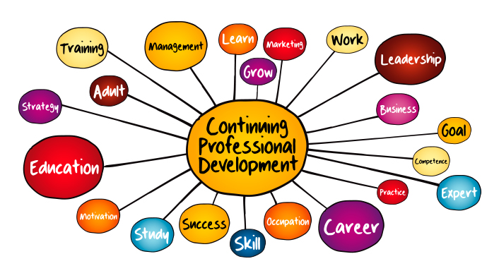
5. Enhanced Communication & Support
Monthly PD newsletter
Create a one-stop PD resource hub

Slide 21

6. Modular Tracks & 7. Leverage Technology

Slide 22

For Example,
Integrate PD modules directly in Canvas or D2L so faculty can enroll with one click.
Use a “My PD Progress” dashboard where faculty see completed modules, CEUs earned, and upcoming topics.
Add PD progress to faculty annual self-review templates to encourage accountability.

Slide 23
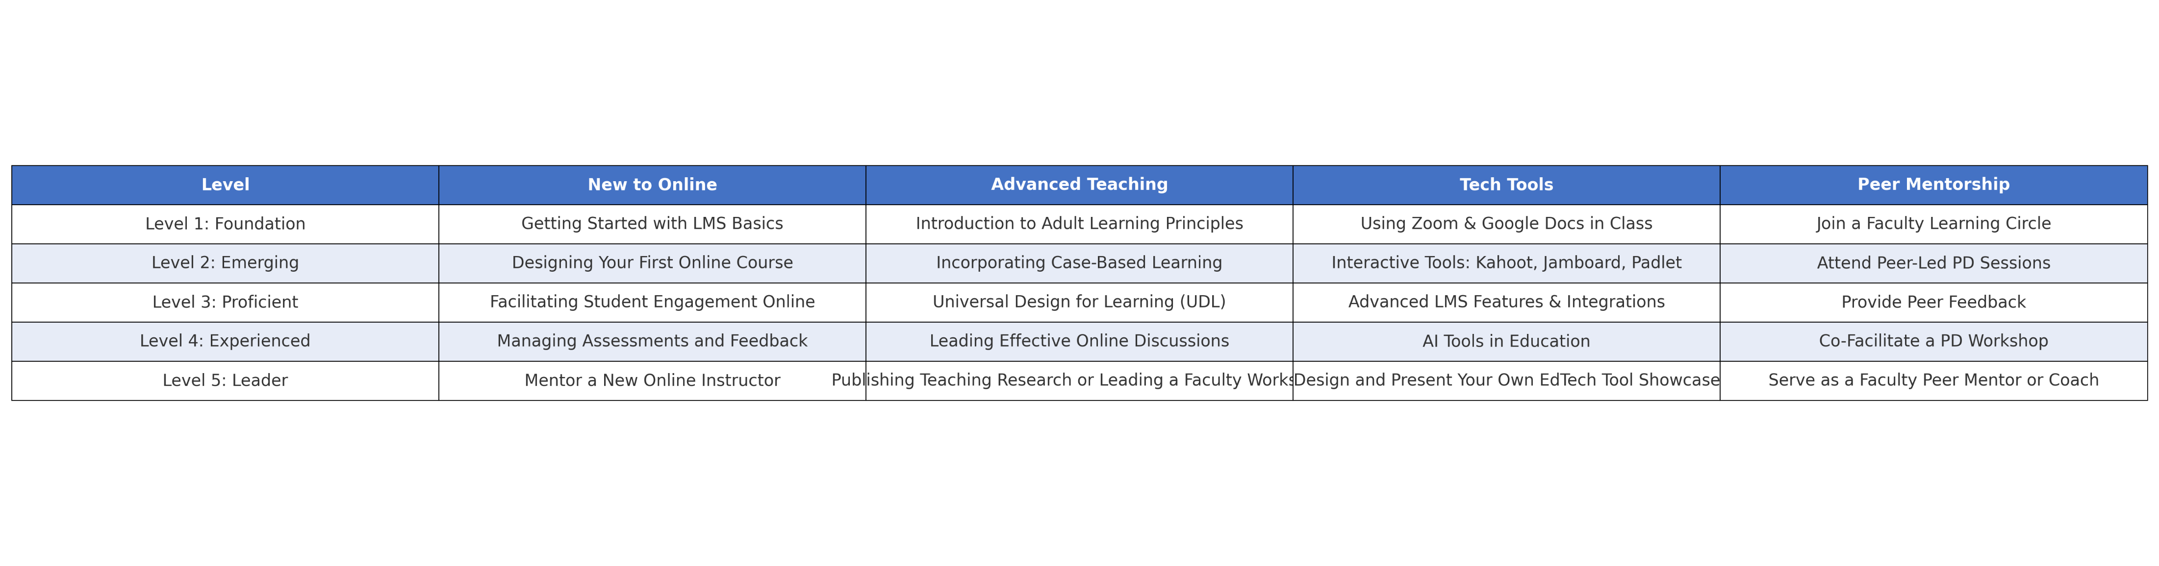
Your PD, Your Way

Slide 24

8. Continuous Feedback & Improvement

Slide 25

For Example,
Include a 1-minute feedback form at the end of each webinar or module.
Conduct a biannual PD Needs Survey to capture what topics faculty are most interested in next.
Use PD engagement data to adjust offerings—if no one watches long webinars, pivot to bite-size video lessons.

Slide 26
Thank You!
Dr. Daniel Zimmerman - Dean of the School of Business and Technology
Email: daniel.zimmerman@aspen.edu

