Slide 1

Student Voice in Assessment of Community Engaged Projects – a Pilot Study
IACBE ACAM 2025

Slide 2

Agenda
Introduction
Meet the Team
Student Voice in Assessment
Community Engaged Learning at Salve
Prior Qualitative Research Findings
Link Student and Employer Perspectives
Current Study – Assessment Tool Development
Pilot Study Results
Discussion

Slide 3

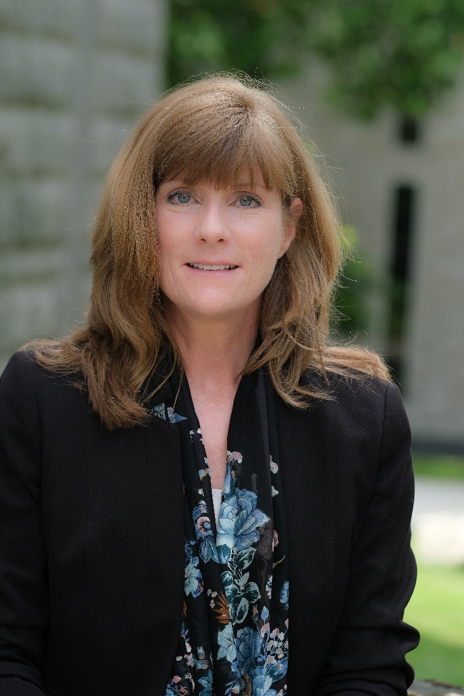
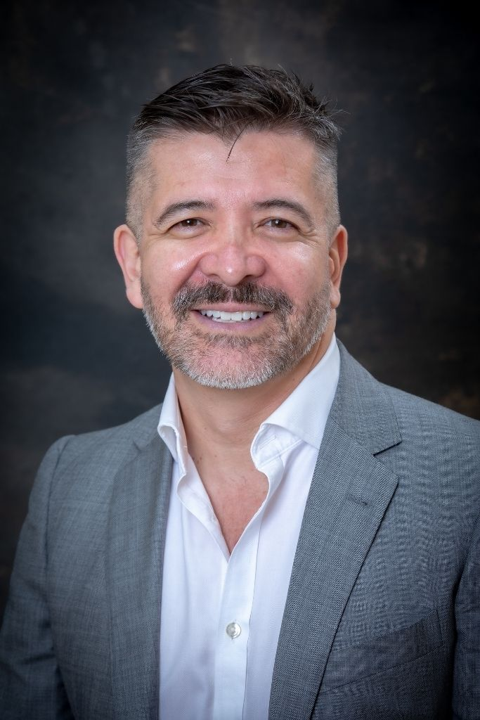

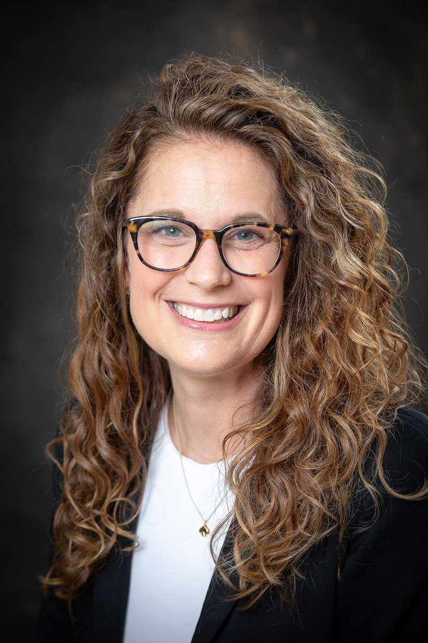
Meet the Team
Jennifer Bonoff, PhD
Associate Professor
Bonnie Kennedy, DBA
Assistant Professor
Luis Lopez-Preciado, PhD
Assistant Professor
Sam Sacco
Senior Lecturer
Melissa Varao, PhD
Associate Professor

Slide 4
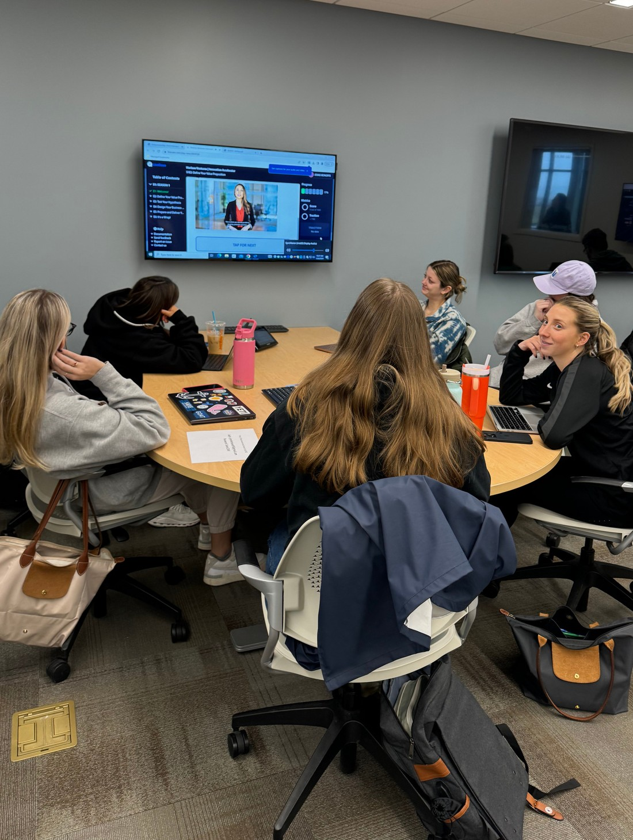
2024
SECTION 02
Introduction
Evolving Pedagogy Higher Education institutions are increasingly engaged in experiencial learning opportunities, particularly community-engaged learning (CEL) projects.
The Challenge How do we assess these more complex experiences in an unbiased, objective, and scalable manner while taking into consideration Student Voice?
Research Our prior qualitative research gives insight into the assessment of CEL projects from a student perspective and considers how student-led assessment can be integrated into course structure. Current research develops constructs and assessment tools for project-based learning incorporating student voice.

Slide 5
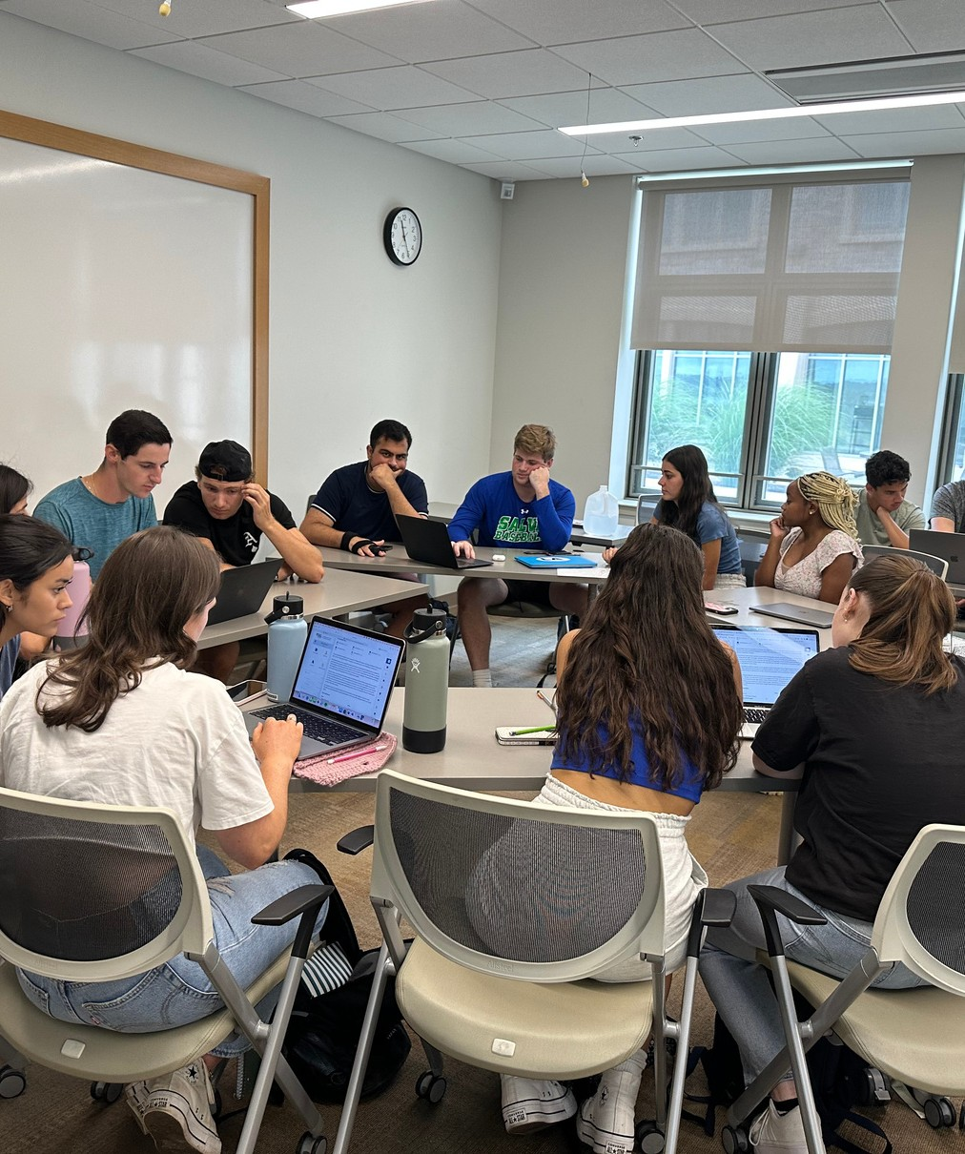
Student Voice in Assessment in Higher Education
SECTION 03
Co-Creation: Exists when "staff and students work collaboratively with one another to create components of curricula and/or pedagogical approaches” (Bovill et al., 2016, p. 196).
Pedagogical Partnership: Students are not viewed solely as recipients of knowledge but as active partners in the teaching and learning process (Cook- Sather et al.,2014).
2024

Slide 6
Yet, even with evidence of progress and a renewed focus, Sun, Gao, et al, (2023) assimilate from a sweeping review of student voice in assessment trends over the last decade that a considerable number of students in higher education still lack a clear understanding of the role they can play in the assessment process, relying on teachers to define and establish assessment measures while positing that "student voice research can improve students’ experiences, change teachers’ practices and inform university support concerning assessment and feedback" (p. 1009).

Slide 7
Community-Engaged Learning & Assessment
SECTION 04
Nicols (2017) argues that higher education institutions recognize the need for CEL opportunities to foster “more ‘hands-on’ training and experience for college students” (p. 318).
Holistic competency : “Composed of generic skills (e.g. communication skills, problem-solving skills), positive values and attitudes (e.g. resilience, self-confidence, appreciation) which are essential for the development of the ‘whole person’”. Similar terms used in the literature to describe holistic competency include “‘transferable skills’, ‘twenty first century skills’, ‘soft skills’, ‘employability skills’, ‘generic competencies’ and ‘generic attributes’” (Chan & Luk, 2021, p. 467)
The assessment process should better reflect these types of skills intended to prepare students for professional life after college.

Slide 8
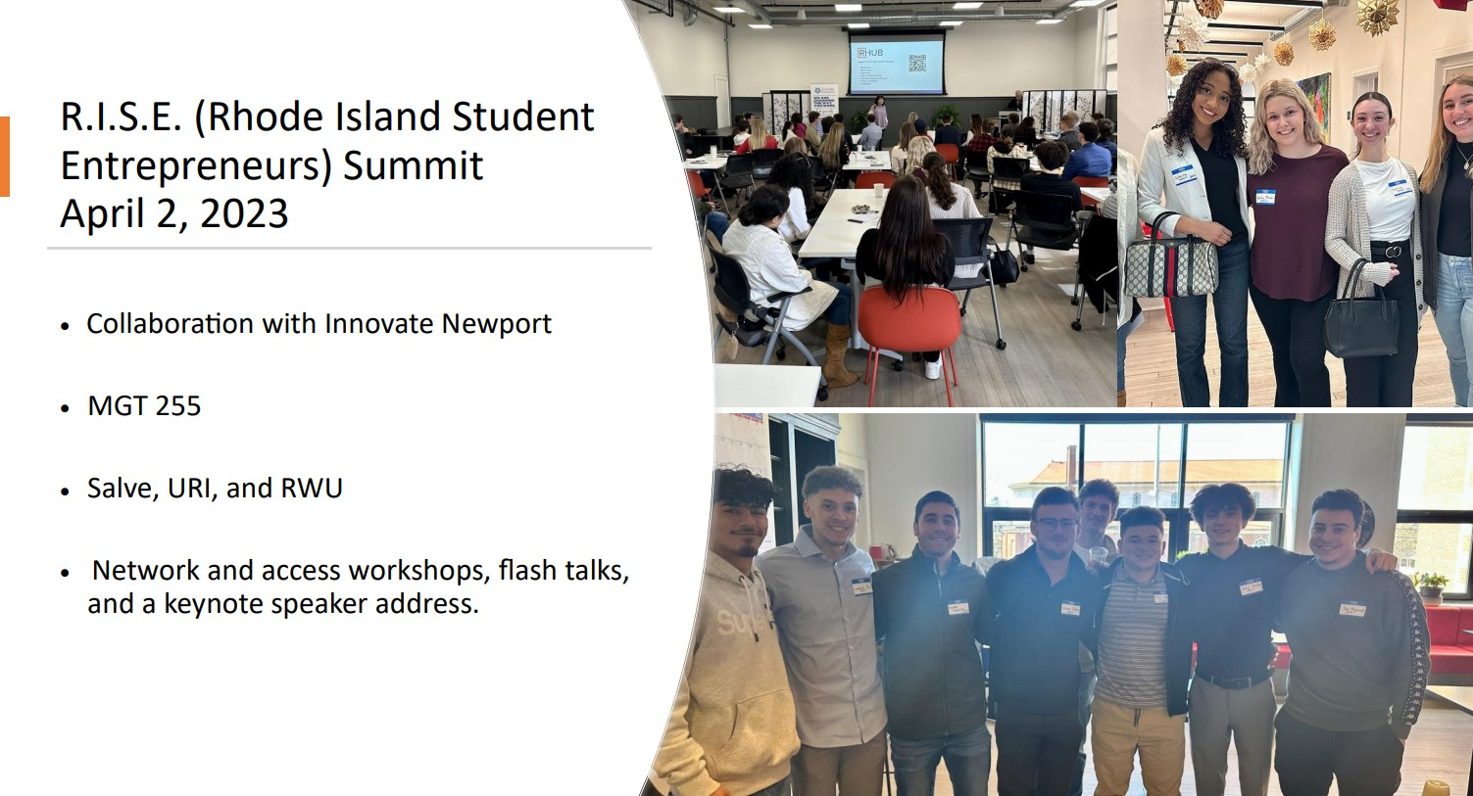

Slide 9
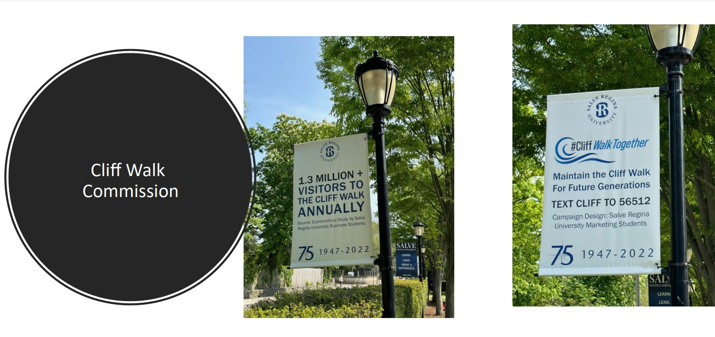

Slide 10
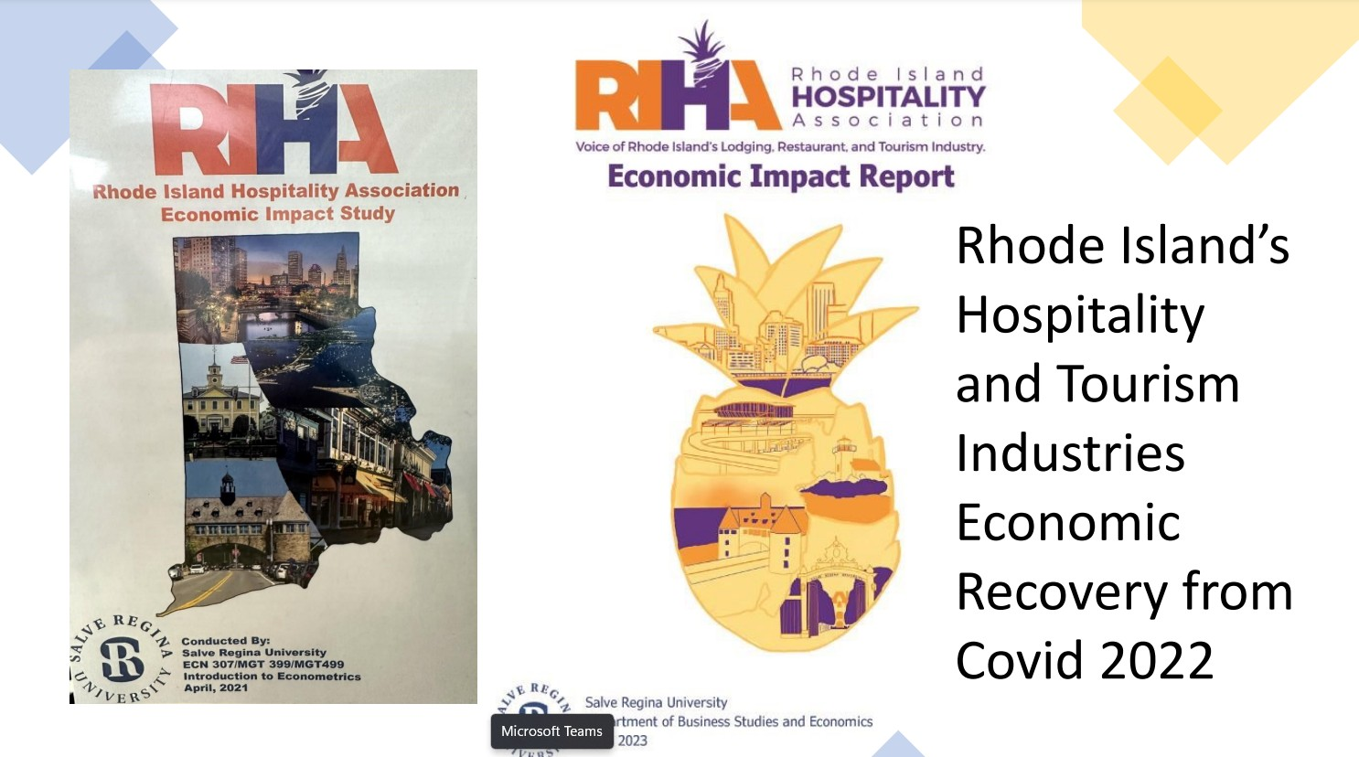

Slide 11
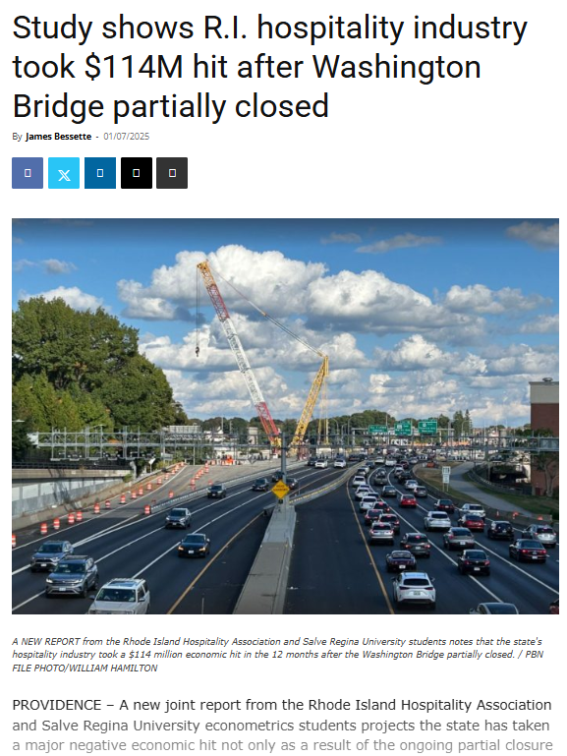
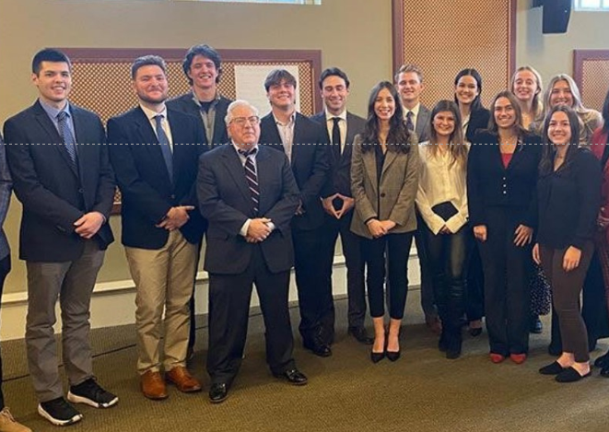


ECN420- Community Based Economic Impact Study

Slide 12

MGT490 Strategic Business Planning
Students develop a business plan working with a client or start up, research with stakeholders and present to community business leaders. Top teams compete for prizes and bragging rights at the annual Seahawk Tank competition.

Slide 13

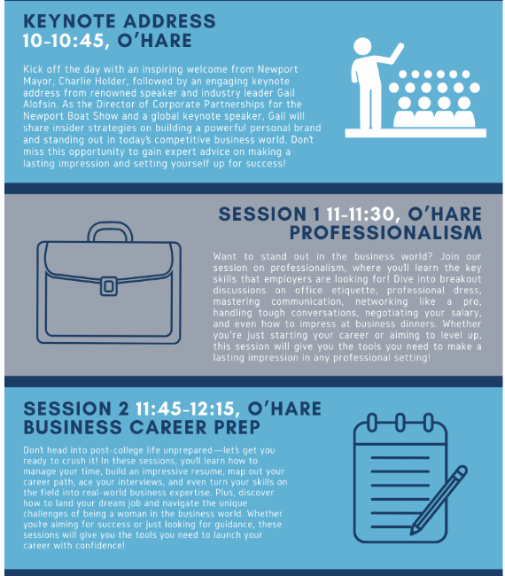
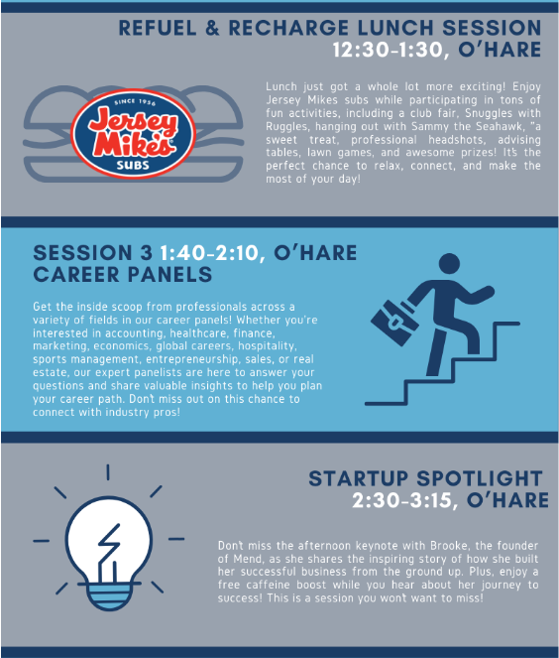

MGT399 Practicum Event Planning
Link to Event Site

Slide 14
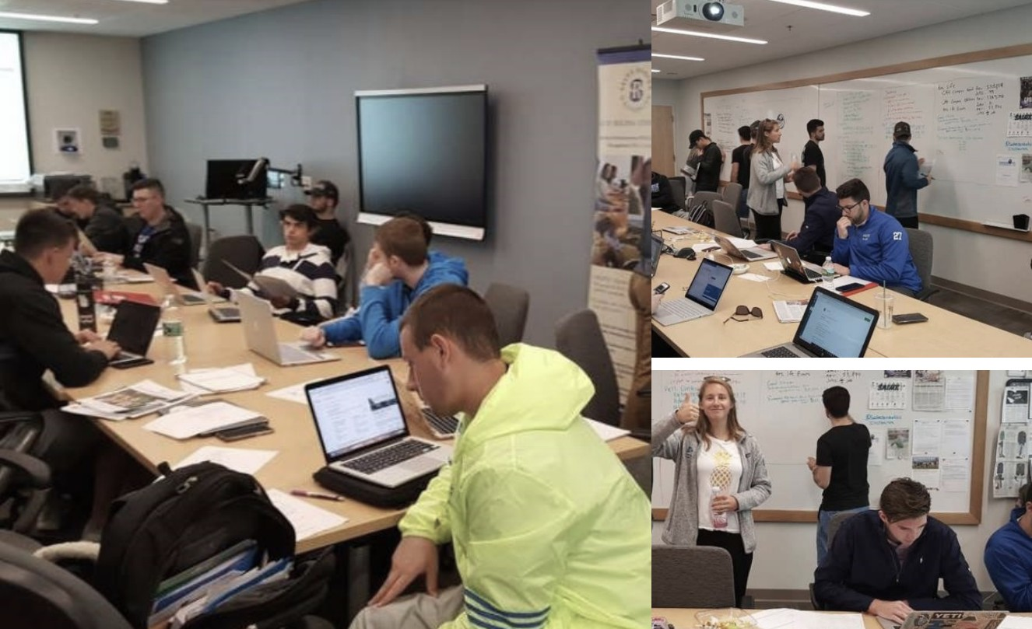
Methodoloy & Analysis
SECTION 05
Qualitative Research
End-of-term comments, focus groups, and in- depth interviews with an undergraduate population (52 students) engaged in experiential, community-engaged learning projects.
The scope of this research covers a three-year period encompassing 12 semesters and multiple unique community engaged learning projects
Rigorous thematic analysis (Braun & Clarke, 2006) which aims to identify and analyze patterns of meaning or themes that emerge from the data following an inductive approach
2024

Slide 15
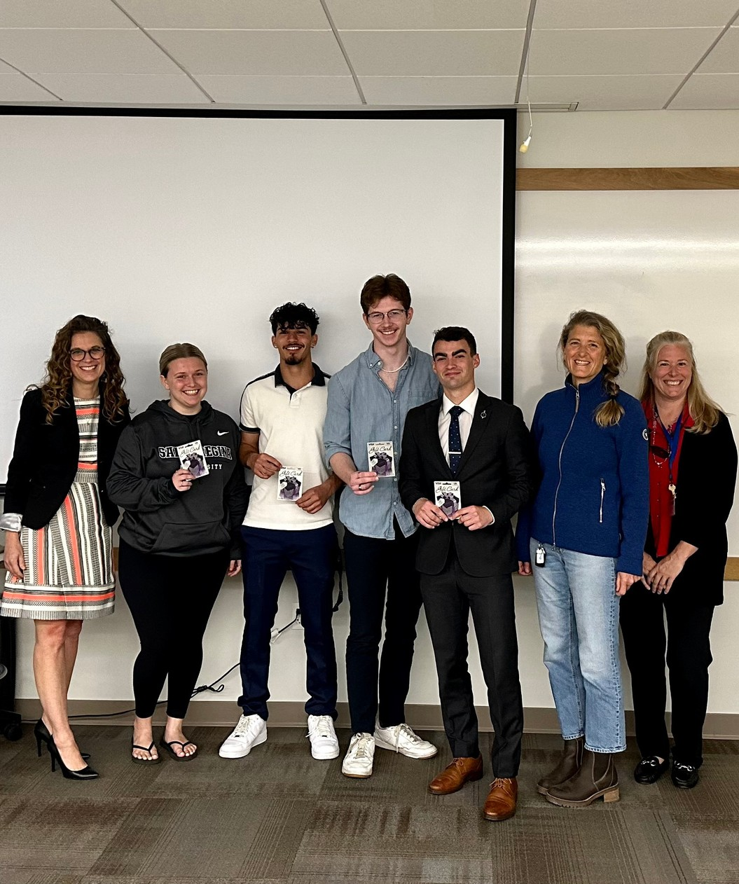
Findings
From the students’ perspective, central themes surface as critical catalysts that should impact the design, choice, execution, and interpretation of assessment methods or tools including:
1. Adaptation
2. Balancing Teamwork with Individual Accountability
3. Creativity in Problem Solving
2024

Slide 16
J. Bonoff, B. Kennedy, S. Sacco & M. Varao. “Rethinking Assessment: Community-Engaged Experiential Learning and Complex Environments in Business from a Student Perspective”, International Journal of Learning, Teaching and Educational Research, Vol. 23, No 8, pp. 1-18. August 16, 2024.

Slide 17
Linking Student and Employer Perceptions

Slide 18


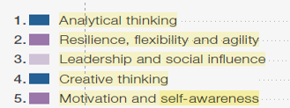
Referring to the top 5 skills …
This combination of cognitive, self-efficacy and interpersonal skills within the top five emphasizes the importance ascribed by respondents to having an agile, innovative and collaborative workforce, where both problem-solving abilities and personal resilience are critical for success.

Slide 19
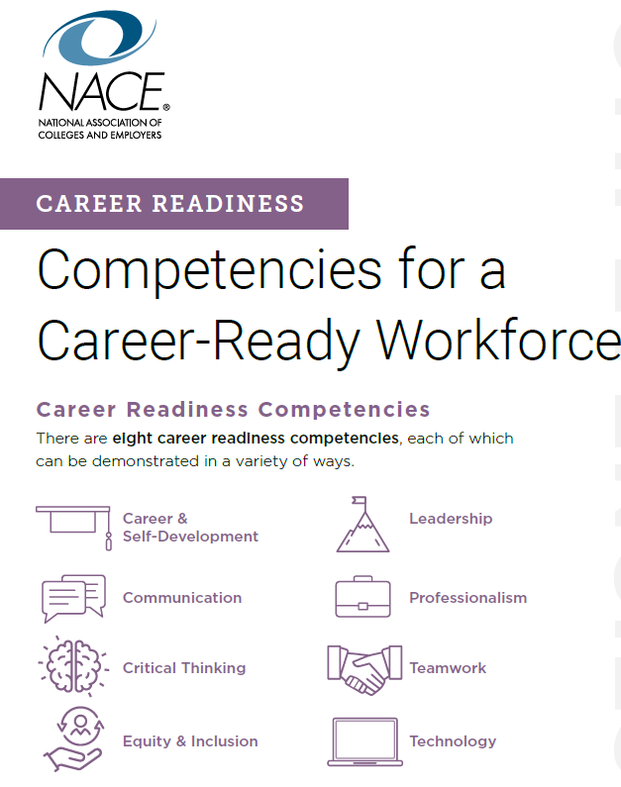
Connection to NACE competencies
Career & Self-Development
  Awareness of one’s strengths and weaknesses
  Continual growth while pursuing and applying feedback
  Display curiosity
Leadership
  Inspire, persuade, and motivate self and others
  Seek out and leverage diverse resources and feedback
  Use innovative thinking
  Approach tasks with a positive attitude
Professionalism
  Accountability to self and others
  Positive personal brand
  Be present and prepared
  Demonstrate dependability
  Prioritize and complete tasks to accomplish goals
  Show a high level of dedication toward doing a good job.

Slide 20
Assessment Tool Development

Slide 21

Assessment Tool Development
Foundations in the Literature
Authentic Assessment Enhances Adaptability and Learning Agility
- Authentic tasks encourage students to adjust their strategies in response to feedback and challenges, supporting adaptability and real-world problem-solving (Ashford-Rowe, Herrington & Brown, 2013).
- Students perceive assessments as more meaningful and motivating when they are aligned with future professional roles, supporting a growth mindset and reflective adaptability (Ajjawi et al., 2019).
Authentic Assessment Promotes Creativity and Real-World Problem Solving
Engagement in work-integrated learning (WIL) assessments fosters critical thinking by placing students in ambiguous, evolving contexts that mirror real work situations (Ajjawi et al., 2019).
- Well-designed authentic assessments stimulate students to generate original solutions and apply theoretical knowledge to complex, ill-defined problems (Ashford-Rowe Herrington & Brown., 2013).
Ashford-Rowe, K., Herrington, J., & Brown, C. (2013). Establishing the critical elements that determine authentic assessment. Assessment & Evaluation in Higher Education, 39(2), 205–222.
Ajjawi, R., Tai, J., Huu Nghia, T. L., Boud, D., Johnson, L., & Patrick, C. J. (2019). Aligning assessment with the needs of work-integrated learning. Assessment & Evaluation in Higher Education, 45(2), 304–316.
Notes:
Ashford-Rowe, K., Herrington, J., & Brown, C. (2013). Establishing the critical elements that determine authentic assessment. Assessment & Evaluation in Higher Education, 39(2), 205–222.
Ajjawi, R., Tai, J., Huu Nghia, T. L., Boud, D., Johnson, L., & Patrick, C. J. (2019). Aligning assessment with the needs of work-integrated learning. Assessment & Evaluation in Higher Education, 45(2), 304–316.

Slide 22
Working with Existing Constructs and Scales
– but customized for our projects
Adaptation
Context: Designed for high school/university students
Focus: Cognitive, emotional, and behavioral adaptability
Martin, A. J., et al. (2012). Adaptability: Conceptual and empirical perspectives on responses to change, novelty and uncertainty. Australian Journal of Guidance and Counselling, 22(1), 58–81.
2. Balancing Individual Accountability with Teamwork
Comprehensive Assessment of Team Member Effectiveness (CATME)
Developed by: Purdue University researchers
Focus: Team contribution, interaction, keeping commitments, and expectations of quality
https://info.catme.org/

Slide 23
Working with Existing Constructs and Scales – but customized for our projects
3. Creativity in Problem Solving
Focus: Identifies individuals' preferred styles in the CPS process:
Context: Used in organizational and educational settings
Basadur, M., Graen, G. B., & Green, S. G. (1982). Training in creative problem solving: Effects on ideation and problem finding in an applied research organization. Organizational Behavior and Human Performance, 30(1), 41–70.

Slide 24

Objective Questions – Pilot Study
N=41

Slide 25
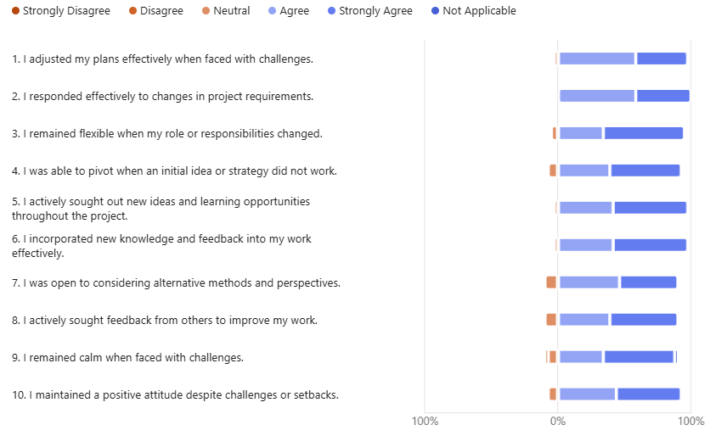
1. Adaptability
Please rate the extent to which you disagree or agree with the following statements about your experience dealing with challenges related to this project.

Slide 26
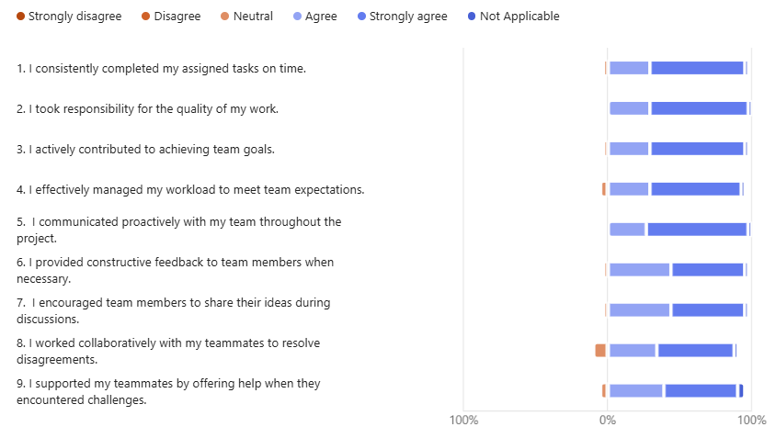
2. Balancing Individual Accountability with Teamwork
Please rate the extent to which you disagree or agree with the following statements about teamwork on this project.

Slide 27
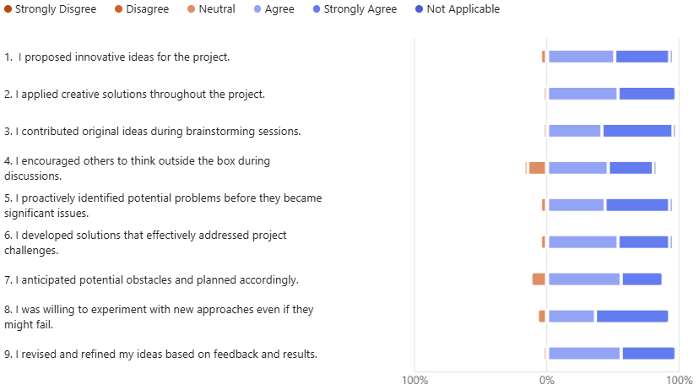
3. Creativity in Problem Solving
Please rate the extent to which you disagree or agree with the following statements related to problem solving and creativity.

Slide 28
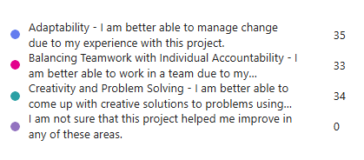
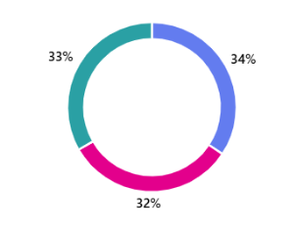
In which areas did this project help you improve? (You can select more than one response)

Slide 29
Qualitative responses – Pilot Study

Slide 30
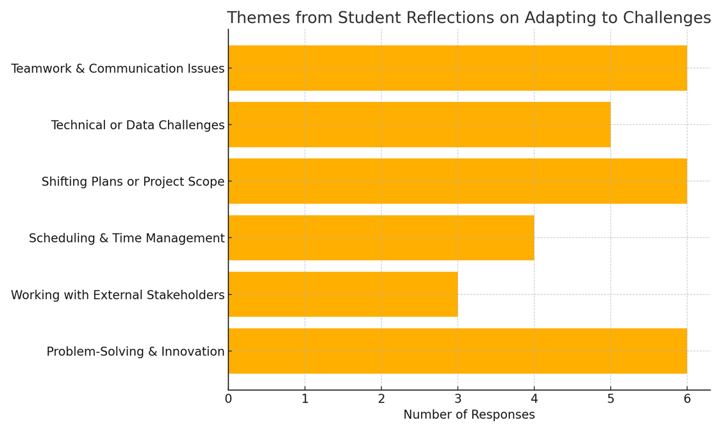
Open Response 1: Can you provide an example where you successfully adapted to a change or challenge working on this project? What was the outcome? N=30

Slide 31
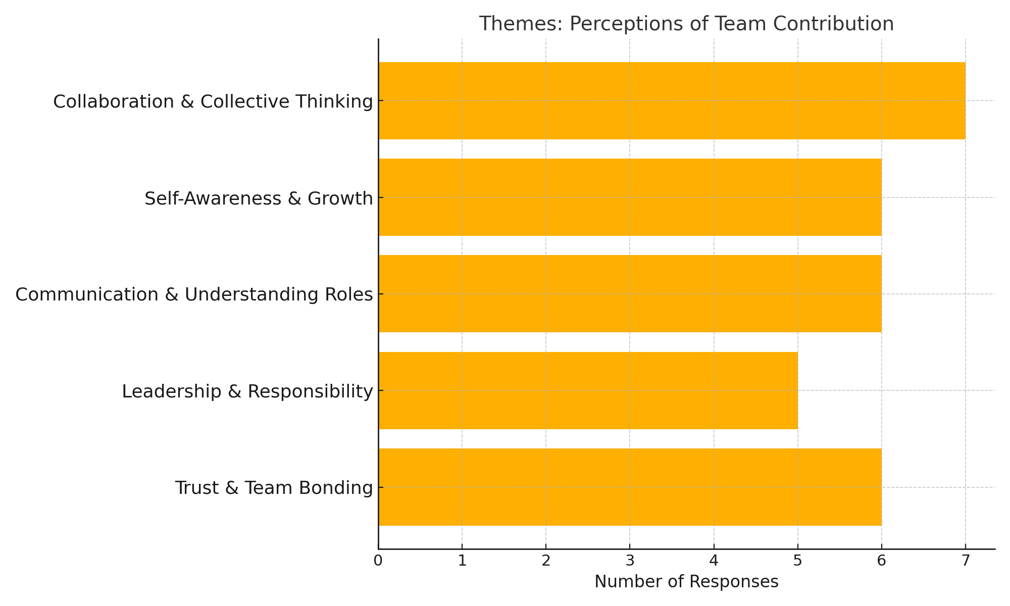
Open Response 2: How has this project influenced your own perception of how you can contribute to a team? N=30

Slide 32
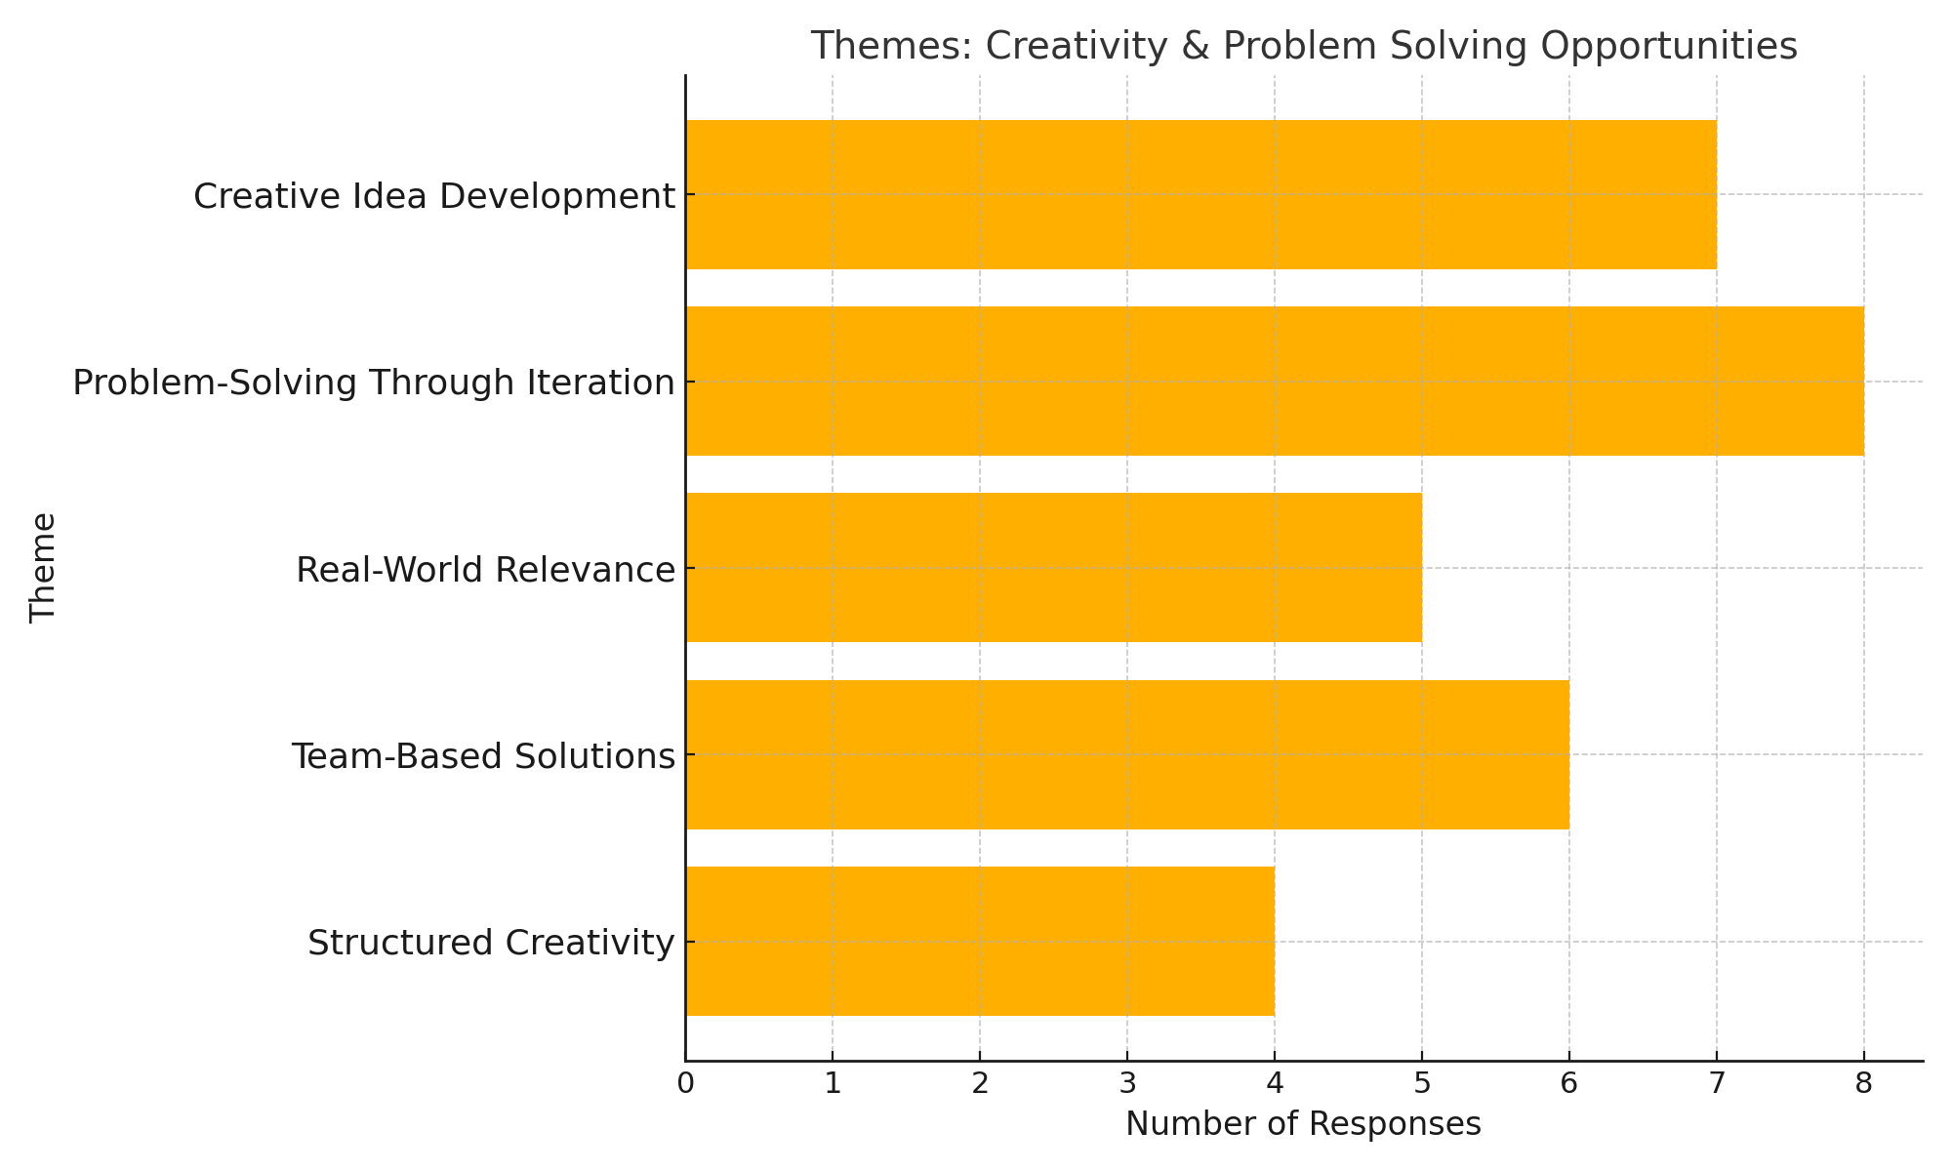
Open Response 3: How has this project provided you with opportunities to be creative and solve problems? N = 30

Slide 33
Open Response 4: In what areas do you feel you excelled in this project? N=31
      Most Common Themes:
      Communication and teamwork
            Students often mentioned clear communication, collaboration, and working well with team members.
Leadership and initiative
Several students described taking on leadership roles, organizing meetings, and guiding group efforts.
Organization and time management
Some noted that staying organized and managing their time well helped them stay on track.
Other Notable Mentions:
Research skills
Presentation abilities
Contributing ideas and being dependable

Slide 34
Open Response 5: In what areas do you feel you need more growth and improvement after completing this project? N=31
Most Common Themes:
Time management
Many students admitted to procrastinating or needing to better manage deadlines.
Public speaking and presentation
Some noted nervousness or lack of confidence in presenting their work to others.
Communication challenges
    A few responses highlighted difficulties in clearly expressing ideas
or coordinating with team members.
Other Observations:
Conflict resolution in teams
Delegation and not taking on too much
Adapting to group dynamics

Slide 35

Next Steps
Refine instrument/validity tests
Roll out to other business courses, next academic year
Collaborate with non-business programs at Salve
Other suggestions?

Slide 36

Thank You!
SECTION 09
In conclusion, despite the challenges associated with its implementation, the potential benefits justify efforts to integrate student perspectives into assessment practices. By valuing and incorporating student voice, educators and institutions can enhance the quality, relevance, and inclusivity of assessments, ultimately supporting student success and holistic development.
Questions?

