Slide 1


Embracing Change:
Why a Shifting Educational Climate Demands Innovation
Dr. Kristin B. Martin

Slide 2

AGENDA
Introduction
Conclusion – Summary and call to action
What is Innovation?
Key Drivers of Change in Higher Education
Challenges of Innovation and Change in Higher Education
Innovation in Action
Culture of Innovation
Transformation of the Educational Landscape

Slide 3

WHAT IS INNOVATION?

Slide 4


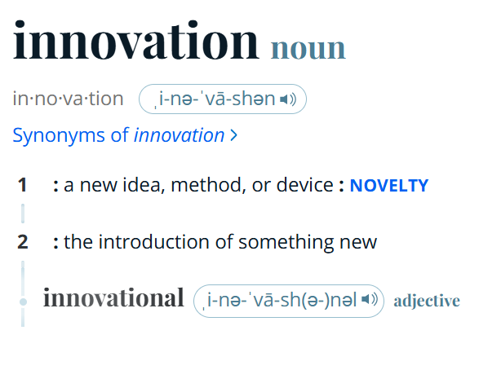
4

Slide 5
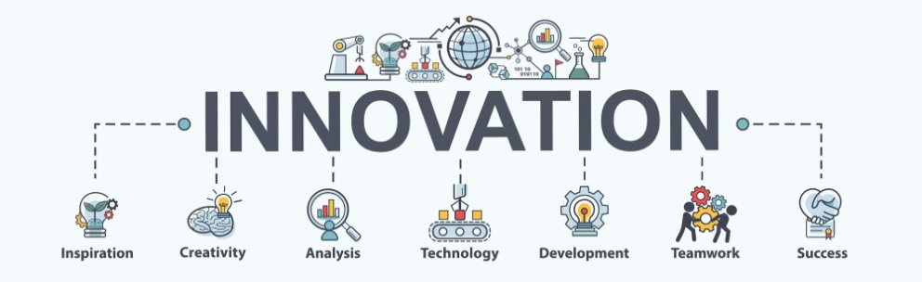
5

Slide 6

Transformation of the Educational Landscape

Slide 7
KEY HISTORICAL CHANGES IN HIGHER EDUCATION
Engagement Methods
Current Trends
Innovative teaching methods like case studies and flipped classrooms gained popularity to engage students effectively^{2.,3}
Technological advances and a focus on non-traditional students are currently driving changes in higher education⁵.
1995
2010-2020
2020-2022
2023-Present
Future
Internet Impact
Pandemic Shift
Tech Integration
The invention of the internet prompted higher education institutions to rethink traditional pedagogy¹.
The COVID-19 pandemic forced universities to rapidly transition to online learning, reshaping educational delivery⁴.
Ongoing technological advancements will necessitate integrating AI, data analytics, and immersive learning in curricula⁶.

Slide 8

1995: INTERNET IMPACT
RETHINKING PEDAGOGY¹
Reassessment of teaching approaches
Begin embracing technology

Slide 9
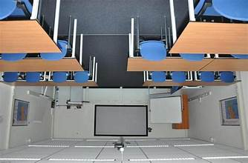
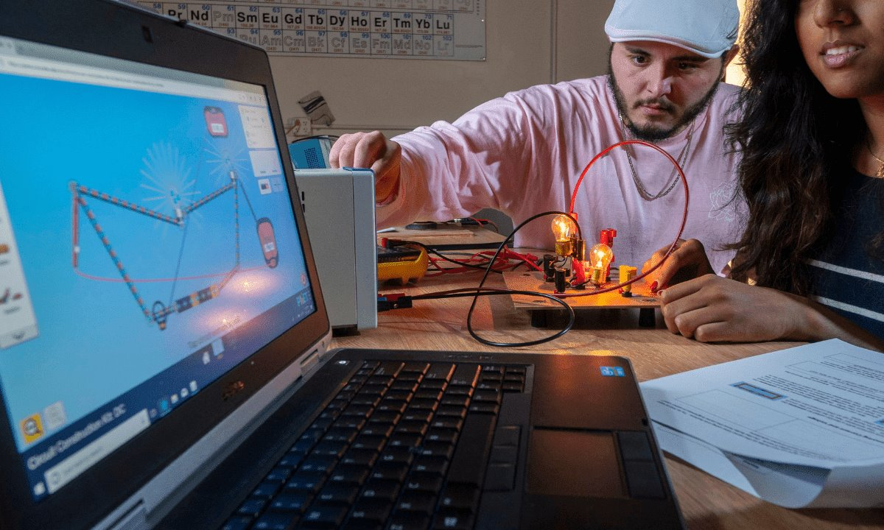
2010-2020
ENGAGEMENT METHODS
Flipped Classroom
Students engage with lecture content at home, using class time for discussions and problem-solving, fostering active learning².
Simulations
Allows students to connect theoretical knowledge with real-world scenarios, enhancing critical thinking skills².

Slide 10
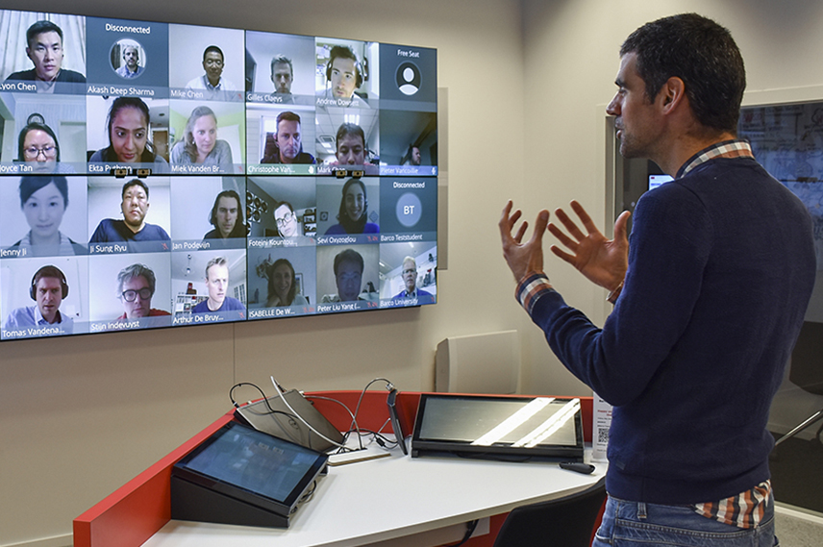
2020–2022
PANDEMIC INFLUENCE
SHIFT TO ONLINE EDUCATION
During the pandemic from, higher education underwent a rapid transition to online learning, requiring institutions to innovate and adapt their teaching methodologies to serve students remotely³.

Slide 11


CURRENT TRENDS
2023-2025
TECHNOLOGICAL ADVANCES
Recent developments in technology shape new learning experiences and methodologies, significantly affecting student engagement³.
NON-TRADITIONAL STUDENTS
Institutions are increasingly catering to non-traditional students, welcoming diverse backgrounds and flexible learning needs to enhance accessibility³.

Slide 12



FUTURE
Virtual Reality (VR)
Ongoing technological advancements will necessitate integrating AI, data analytics, and immersive learning in curricula⁴.
Digital Transformation
Integration of information technologies and the evolving work environment paves the way for the educational field to explore how to incorporate technologies in the learning process, driving the future of learning and talent development⁴.

Slide 13

Key Drivers of Change in Higher Education

Slide 14

TRADITIONAL EDUCATIONAL SYSTEM
Does Not Work Anymore!!
ONE-SIZE-FITS-ALL APPROACH
  The traditional educational system often applies a uniform strategy to all students, which can hinder personalized learning⁵.
STANDARDIZED TESTING FOCUS
  Heavy emphasis on standardized testing can limit the development of critical thinking and problem-solving skills in students⁵.
LACK OF CREATIVITY
  This educational model often overlooks the importance of fostering creativity and innovation among students⁵.

Slide 15

TECHNOLOGY AND DIGITAL TRANSFORMATION
CHANGING EDUCATIONAL EXPECTATIONS
  Globalization and technology are transforming what is expected from students in today's educational landscape⁶.
DIGITAL LITERACY IMPORTANCE
  Students must develop digital literacy skills to effectively navigate and participate in a technology-driven world⁶.

Slide 16

Challenges of Innovation and Change in Higher Education

Slide 17

CURRENT CHALLENGES IN EDUCATION
  Declining Student Engagement
  Many educators face the challenge of declining student engagement, which is crucial for effective learning and academic success.
Preparing For A Complex World
  Education must evolve to prepare students for an increasingly complex world and workforce filled with rapid technological advancements and global challenges.
Resistance To Change
Faculty, administrators, and students are resistant to change the way curriculum and facilitation due to digital transformation. Why change when it works just the way it is?
Varying Learning Styles
  Students have diverse learning styles, making it essential for educators to adapt their teaching methods to meet individual needs (e.g., flexibility, engaging, and career-relevant learning)

Slide 18
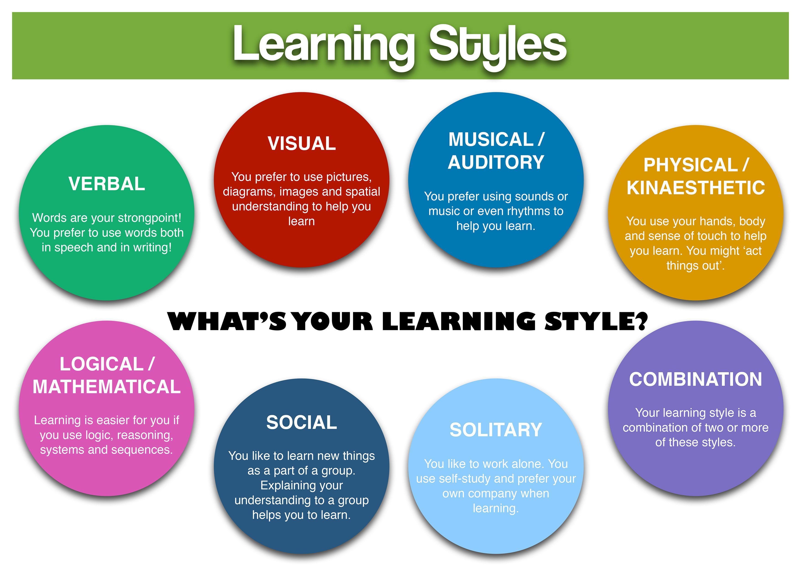

Slide 19

INNOVATION
IN
ACTION

Slide 20
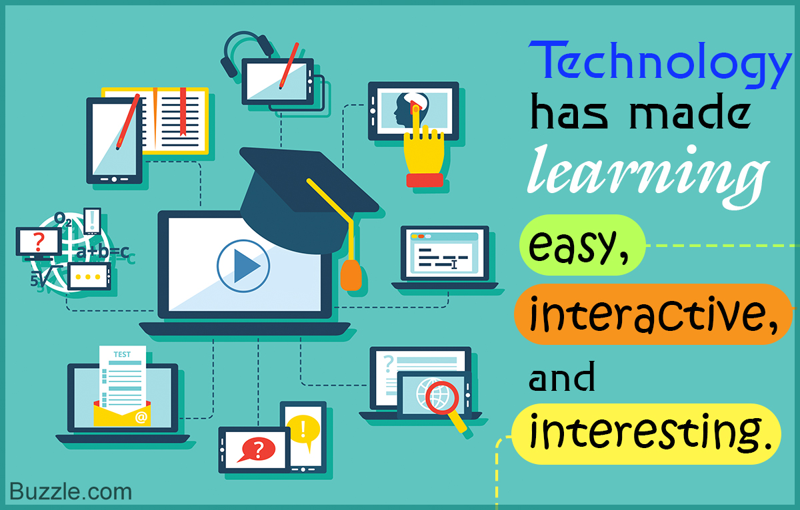

Slide 21
INNOVATIVE SOLUTIONS IN ACTION
AI and Data Analytics
Gamification and Immersive Learning
    AI: Simulation of human intelligence in machines that are programmed to
    think and learn like humans.
    Advantages:
    Improved learning experiences and operational efficiency.
    Tailor educational content to individual students' needs.
    Personalized feedback and support to students, helping them understand complex subjects more effectively
    Data analytics: Collecting, analyzing, and interpreting large volumes of data to make informed decisions.
    Advantages:
    Curriculum Development
    Enhancing Student engagement
    Improved learning experiences
    Operational efficiency.
  Gamification: Application of game-design elements and principles in non-game contexts to engage and motivate people to achieve their goals.
  Advantages:
    Makes activities more enjoyable and engaging.
    Encourages people to complete tasks and achieve goals.
Immersive learning: Educational approach that uses technology to create engaging, interactive, and realistic learning environments.
    Advantages:
    Enhanced engagement
    Experiential learning
    Personalized learning
    Improved retention

Slide 22
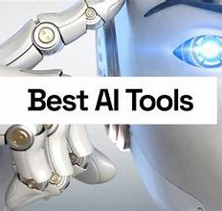
Consensus answers taken from published peer-reviewed studies and papers; list of links to the research materials that were used to generate the answer, to help with verification or further reading (Students and Educators).
Century is a comprehensive AI education platform with numerous features for students and educators (Students and Educators).
Explainpaper generates summaries and explanations of academic studies and research papers (Students and Educators).
Plaito is a generative text tool designed to help writers improve their skills with personalized feedback (Students and Educators).
Synthesia is an AI-powered video creation platform that allows users to generate professional-quality videos without the need for cameras, microphones, or actors (Educators).
Fetchy positions itself as a “virtual assistant for educators” and is comprised of a suite of more than 40 tools that can help teachers to create lessons, plan projects and build teaching frameworks (Educators).
Ivy is an AI framework for creating customer service chatbots with a focus on helping institutions of higher learning (Educators).
Duolingo allows students to roleplay with AI-powered personas to carry out learning-focused tasks (Students).
Brainly is a collaborative homework-help and question-answering service with personalized answers generated by AI (Students).

Slide 23
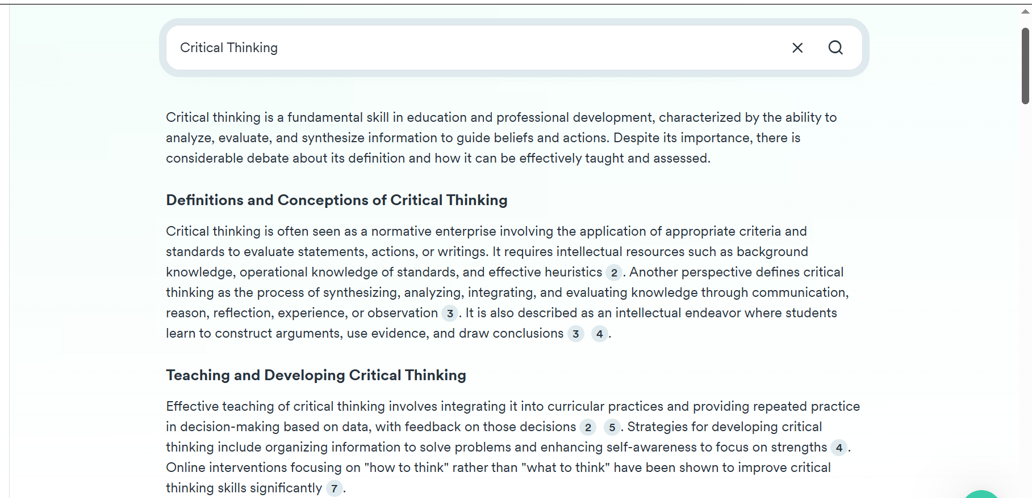
Consensus

Slide 24
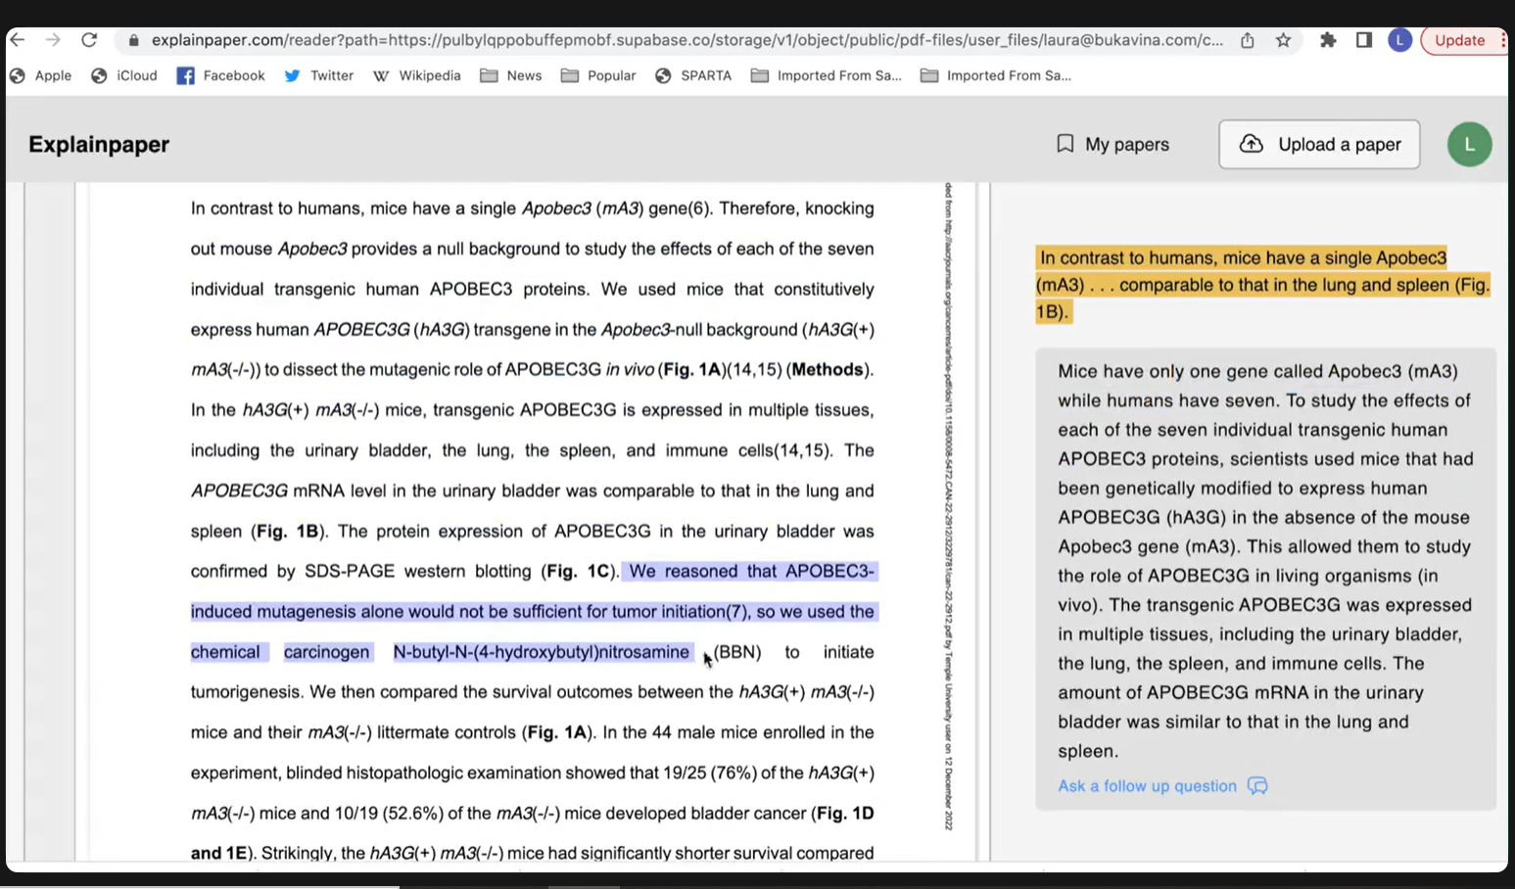

Slide 25
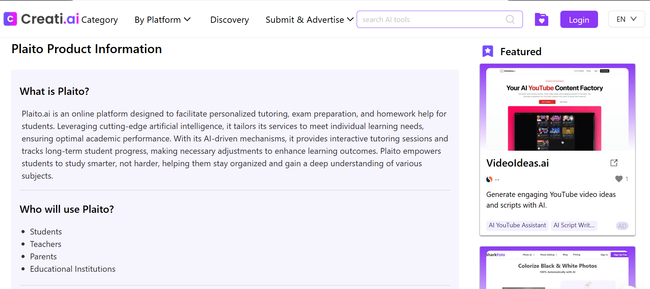

Slide 26
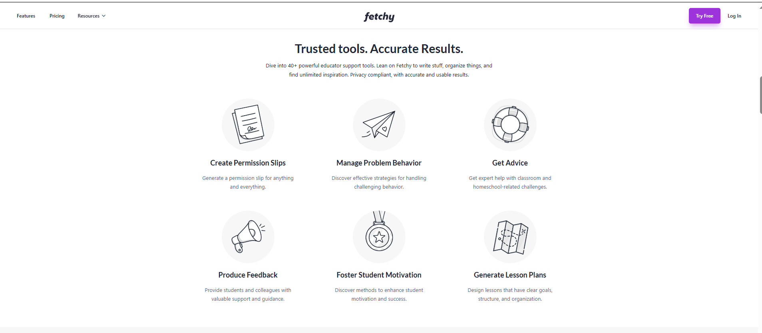

Slide 27
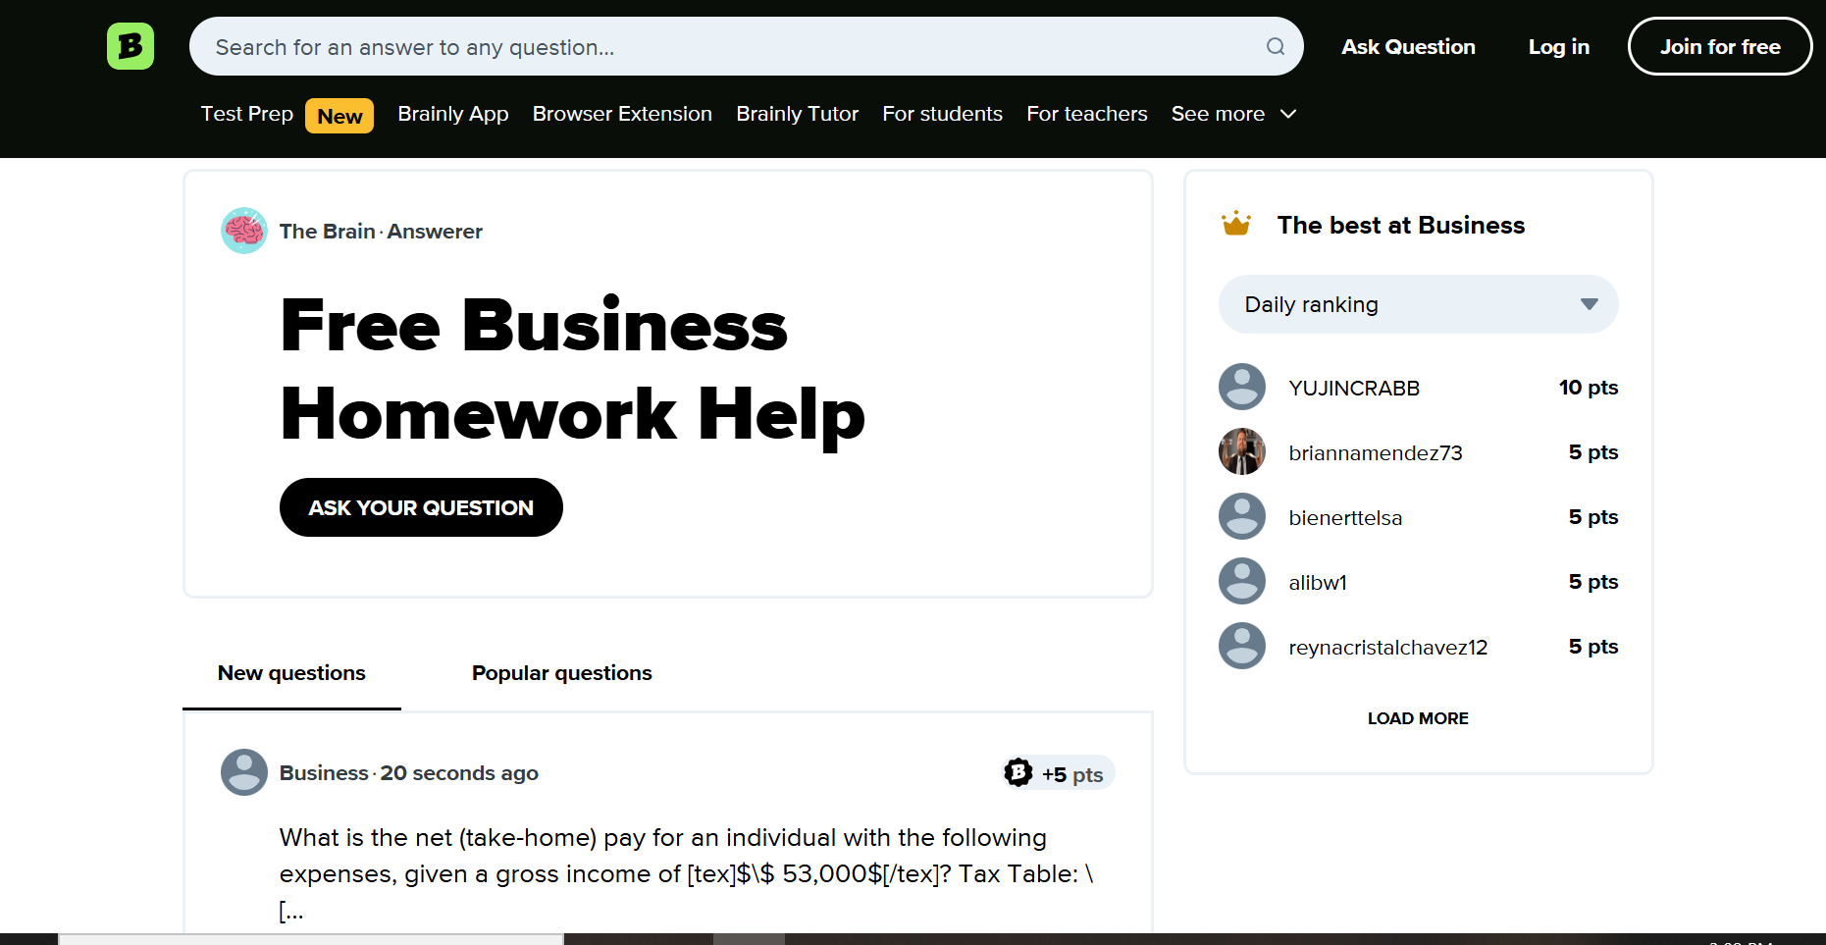

Slide 28

Gamification Tools
For Higher Education:
Kahoot!: A game-based learning platform used in classrooms and corporate training. It allows users to create quizzes and interactive lessons that can be played in real-time.
Scavify: A platform for creating and hosting scavenger hunts and experiential learning activities. It includes features like customizable challenges, AR elements, and progress tracking.
Xperiencify: Focuses on gamifying online courses and training programs. It includes tools for creating points systems, badges, and interactive challenges.
For Business:
Bunchball: Offers gamification solutions for employee engagement, customer loyalty, and training programs. It uses game mechanics to drive participation and performance
Gametize: A versatile gamification platform that can be used for employee training, customer engagement, and social causes. It includes features like quizzes, challenges, and rewards
Funifier: A gamification platform that offers tools for creating engaging experiences in various contexts, including education, business, and health

Slide 29
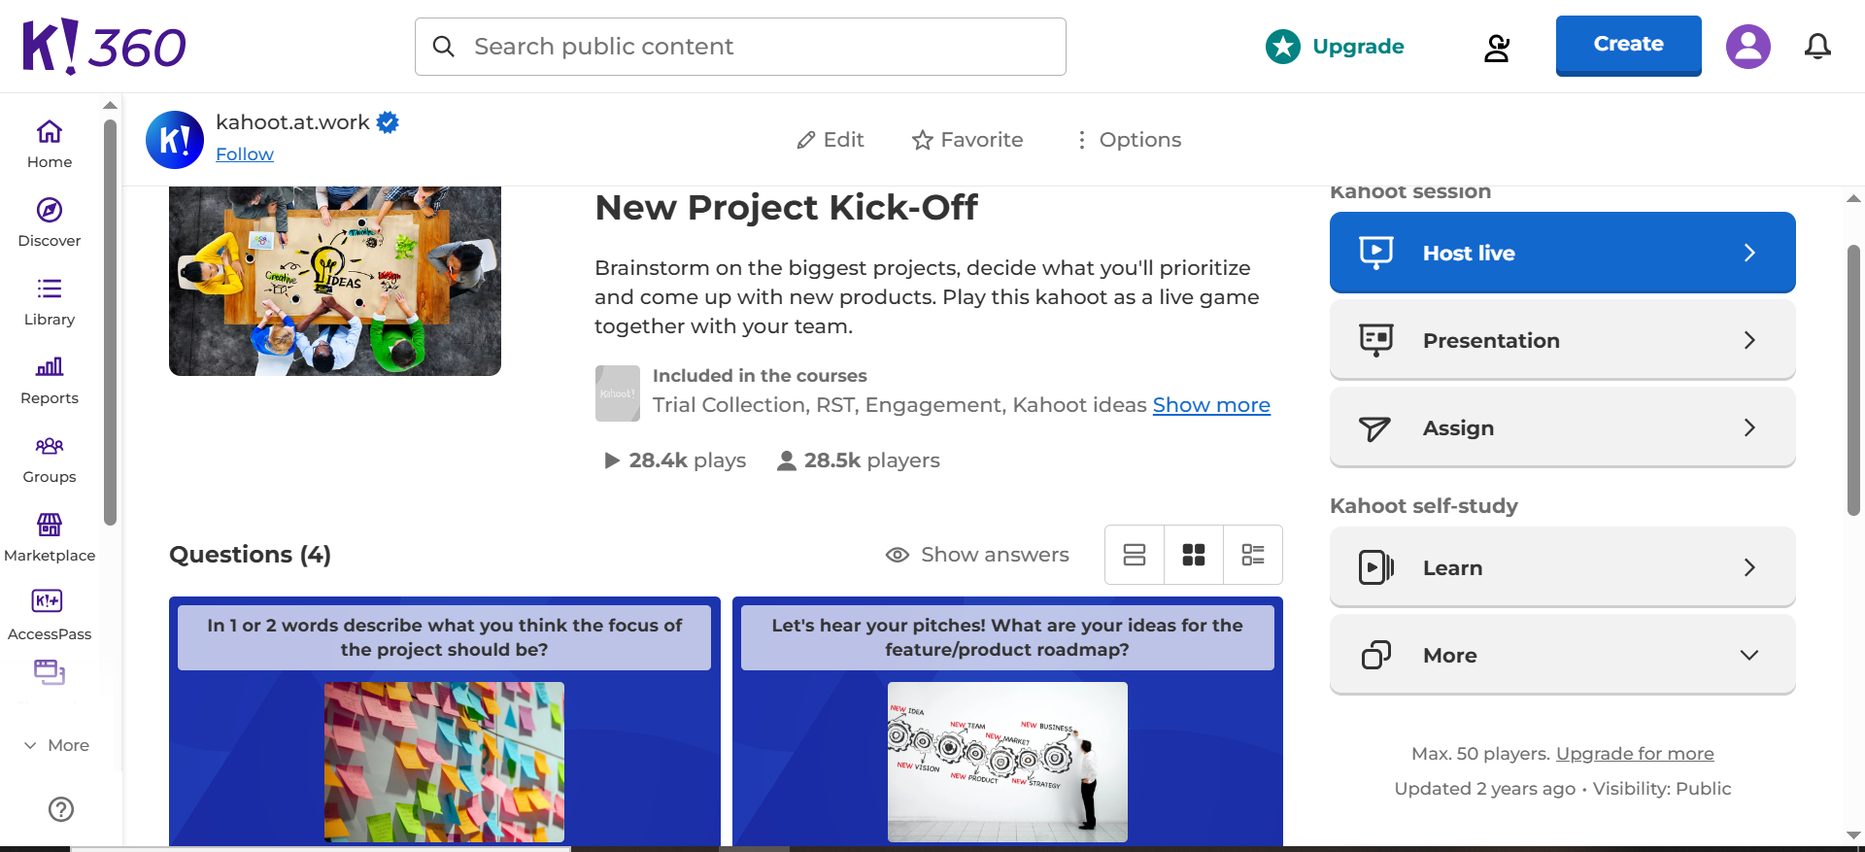

Slide 30
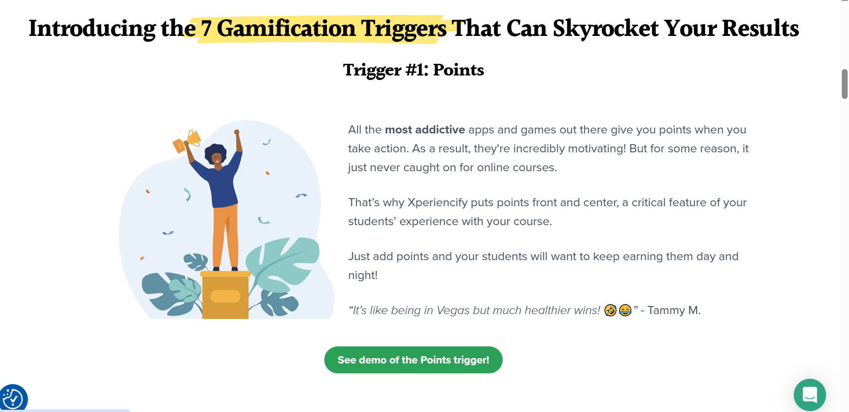
Xperiencify

Slide 31
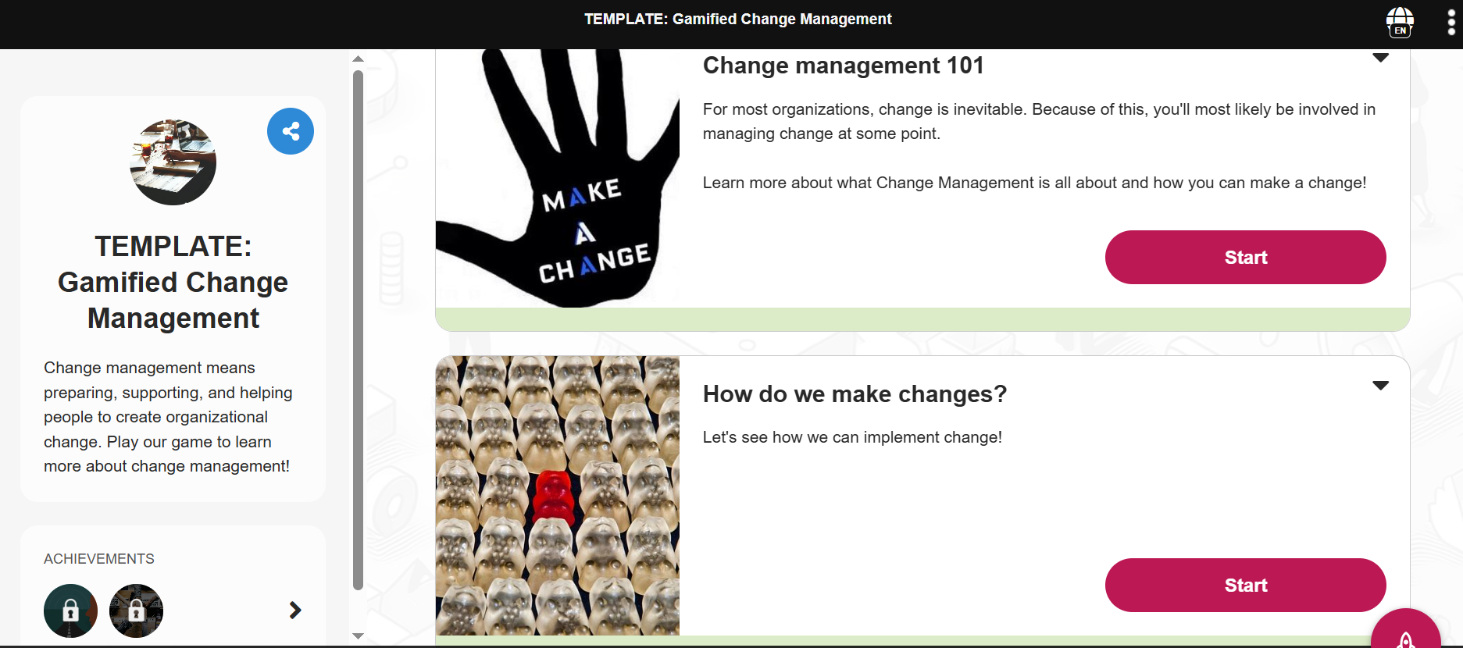
Gametize

Slide 32

CULTURE OF INNOVATION

Slide 33
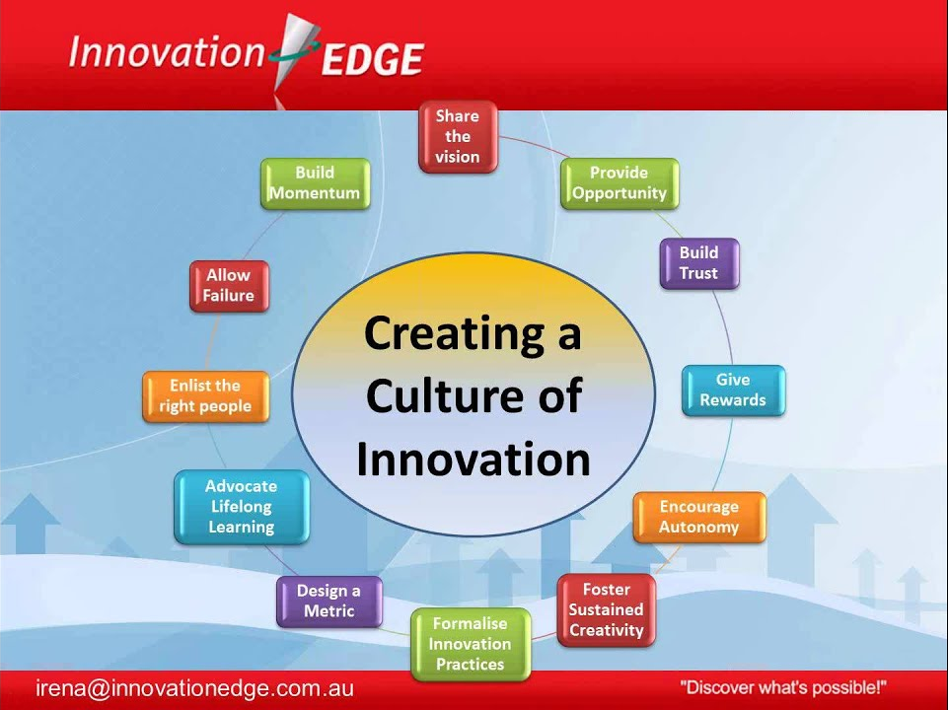

Slide 34
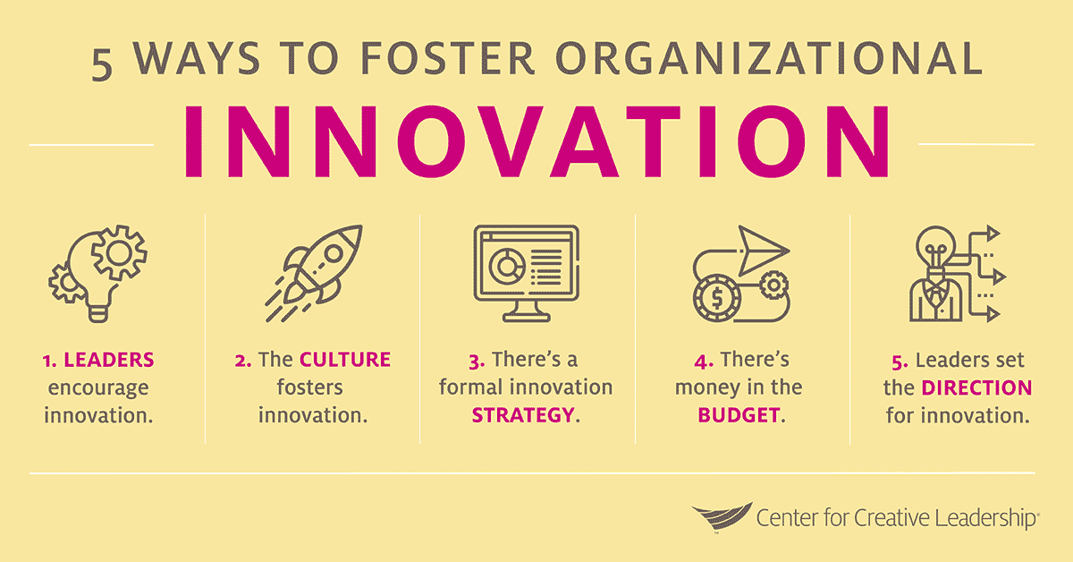

Slide 35

CONCLUSION
Notes:
To conclude this presentation, we have explored the transformative journey of higher education in response to a shifting educational climate. We have examined the historical changes, current trends, and future directions that are shaping the landscape of higher education. Innovation has been a central theme, highlighting the importance of embracing new ideas, methods, and technologies to enhance learning experiences and meet the evolving needs of students.
As we move forward, it is crucial to foster a culture of innovation within educational institutions. This involves establishing a clear vision, promoting collaboration, providing resources, and continuously improving. By doing so, we can create an environment that supports creativity, critical thinking, and lifelong learning.
Thank you for your attention and participation. If you have any questions or would like to discuss further, please feel free to reach out.
Dr. Kristin B. Martin Franklin University

Slide 36

title
Questions?

Slide 37





Thank You
Dr. Kristin B. martin
+1 614-947-6638
Kristin.martrin@franklin.edu
Franklin University

Slide 38


About Me
I am the Program Chair for the MBA Program and Lead Faculty in Financial Management at Franklin University in Ohio. With a 30-year career in finance, she transitioned to academia in 2019 as the MBA Director at Columbia College before moving to Franklin University in 2021. I received the award for Top 100 Visionaries in Education by Global Forum for Education and Learning (GFEL) in 2021.
I have the following designations:
DBA in International Business and Finance from Walden University
MBA from Averett University
BS in Finance from Virginia Commonwealth University.
Dr. Kristin B. Martin
MBA Program Chair
Franklin University

Slide 39
REFERENCES
¹Leiner, B. M., Cerf, V. G., Clark, D. D., Kahn, R. E., Kleinrock, L., Lynch, D. C., Postel, J., Roberts, L. G., & Wolff, S. (1997). A brief history of the internet. The Internet Society. https://www.internetsociety.org/internet/history-internet/brief-history-internet/
²Vu, N. T. & and Nguyena, T. L. H. (2023). Flipped learning in teacher education: Using the theories of reflection to understand English-major students’ sense of engagement. Journal of Intercultural Communication Research, 52(3), 284–313. https://doi.org/10.1080/17475759.2023.2197915
³Annuš, N. (2024). Education in the age of artificial intelligence. Technology, Education, Management, Informatics Journal, 13(1). 404-413. doi:10.18421/TEM131-42.
⁴Solis,D. (2024, July 13). What’s trending in business education: Key trends and innovations. Sustainable Business Toolkit. Retrieved from https://www.sustainablebusinesstoolkit.com/whats-trending-in-business-education/
⁵Palmer, M. S., & Giering, J. A. (2024). Characterizing pedagogical innovation in higher education. Innovative Higher Education, 49(3), 453–473. https://doi-org.links.franklin.edu/10.1007/s10755-023-09681-6
⁶World Economic Forum. (2024). Shaping the future of learning: The role of AI in education 4.0. https://www.weforum.org/publications/shaping-the-future-of-learning-the-role-of-ai-in-education-4-0/
⁷Bancă, A.-M., & Coman, C. (2024). Empowering the workforce: The Imperative of professional training in a technology-driven world. Revista Universitară de Sociologie, 2, 50–58. https://www.ceeol.com/search/article-detail?id=1283728
⁸Babashahi, L., Barbosa, C. E., Lima, Y., Lyra, A., Salazar, H., Argôlo, M., Almeida, M. A. de, & Souza, J. M. de. (2024). AI in the workplace: A systematic review of skill transformation in the industry. Administrative Sciences (2076-3387), 14(6), 127. https://doi-org.links.franklin.edu/10.3390/admsci14060127

