Slide 1

Dr. Kellie Playter
Dr. Tammie Burkhart
Transforming Future Business Leaders Through Experiential & Service Learning

Slide 2

Introductions
Kellie Playter
  Associate Professor & Internship Director
Tammie Burkhart
  Associate Professor of Accounting & ENACTUS Director
www.cui.edu
Notes:
Dr. Thomas

Slide 3

Current Student Demographics
Most undergraduates are Generation Z
people born roughly between 1995-2010
  Ethnically diverse
  Influence of technology
    Learn new skills (YouTube, TikTok, Google)
    Social Interaction
    AI
www.cui.edu
Notes:
Dr. Ashmon

Slide 4

Challenges & Opportunities
Challenges
Lack soft skills
Personal qualities
Lack work experience
Opportunities
Eager to learn practical workplace skills in college
Accustomed to technology
Comfortable in a diverse world
Desire to be helpful and responsive
Notes:
Crystal

Slide 5

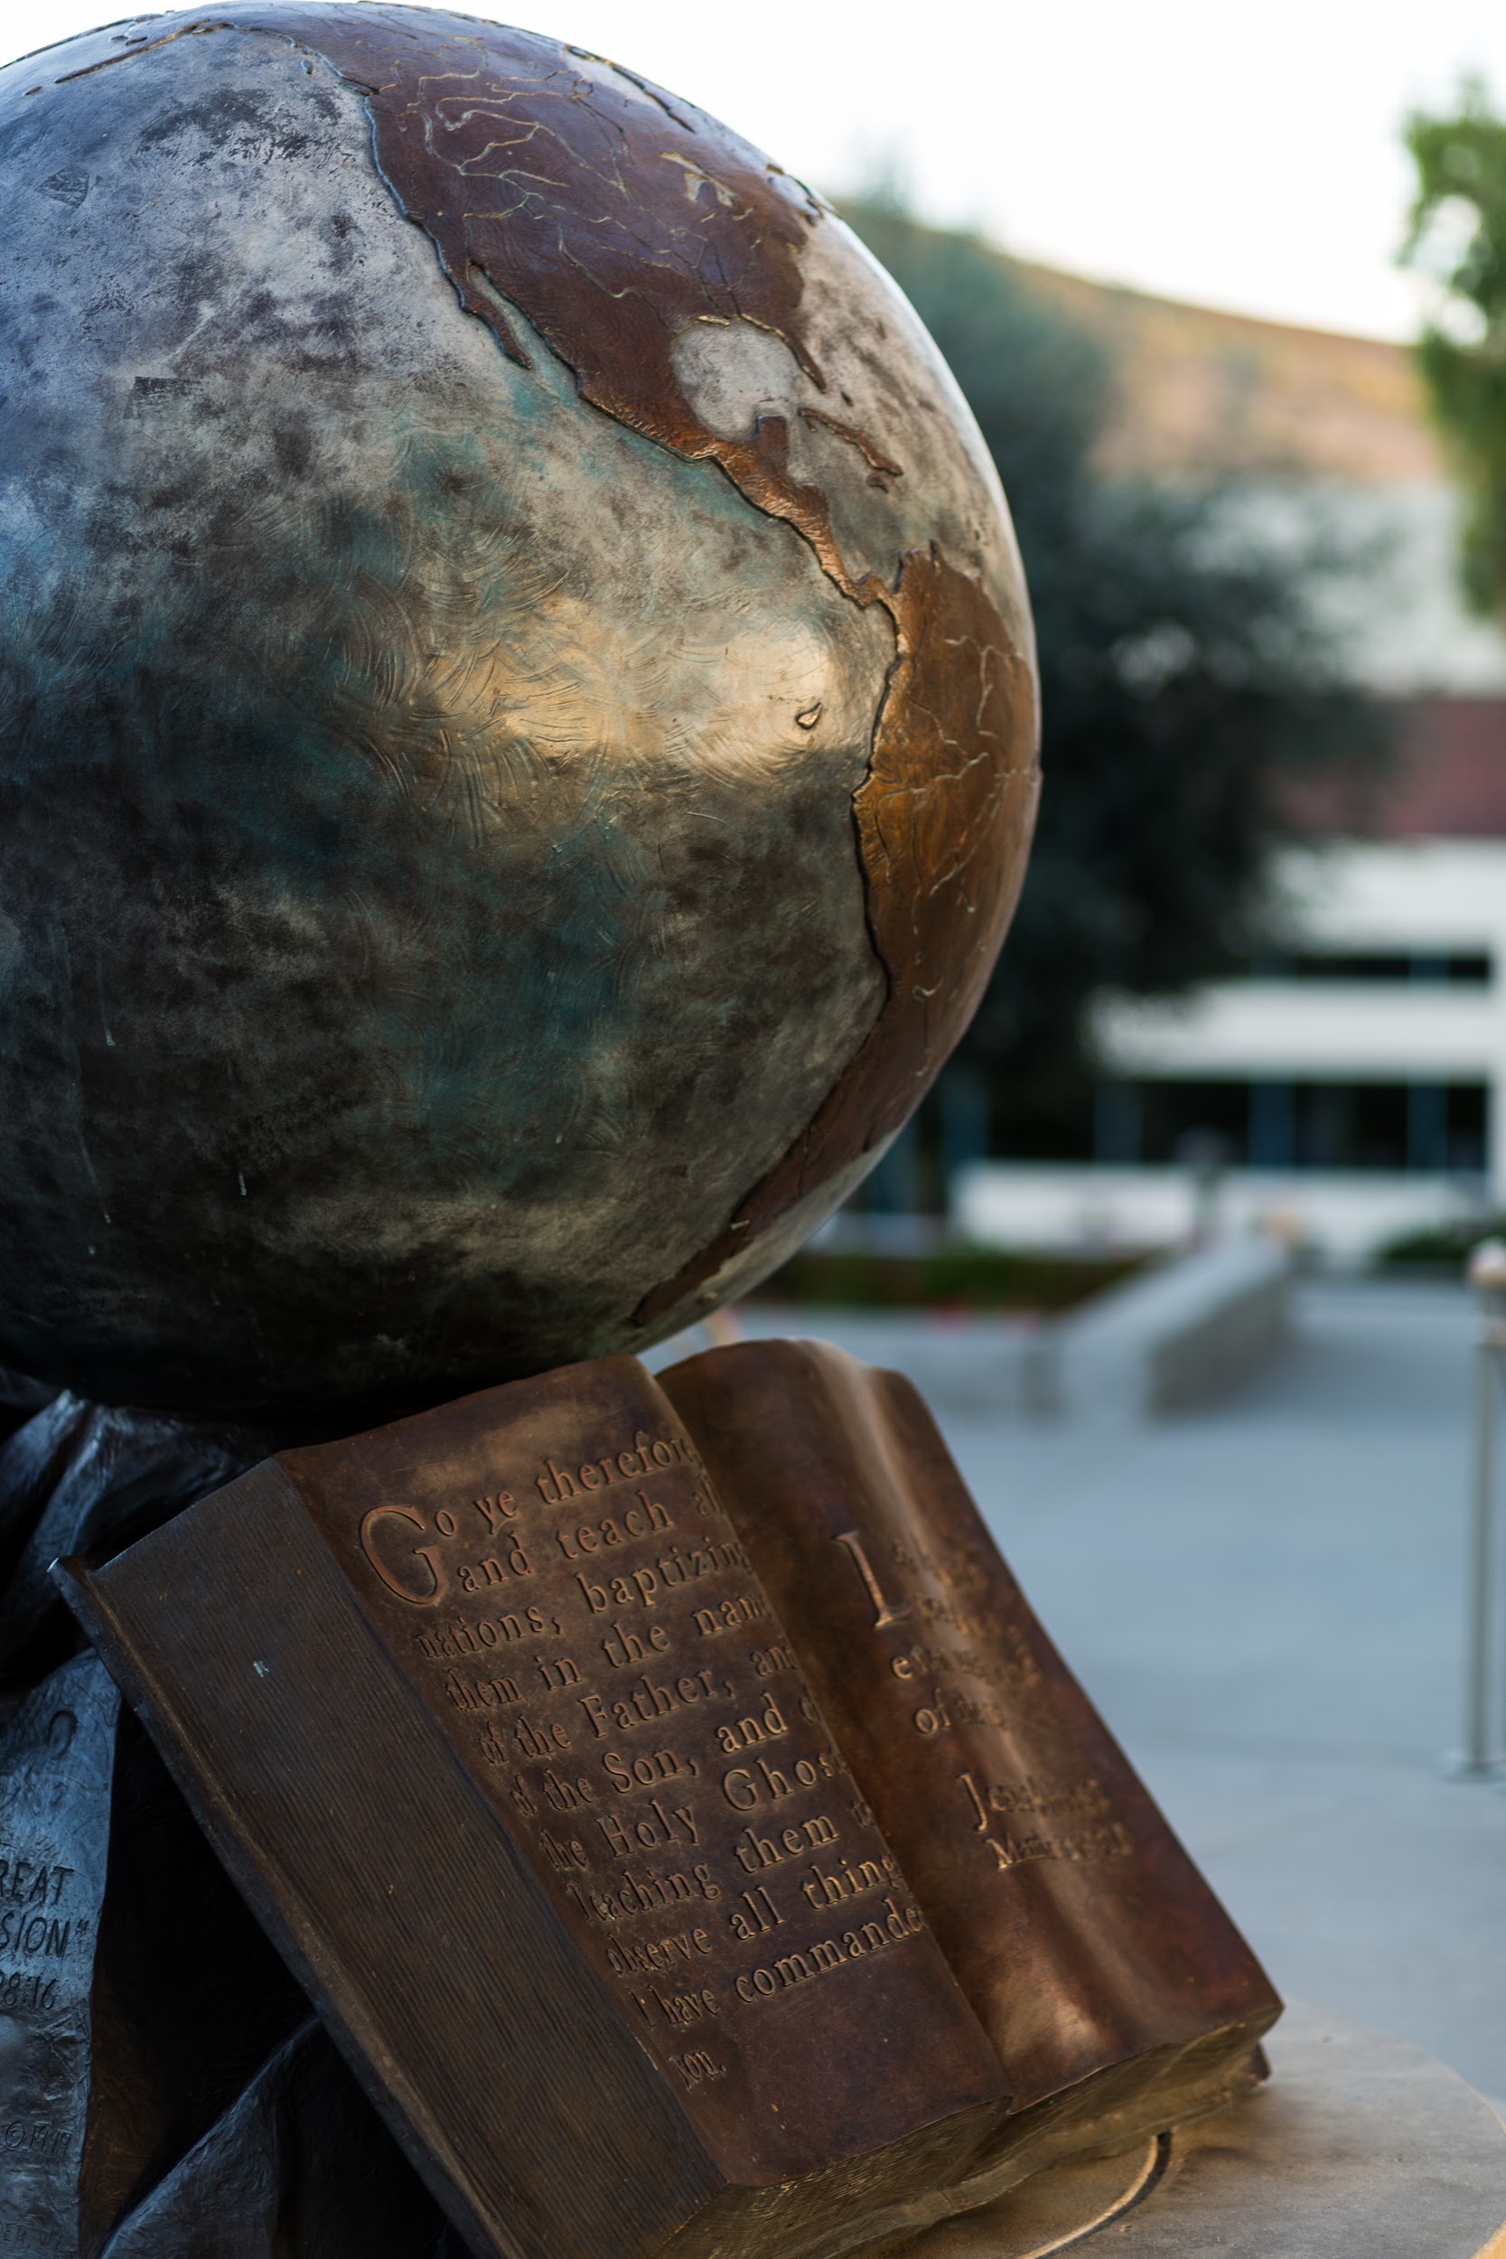
Employer Needs-
NACE Competencies
Career & Self-Development
Communication
Critical Thinking
Equity & Inclusion
Leadership
Professionalism
Teamwork
Technology
www.cui.edu
Notes:
Student 4

Slide 6
Experiential Learning
“Experiential learning is an umbrella concept that includes many varieties of hands-on learning activities, including laboratory experiments, kinetic learning activities, professional internships, and course-related fieldwork” (Ludlow, 2010, p. 45).
www.cui.edu
Notes:
Dr. Thomas

Slide 7
Concordia Internships
4/10 college students complete an internship (Gallup, 2023)
Concordia has a required internship program
Personal development & professional document preparation (resume, cover letter, LinkedIn, Handshake)
Interview and networking skills
80+ hours of field experience in the students desired career field
Post fieldwork reflection & evaluation
Outcomes
NACE Competencies (Career & Self-Development, Communication, Critical Thinking, Equity & Inclusion, Leadership, Professionalism, Teamwork, Technology)
www.cui.edu
Notes:
Dr. Ashmon

Slide 8
Philanthropy/Service Learning
ENACTUS - ENtrepreneurial ACTion US
Global organization with a long-standing commitment to using entrepreneurial action as a catalyst for change
Micro-loans to low income small business owners
Students are assigned business plans to review
Notes:
Crystal

Slide 9
Philanthropy/Service Learning
Receive small business plans from our partners
Approved 5 business plans to fund - Philippines
Visit Cebu in May with students
Meet business owners & visit businesses
Provide small business workshops
www.cui.edu
Notes:
Dr. Ashmon

Slide 10
Conclusion
These are just a few ways Concordia is helping prepare and transform future business leaders outside the classroom in safe and supportive environments where they can learn, fail, grow, make connections, and give back.
Notes:
Crystal

Slide 11
Q & A
www.cui.edu
Notes:
Student 4

