Slide 1
Behind the scenes of a 3+1 Accelerated Dual Degree Program – sharing the experience of designing, implementing, and maintaining the program
Kathy Baughman, CPA, CGMA, CFE
Division Head and Professor
IACBE ACAM - Memphis, TN
April 4, 2024

Slide 2
Description of Program
Designed to provide another degree option for students
2 degrees in 4 years
Students complete a 120 credit Bachelor degree in 3 years
Students complete the Master Degree in the 4th year
Additional networking
Academic advising support
Course registration assistance
Tuition discount

Slide 3
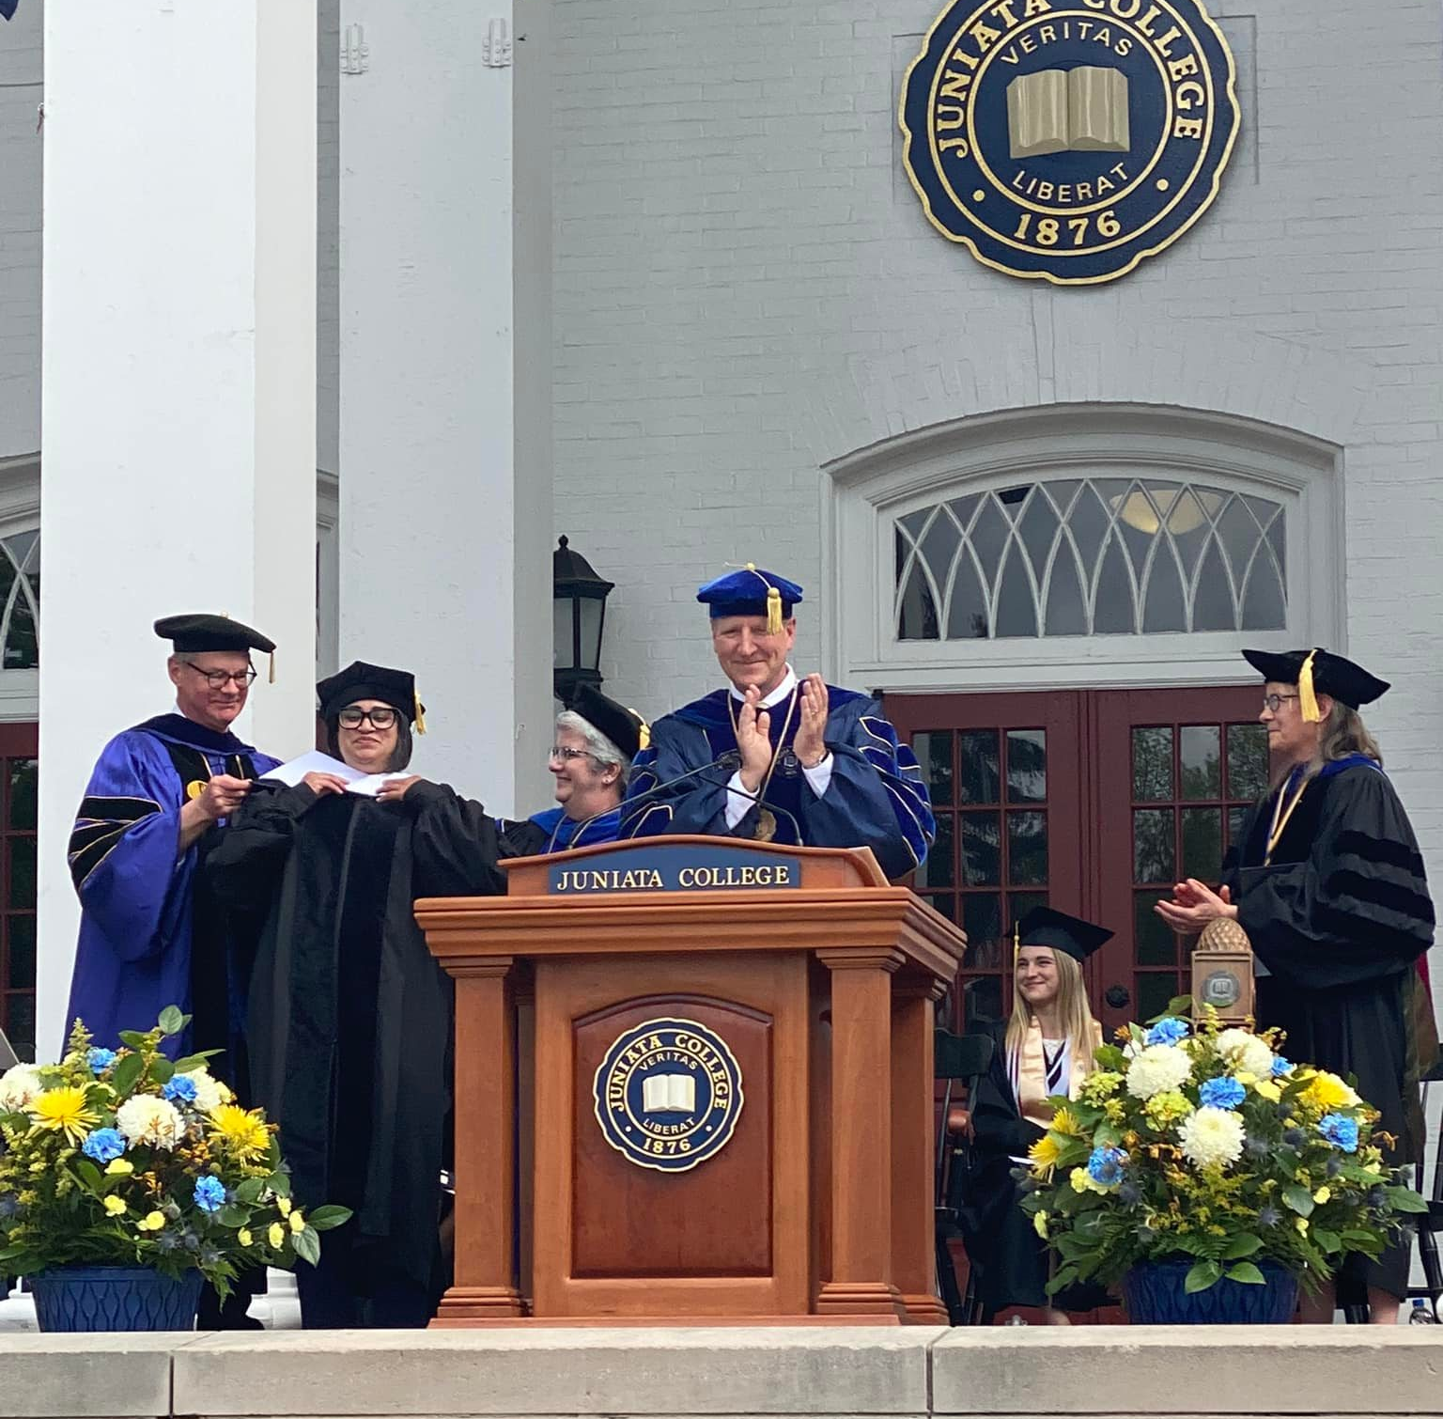
3+1 Academic Program Offerings
Accounting, Business, or Economics + Organizational Leadership
Accounting, Business, or Economics + MBA
Accounting/Finance + Master of Accounting
Communications + Organizational Leadership
Chemistry + MBA
Environmental Science + Applied Ecology and Natural Resources
Psychology + MBA
Psychology + Organizational Leadership
Integrated Media Arts + MBA
Integrated Media Arts + Organizational Leadership

Slide 4
Master’s Degrees
MBA
  Prerequisites must be completed in your first 3 years:
    Economics course
    Statistics
    Financial Accounting
Organizational Leadership
  No course prerequisites
Master of Accounting (MAcc)
  Accounting or Finance POE
  Must have completed Intermediate Accounting I & II

Slide 5
Program Benefits
Challenging academic environment with peers who share your academic and career goals
Easy transition to graduate program
Extra year of earnings
Preferred/discounted tuition rate for master’s degree

Slide 6
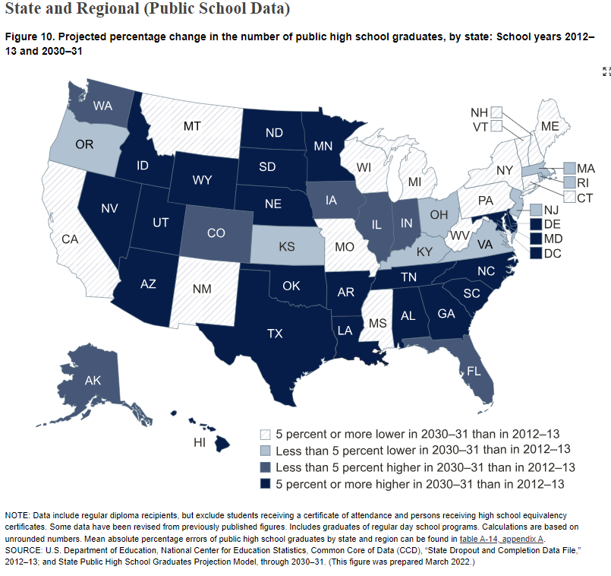
Why?
National Center for Educational Statistics https://nces.ed.gov/programs/PES/section-3.asp

Slide 7
Why?
National Center for Education Statistics indicates 34% of high school students nationally earn college credit while in high school.¹
“Like Advanced Placement, dual enrollment started as a way to give more advanced students access to challenging coursework. It was seen as solution to senioritis and the wasted senior year.” ²
“But as the cost of college rose, and graduation gaps hardened, dual credit was repurposed. Policymakers began pitching the programs as a way to lower the cost of a degree and put more low-income and first-generation students on the path to postsecondary education.” ²
“Over time, states began offering the programs as early as freshman year. By 2010-11, forty percent of institutions allowed tenth graders to take their courses, and a quarter gave 9th graders that option, a federal survey found.” ²
1 https://www.legis.state.pa.us/WU01/LI/TR/Transcripts/2023_0398_0002_TSTMNY.pdf (PA House Education Committee = 10/19/2023) – Michael Giazzoni testimony)
² https://www.educationnext.org/rise-dual-credit-more-students-take-college-classes-high-school-degree-attainment-rigor/

Slide 8
Enrollment Statistics
Goals:
2021 small class to start the program
Continued increase in enrollment percentage
Retain high proportion of students
3+1 FUNNEL | 2021 | 2022 | 2023
Applications | 395 | 516 | 551
Admission | 147 | 246 | 275
Enrollment | 8 | 28 | 37
Enrollment % | 5% | 11% | 13%

Slide 9
Student Persistence/Retention Statistics

Slide 10
Requirements to remain in the program
3.0 GPA
Complete 40-45 credits by the start of the fall semester in your 2nd year
Complete 82-85 credits by the start of the fall semester of your 3rd year
POE changes require approval by the academic department chair & advisor
Must complete application to master’s program prior to the end of the 3rd year

Slide 11
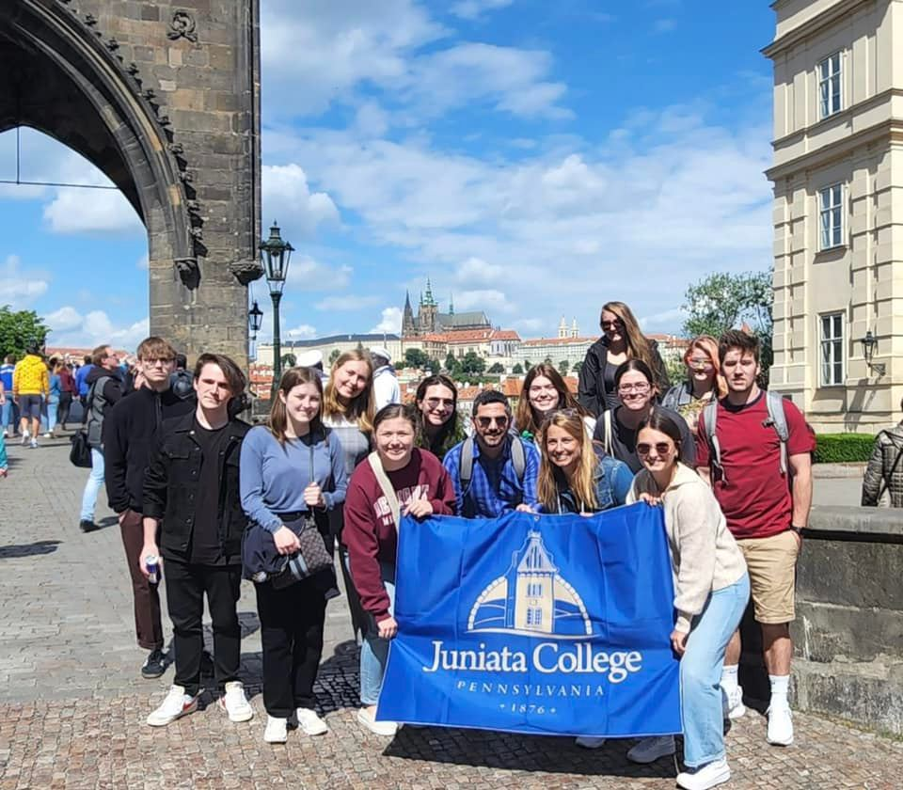
Summer and Winter Sessions – Credit opportunities
General education and business core courses offered in summer and winter sessions
Short-term study abroad courses
Summer internship credits
Summer community engaged learning credits

Slide 12
Design consideration
Faculty point of contact for initial year
  Coordinate enrollment messaging
Prepare academic course pathways
Availability of summer/winter online courses
  Business Core
  General education
Tuition considerations
  Alumni discount
  6 Graduate credits in year 3, as part of undergraduate tuition
Exclusive events
  Trustee and Advisory Board engagement

Slide 13
Focus Group – Fall 2023
Desire to identify with cohort
Specialize or priority advising
Networking opportunities
Appropriate long term course planning

Slide 14

Lessons Learned
Start small
Need to develop cohort relationships
Advisor training is critical
  Annual advising updates/reminders
Administrative office support - Registrar
Feedback opportunities for students
  Creating end of year survey instruments
Required semester meetings for students
Provide students with direct guidance on marketing their experience

Slide 15
Questions?

Slide 16
Sources:
https://nces.ed.gov/programs/PES/section-3.asp
https://www.legis.state.pa.us/WU01/LI/TR/Transcripts/2023_0398_0002_TSTMNY.pdf
https://www.educationnext.org/rise-dual-credit-more-students-take-college-classes-high-school-degree-attainment-rigor/

Slide 17
Thank you
Name
(pronoun)
Title
Title
email@juniata.edu
814-xxx-xxxx
social
social
1700 Moore Street
Huntingdon, PA 16652

