Slide 1


IMPACTING COLLEGE SUCCESS RATES FOR FIRST YEAR STUDENTS:
AN EXPLORATION INTO STUDENT ENGAGEMENT
By:
Dr. Cathy Robb
Dr. Jervaise McDaniel

Slide 2


Notes:
Professional Christian University.

Slide 3

Rationale…Why is First Year Student Success important?
To explore a problem in higher education of
improving student success rates by examining
first-year student engagement.
  Retaining full-time freshmen is a problem for higher education institutions as approximately 30% of freshmen students drop out prior to their sophomore year
  (Pariafsai et al., 2021).
  Most college dropouts do not return to higher education which leads to a non-recoverable social and economic loss (Gupta et al., 2020).
  A comprehensive understanding of student engagement remains a challenge, due to the variety and complexity of elements influencing it
  (Kahu et al., 2020).
Notes:
Difficult transition from high school to college.
Challenge of student engagement academically and socially.
Difficulties for students to build new relationships….students want to text but not engage socially.
Student engagement…..academics and social elements – inside and outside the classroom.

Slide 4
Research Framework
First-Year Experience Course
Student Engagement
Student Success
Social and Economic Benefits
Grade Point Average
Student Retention
Spirituality
Blended Learning
Notes:
FYE Course at OCU for Fall 2023. All first year students enrolled. Class met one day a week & is a required course to graduate.
Student Engagement
Does faith impact engagement?
Does a blended learning format better support engagement?
Student Success
Social & Economic Benefits.
Research shows that college graduates are more productive members of society.
College grads are more likely to pay taxes, have a healthy lifestyle, involved in community activities.

Slide 5
Data Collection for Student Engagement
Qualitative data collection
  Interview guide with 13 open ended questions supported reviewing six engagement categories.
Quantitative data collection
  Survey supported reviewing six engagement categories.
  Six engagement categories:
    Transition Engagement
    Academic Engagement*
    Peer Engagement
    Student-Faculty Engagement*
    Blended Engagement
    Beyond-Class Engagement
Krause, K., & Coates, H. (2008). Students’ engagement in first-year university. Assessment & Evaluation in Higher Education,
33(5), 493–505. https://doi.org/10.1080/02602930701698892
Notes:
Engagement Categories:
Transition - focused on the first-year students’ experiences during the transition to the university from HS.
Academic – focused on motivators to work harder and perform academically in class.
Peer – focused on student interactions inside and outside the classroom
Student-Faculty – focused on how faculty can impact student engagement
Blended – focused on how using an LMS can impact student engagement
Beyond Class – focused on extra- curricular activities and on how students’ faith impacts engagement.

Slide 6

Qualitative Data - Interviews
Academic Engagement
Motivation to Work Harder
From Interview Questions
S8 stated,
“The more I am engaged through class projects and discussions the better I learn and want to succeed.”
Another student’s response:
Notes:
Students wanted more in class discussions on topics – that motivated them to work harder in class.

Slide 7
Qualitative Data - Interviews
Student-Faculty Engagement
Caring and Supporting Faculty
From Interview Questions.
S5 stated that,
“Professors know you as a person. They call on me by name.”
Other students’ responses:
Notes:
Powerful relationships that faculty can have with students.

Slide 8
Beyond Class Engagement
Strengthening Relationship with God and How Faith Reduces Stress
From Interview Questions
S5 stated, “it has allowed me to come a lot closer to God by being around other people who love God. ”
S9 stated, “My roommates and I all went to Bible study together and this helped each other to manage stress.”
Notes:
Interviews reflected that students wanted a stronger integration of faith into the curriculum.

Slide 9
Quantitative Data Findings….
Factor Analysis for Student Transition Engagement:
Results reflected that academic and student-faculty engagement are most strongly related to student transition engagement.
Notes:
Questions on the 6 Student Engagement categories were grouped together as a new variable in SPSS for a factor analysis.
The factor analysis was run in SPSS to determine the relationships of the variables in supporting the student transition to college.
The higher factor loadings reflects a stronger relationship…..Academic engagement & Student_Faculty engagement had the strongest loadings.

Slide 10

Conclusion from the research…
Research reflects that supportive relationships and engagement with students’ academic experiences are vital to their long-term success (Lu, 2022).
The findings suggested that college students who completed a first-year seminar course experienced higher engagement and as a result reflected improved GPAs and retention rates for their first year at college.
This study reflected the strongest areas of student engagement are from the academic and faculty relationships which contributed to successfully overcoming the stress and challenges of students transitioning to college life.

Slide 11

FYS at OCU Activities….
Speakers from various campus representatives
  Library
  Community Engagement
  Campus Minister
  Student Success
Occasional meetings at the campus coffee shop
End of semester lunch for class!
Scavenger hunt - Fliphunt

Slide 12

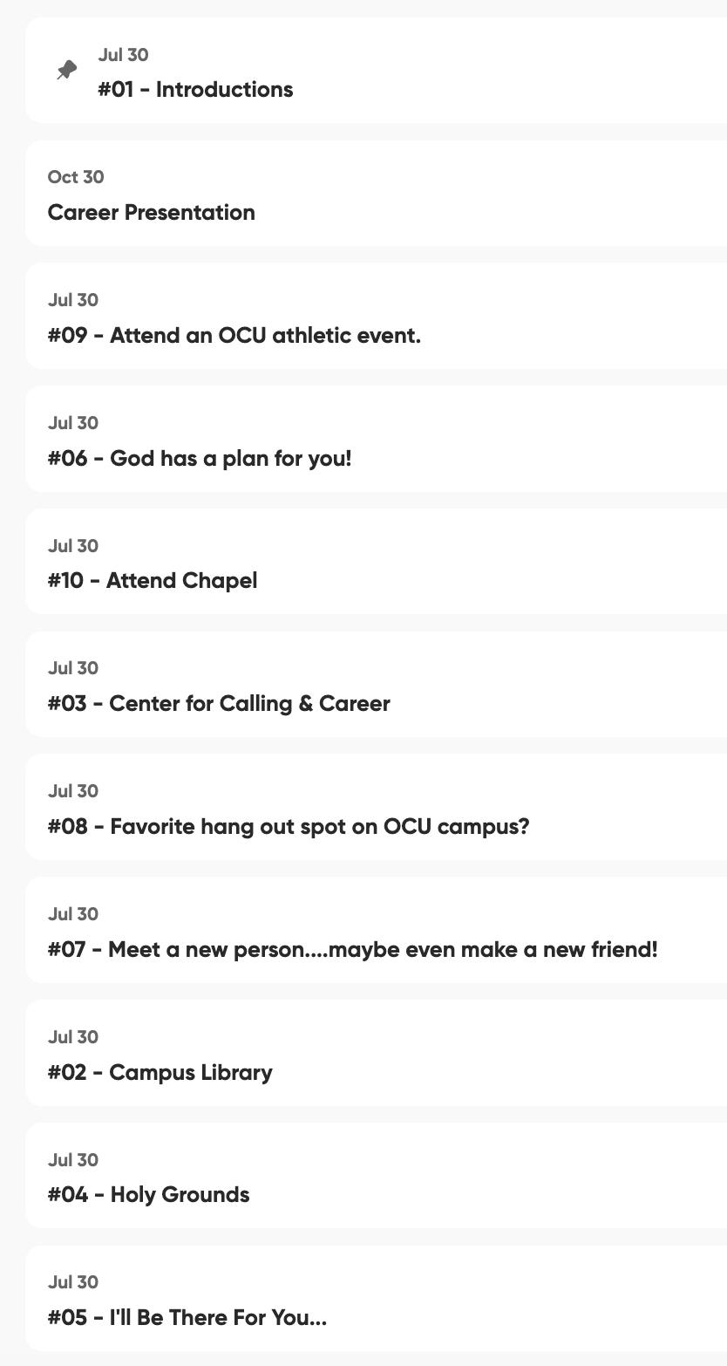
FYS at OCU Activities….

Slide 13
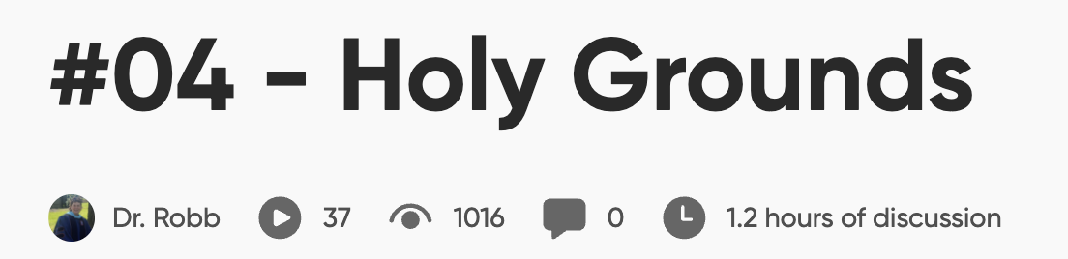


Total video views with only 55 students in the class!
Visit Holy Grounds & take a selfie video with describing your favorite drink to order!

Slide 14


Record a video of you & your friends at a chapel service.
Be sure to take your recording before or service please!

Slide 15

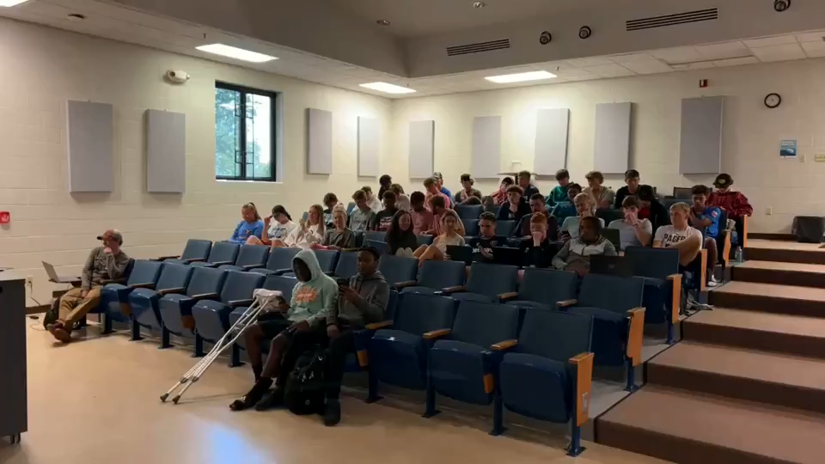

Slide 16

Thank You!
Dr. Cathy A. Robb
crobb@oak.edu
Dr. Jervaise McDaniel
jmcdaniel@oak.edu

