Slide 1

Health of Program Review:
Leveraging Technology for Program Reviews
IACBE Annual Meeting
April 3, 2024
Dr. Alyncia Bowen, Dean Ross College of Business

Slide 2

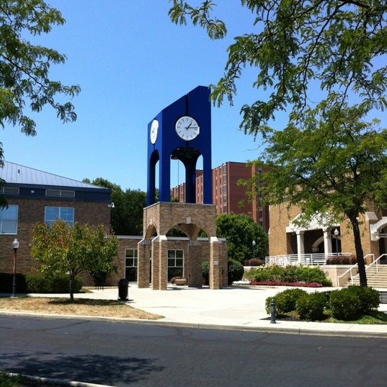
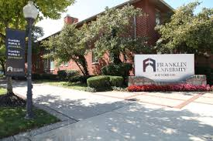
Franklin University
Located in Columbus, Ohio
Founded in 1902
Degree Offerings: 11 Associate, 39 UG, 18 Masters, 5 Doctoral
Academic Affairs organized by 4 colleges
Adult Learners: Average student age is 34
Predominately online course delivery but some F2F courses
Locations: London Correctional Institution, Oman, Poland, Serbia
Accreditation: HLC, CCNE, CAEP, IACBE
Assessment: Annual Program Assessment Reports, Program Review every 3 years (last one completed in 2018)
Centralized curriculum model

Slide 3
Academic Affairs Task Force
Alyncia Bowen
IE/IT
Ariel Chen
Implementation Team
Alyncia Bowen
Ryan Brainerd
Kelly Evans-Wilson
Yuerong Sweetland
Kris Coble
Stephen Schreiber
Travis Raber
Mary Bynum
Joel Gardner
Bruce Ramsey
Kelly Renner
Teamwork Makes the Dream Work

Slide 4
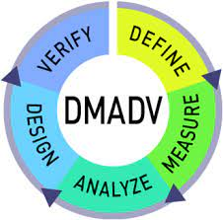
Change Management
Multiple Approaches In Action
Change Management
Communication
Stakeholder Support
Training and Support
Resistance Management
Recognition and Rewards
Monitoring and Evaluation
Mindset
Institution
Sphere of Influence

Slide 5
Health of Program (HoP) Milestones
2020
January – June: Academic Task Force
July – December: Prepare Faculty Survey
2021
January: Faculty Survey Emailed
January – December:
Regular Academic Affairs and Faculty Senate communications and feedback
IE & IT develop infrastructure
Prepare for MBA Pilot
Implementation Team meets monthly

Slide 6
Health of Program (HoP) Milestones
2023
January: Finalize Dashboard with IT
June - July: Launch pilot with MBA (2021-22 AY)
August: FMIP Training
January: Department Chair Reviews
Implementation Team continues monthly meetings re: improvements with IE/IT for 2022-23 academic year launch
August: FMIP training
October: Launched HoP (Comprehensive Review 2019-22)
October – November: Faculty Training
March: Assessment Committee hosted Faculty Forum
September: Launch (2022-23 AY)
December: Review Completed & Contributor Experience Questionnaire
March: Dean Reviews
2022
April – July: Internal presentations and updates to BOT & University Community
October: Created a HoP email for faculty to ask questions/ideas
December: Reviews Closed and Contributor Experience Questionnaire

Slide 7
Health of Program (HoP) Milestones
January: Department Chair Reviews (2023)
2024
January: Planning for 2024
Curriculum continuous improvement: outcome alignment and assessment validity (assignment alignment)

Slide 8
Health of Program (HoP) : Contributor Experience Survey
Comments from 2023
“The chart and table helped me identify the trend conveniently.”
“The trending data was informative. It gave a unique perspective of my program(s) with other programs in the University and the level of my programs”
“The age of students in my program has decreased significantly, this may impact how I write curriculum in the future because they have limited or no work experience”
“The value of the process is dependent on the status of the program. The initial hop created new changes but this cycle came too soon for those initial items to be implemented and start to generate data”

Slide 9

Tell Our Story
Specialized Accreditation
HLC and ODHE
Continuous Improvement
Leadership Deep Dives
Change management in action
Four Cornerstones
Ensure Quality
Data-Informed
Academic Opportunities
Adapt to Students
Respond to changes
AALHE presentation (June 2023)
HoP:
A tool to
Achieve
Our Mission

Slide 10
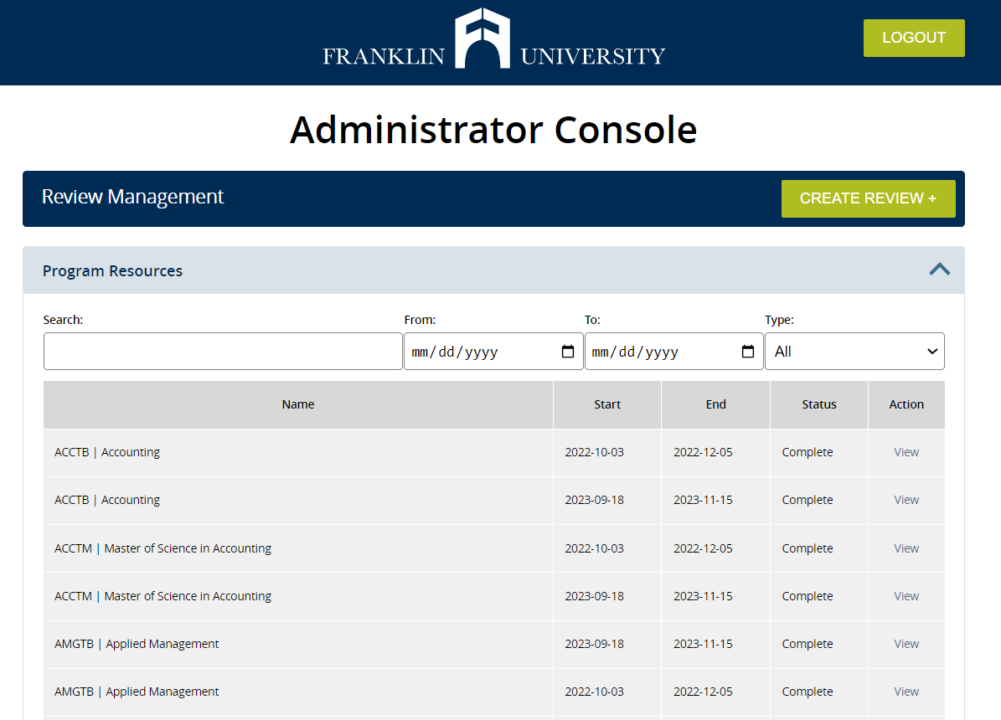

Slide 11
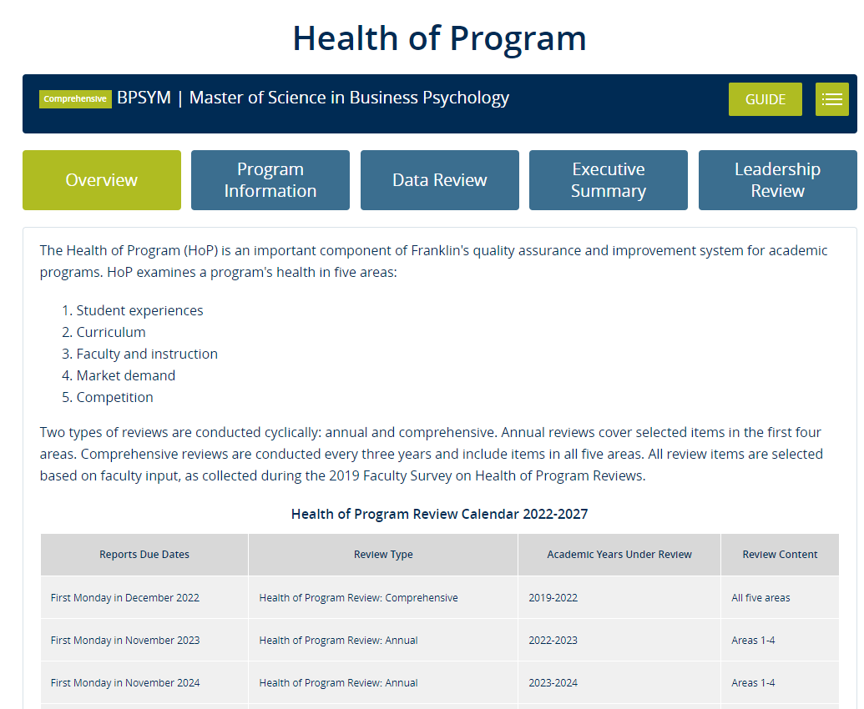
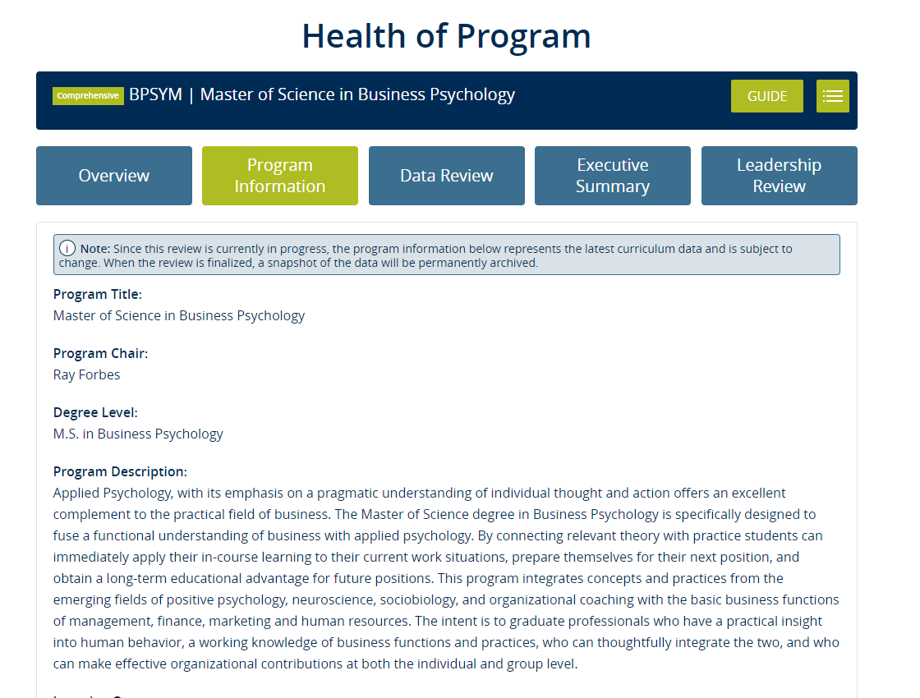

Slide 12
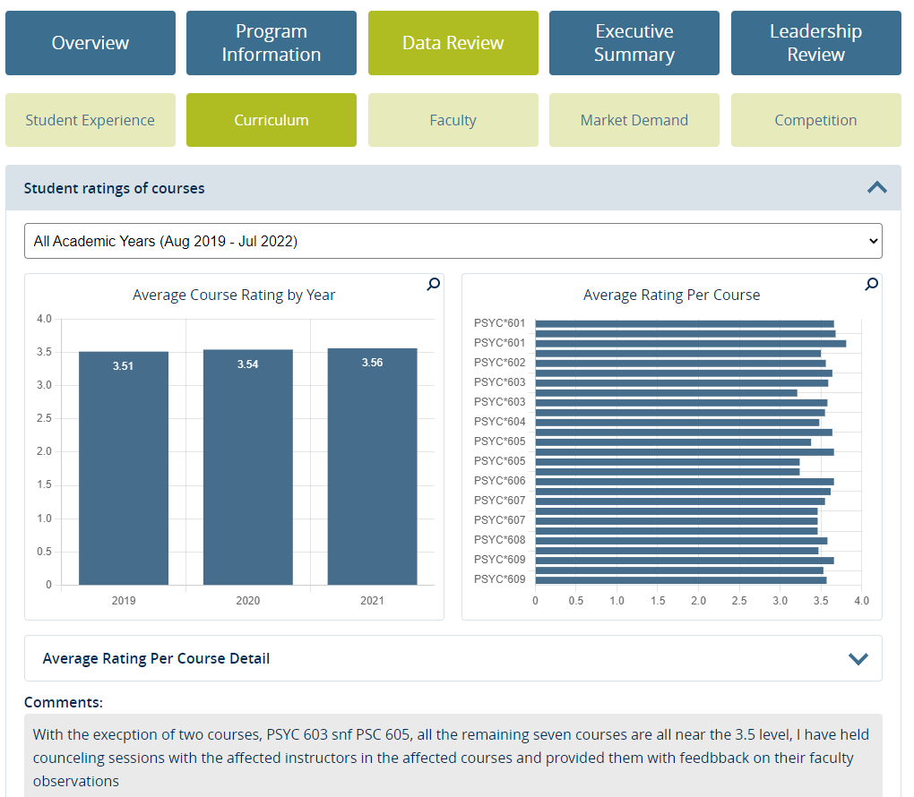
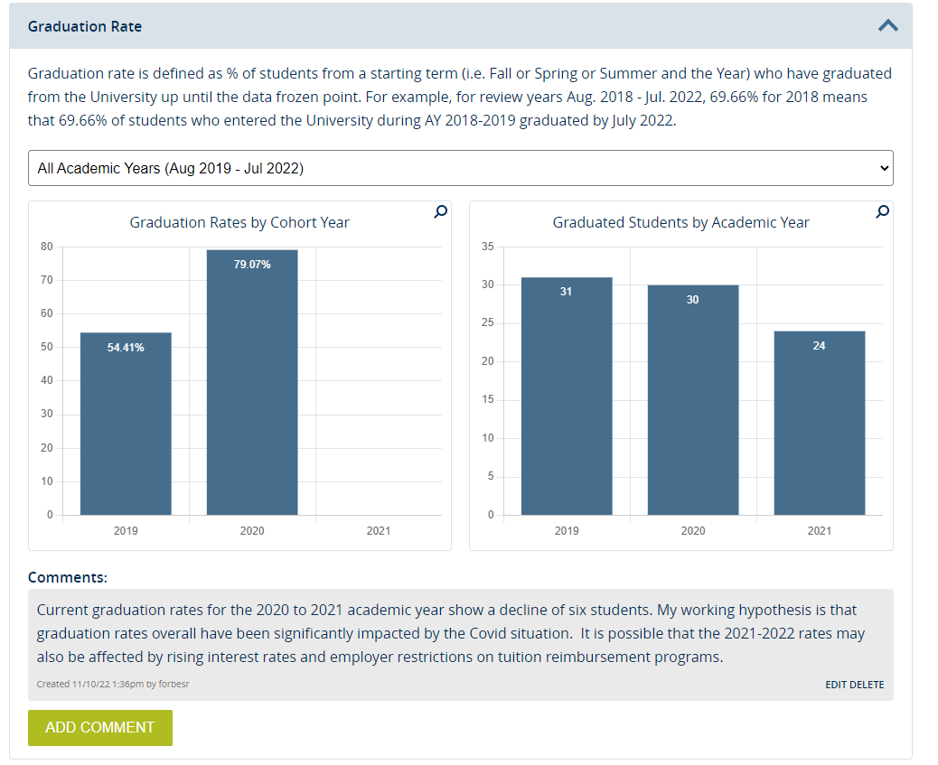

Slide 13
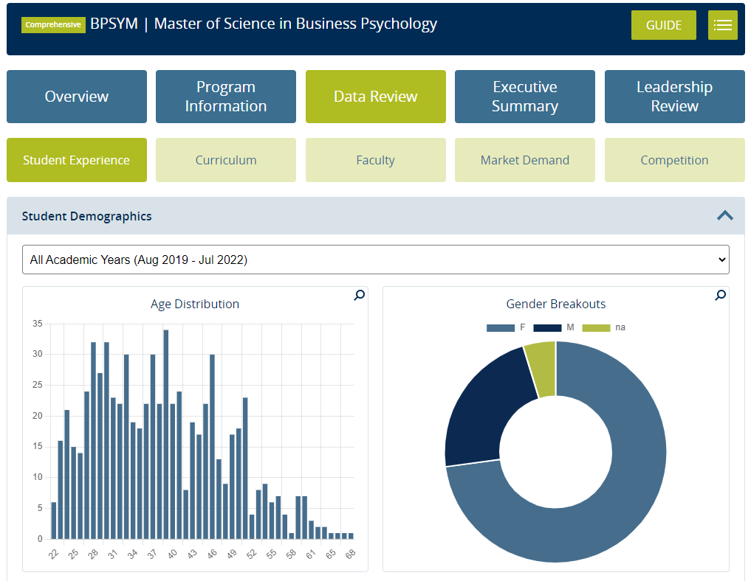
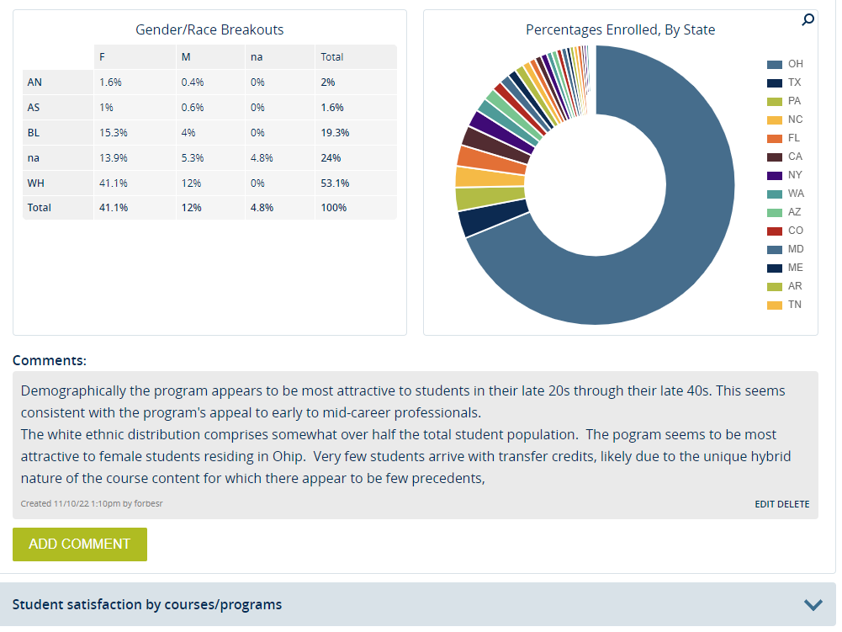

Slide 14
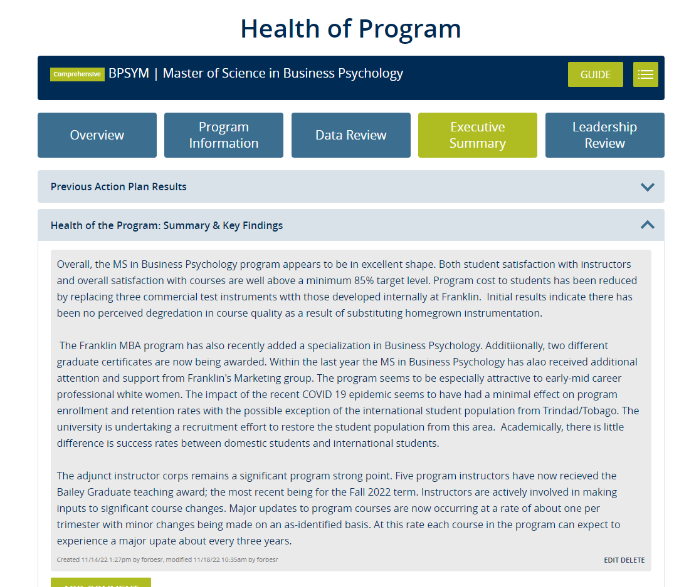
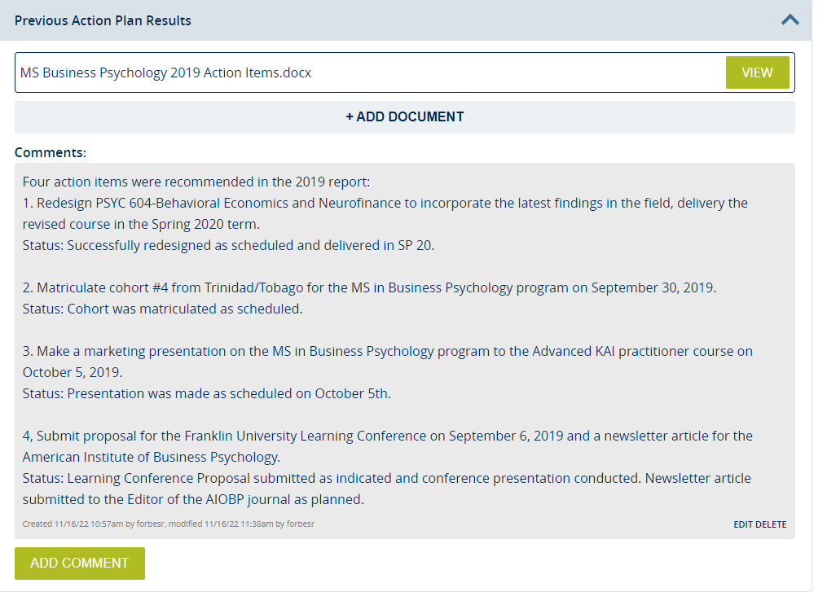

Slide 15
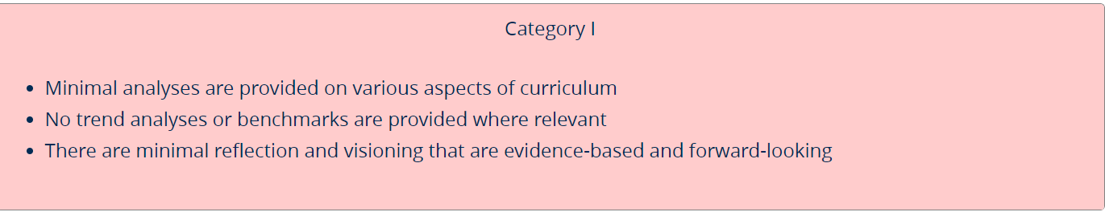
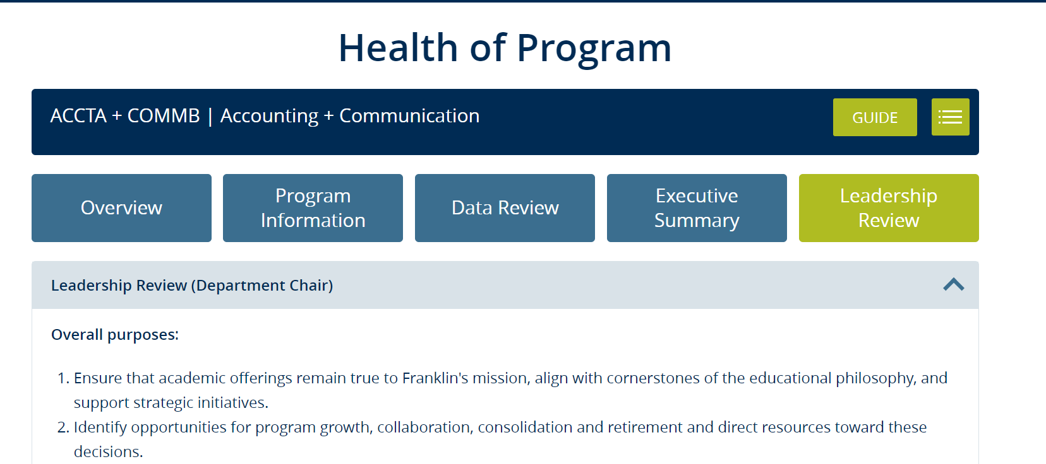
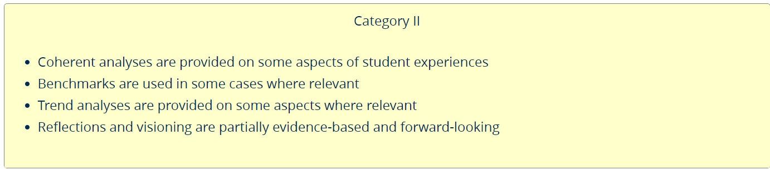
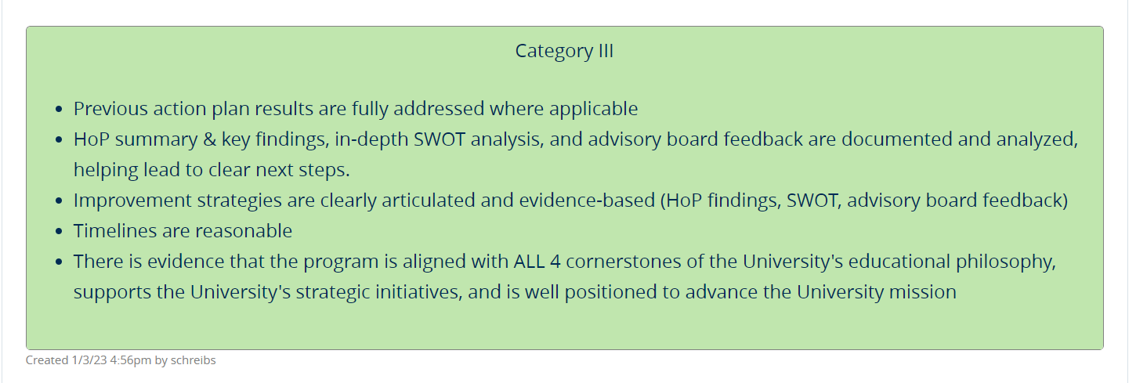
Leadership Review

Slide 16
Faculty Inspired & Faculty Driven
Faculty may have ideas on improvement but not all will be implemented
Remind that this is a portal and the goal of the tool
Effort – Results – Impact (take effort to review results and you can make impactful changes)
Timelines will be adjusted with the additional of priorities, especially Deans
Honest communication
Empowering faculty
Faculty and leadership
Can’t change data but use it to make informed decisions
Data that you give people access to…data not analyzed
Celebrate small wins – phased approach with IT/IE
Ongoing initiatives – not a one and done/stop – true change management in action
Faculty
Inspired
Driven
Continuous Improvement
Reminder Portal
Timeline Adjustments
Empowered
Celebrate Small wins
Ongoing Initiative
Honest Communication
Can’t change/Opportunity
Informed decision-making
Data that you give people access to
Goal of Tool
Ideas for improvement but all can’t be implemented
Lessons Learned – Year 1
Effort
Results
Impact

Slide 17

HoP: Change Management In Action
Change Management
Communication
Stakeholder Support
Training and Support
Resistance Management
Recognition and Rewards
Monitoring and Evaluation

Slide 18

Dr. Alyncia Bowen
alyncia.bowen@franklin.edu

