Slide 1
Leading in a Disruptive World: A New Approach
IACBE ACAM 2022
Dr. Laurie Yates
Oregon Tech
Notes:
Welcome and thank you for joining me in a discussion about the future of leadership.

Slide 2
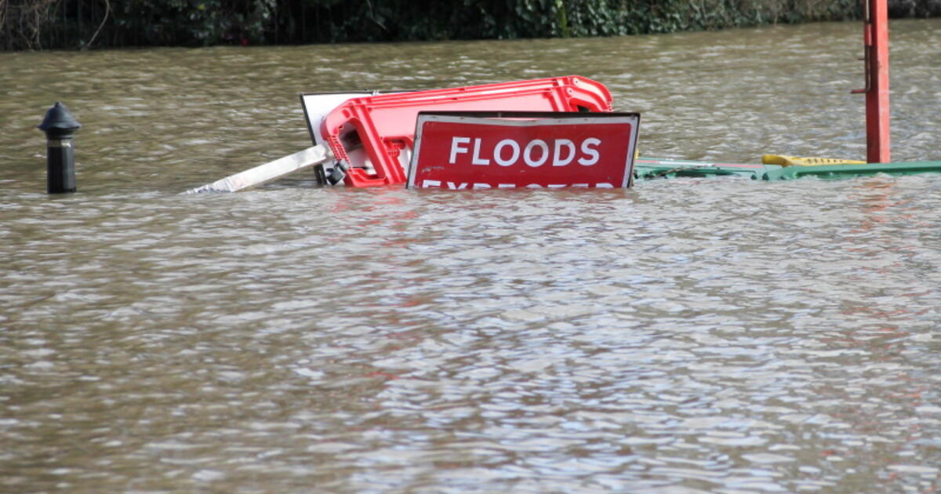
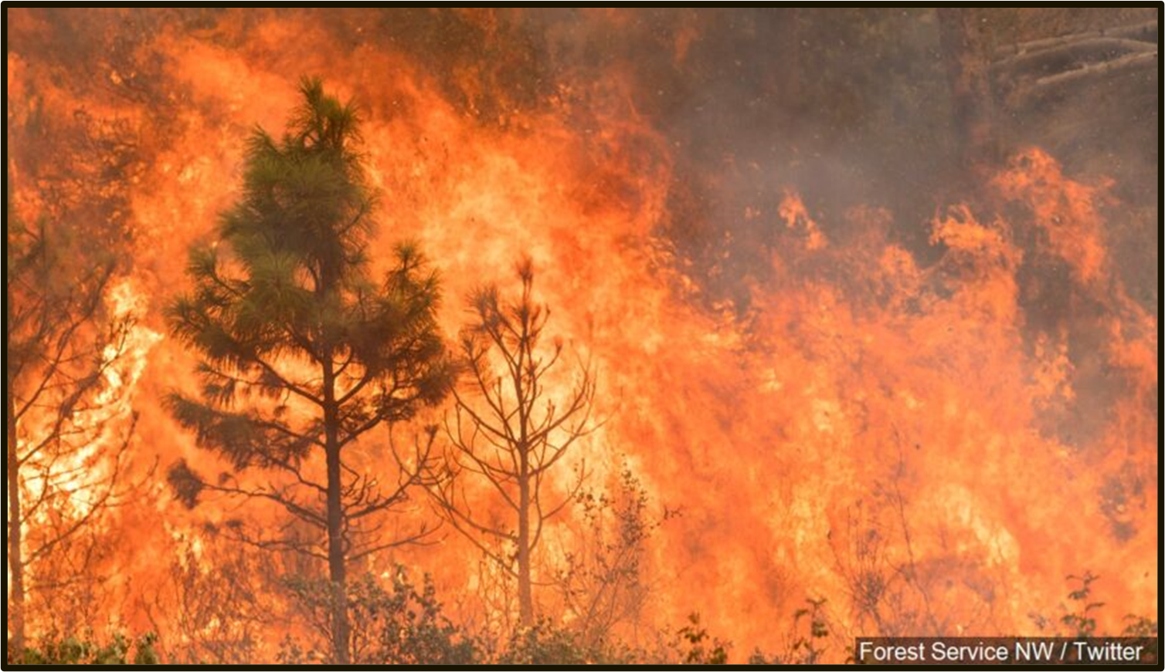
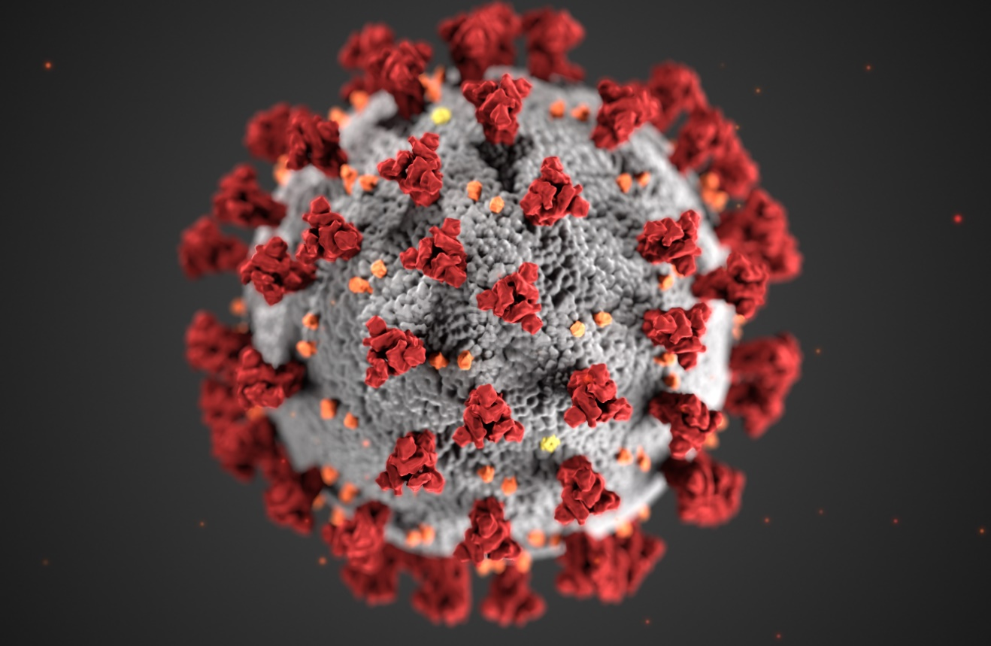
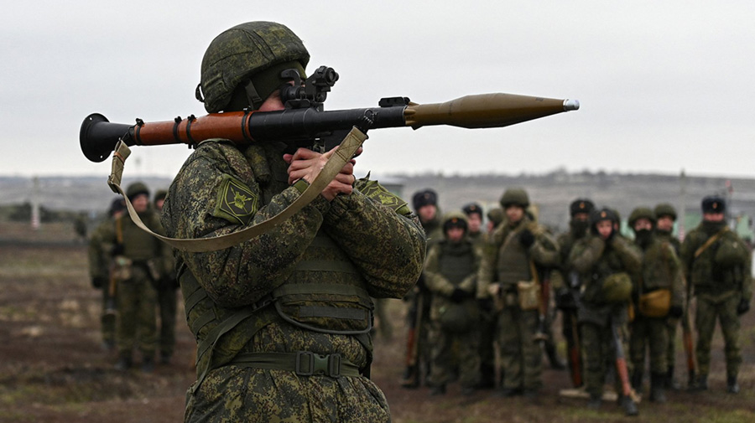
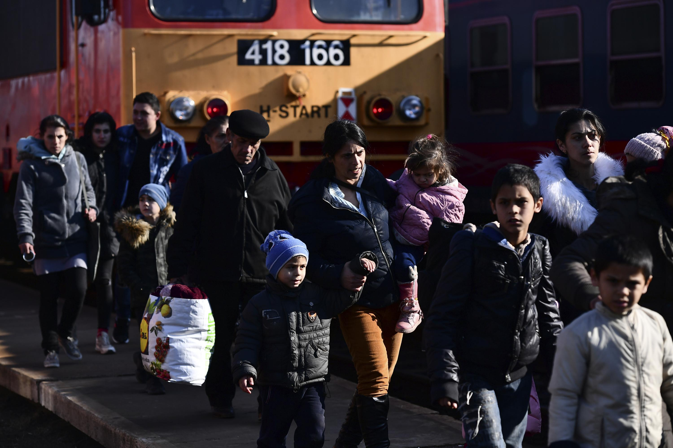
2022
Notes:
2020-2021 and then 2022 ushered in some new challenges of significant magnitude.
Riots, Pandemic, Fires, Floods, Wars
The problems that we face are increasing in intensity and frequency. Many were unexpected. Many others should have been anticipated but preparations were not made.
How does this affect our view of leadership?
On that note, let’s jump in! Here we go . . .

Slide 3
Our World
Notes:
Entering a new “Age of Disruptive Evolution.” We live in what feels like an upside-down world.
Product of the 4th Industrial Revolution and Globalization 4.0
Rapidly advancing technology
Ideas spread like wildfire

Slide 4
“We stand on the brink of a technological revolution that will fundamentally alter the way we live, work, and relate to one another. In its scale, scope, and complexity, the transformation will be unlike anything humankind has experienced before” (Schwab, 2018)
Notes:
Klaus Schwab, Executive Chairman of the World Economic Forum

Slide 6
The World Today
Fourth Industrial Revolution
Fusion of digital, physical, and biological worlds
Highly disruptive
Rapid pace of change
Exponential change and leapfrogging
Age of Disruptive Evolution
Notes:
The shift from simple digitization of the previous era to new methods that combine multiple technologies at once, is rapidly changing our world.
The Fourth Industrial Revolution magnifies the basic digital economy of the previous period and is further fueled by artificial intelligence (Vanham, 2019).
Organizational leaders must learn to understand this new landscape and challenge their organizations to continually innovate and adapt in order to keep pace.
As business educators we tend to focus on organizations. Although we often use business as a source of examples when speaking of leadership, political and economic organizations are equally affected by the new world order. We only have to look at the various governing bodies of some of the most powerful countries around the globe to see how their leaders are ill equipped to handle the “wicked” problems that are crucial to our survival.
Wicked problems- Wicked problems are problems that are unique, difficult to define, and inherently unsolvable. Failing healthcare systems and the effects of climate change are two examples. They are hampered by multiple constraints and lack clarity in both their aims and solutions. Because any trial-and-error attempt has irreversible consequences, potential solutions cannot be tested (Rittel & Webber, 1973). Leadership just became much more complicated.

Slide 7
Industry 4.0
Breakthroughs in:
Machine to machine communication
Internet of Things
Robotics
Artificial Intelligence
Nanotechnology
Quantum computing
Biotechnology
Neuro-technological brain enhancements
Genetic editing
Blockchain
Notes:
Technology and globalization are powerfully intertwined. The 4th Industrial Revolution takes us into a new era of globalization that takes the digital economy to a new level, a cyber dominated world.
The new period is differentiated from the previous one by velocity, scope, and systems impact.
The Fourth Industrial Revolution is developing at an exponential speed as opposed to the linear pace of the Third Industrial Revolution. Industries across the globe are affected by disruptions from the unprecedented velocity of breakthroughs. Technologies that form the foundation of this new era are transforming organizations faster than their leaders and organizations can adapt.
The acceleration of innovation and the velocity of disruption create a complex environment that represents surprise after surprise for today’s organizations. The development of technologies allows innovative and agile competitors to seriously challenge and disrupt giants of industry (Schwab, 2018).

Slide 8
Are 20th century leadership theories up to the challenge?
How can we develop a style of leadership that can not only survive, but also thrive in this new transforming environment?

Slide 9
Paradigm Shift
Builds on previous leadership theories
Transformational leadership
Adaptive leadership
Ethical leadership
Organic leadership
Complexity leadership theory
Notes:
The body of knowledge on leadership is robust. A few leadership styles/theories are especially relevant moving forward and we can build on these.
- Transformational leadership, adaptive leadership, organic leadership
Today I propose adding to the existing body of knowledge and developing a new model or view of leadership. To meet the demands of leading in this new, disruptive era, a new approach to leadership is proposed, Leading with Adaptive DNA. Leading with Adaptive DNA encourages leaders to embrace their unique abilities and to create organizational environments that encourage this evolutionary adaptation.
Definition: A leadership model that is more organic in nature, one that allows for continual adaptation and itself transforms as a living organism might.
Leading with Adaptive DNA moves beyond current leadership theory by challenging leaders to serve as catalysts for adaptive change
Leading with Adaptive DNA has three primary domains: context, leader individuality and uniqueness, people and relationships.
And the secret sauces: Connectivity. Connectivity is the energy that binds the various domains.

Slide 10
Mother Nature- Biological metaphor
Adaptive DNA
Survival/Evolutionary process to thrive
Homeostasis
Leaders
Build cultures that encourage evolutionary adaptation
Create connections
Remove barriers
Champion innovation
Notes:
To help us understand this approach, let’s consider a biological, or natural world, metaphor.
In the natural world, DNA contains instructions needed for an organism to develop and survive. Organisms also possess an adaptive ability, an evolutionary process, that allows them to thrive better in their habitats. Leading with Adaptive DNA encourages leaders to embrace their unique abilities and also to create organizational environments that encourage this evolutionary adaptation.
A biological image—less preoccupation with orderliness (than the machine) and more attention given to adaptiveness/flexibility. Tasks and lines of authority can be changed in response to the environment. It considers survival, org/environment relations, effectiveness (as opposed to efficiency); Often a systems approach—open system; homeostasis (self-regulation); requisite variety; equifinality; system evolution.
Equifinality is the principle that in open systems a given end state can be reached by many potential means. Homeostasis- self-regulation.
Strengths—the openness and flexibility gives importance to human capacities. Works in turbulent environments that require adaptation.
Limitations—Easy to extol its virtues and overlook its own built in conflict potential. Organisms are not infinitely adaptable but can become obsolete and die.

Slide 11
Complexity Leadership Theory
Complexity theory and complex adaptive systems
Innovation
Self-organizing
Mobilization of people
Decentralized- pushing problem-solving downward
Developing alliances and bridging gaps across organizational units
System phenomenon
Leadership sparked by adaptive challenges
Notes:
“As twenty-first century management continues to emphasize decentralized organizing structures and co-evolutionary ecologies of firms, institutions, and markets, there is a growing recognition that traditional top-down theories of leadership are at best overly simplistic” (Lichtenstein 2006). Complexity Theory and complex adaptive systems are introduced to illustrate how and why an organic leadership and culture model works.
“A CAS [complex adaptive systems] is comprised of agents, individuals as well as groups of individuals, who ‘resonate’ through sharing common interests, knowledge and/or goals due to their history of interaction and sharing of worldviews” (Lichtenstein 2006). “CAS are neural-like networks of interacting, interdependent agents who are bonded in a cooperative dynamic by common goal, outlook need, etc.” (Uhl-Bien, 2007). “. . . temporary constellations of people and units” (Uhl-Bien, 2007). Complex adaptive systems are often present in times of chaos and unpredictable, fluctuating situations.
Complexity Leadership Theory: Leadership “is a complex interactive dynamic sparked by adaptive challenges. Individuals act as leaders in this dynamic when they mobilize people to seize new opportunities and tackle though problems“(Lichtenstein 2006).
“Leadership transcends the individual by being fundamentally a system phenomenon” (Lichtenstein 2006)
Complexity theory has many critics and may be better suited as a way of thinking rather than a standalone theory, providing an alternative to linear thinking. Combining adaptive leadership theory and aspects of complexity leadership theory may very well provide today’s leaders with the tools needed to find pathways forward in this turbulent and unpredictable world. These “stablerupting” leaders enable both stability and disruption, having developed an ambidextrous talent (Arena & Uhl-Bien, 2019).

Slide 12
A new model: Leading with Adaptive DNA
Context
Individuality and uniqueness (leader)
People and relationships
Secret sauce: Connectivity
Notes:
Time does not permit a deep dive into each of these areas, only an overview.

Slide 13
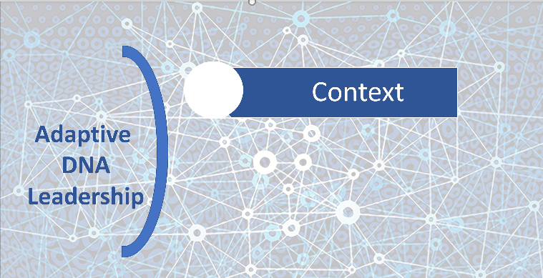
Context
Paradigm blindness
Contextual intelligence
“New normal”
Companies do not live in a vacuum
1st domain of the new model
Notes:
A leader’s nemesis in this world is paradigm blindness, or an inability to see information that threatens their worldview (Kuhn, 1996). Whether conscious or subconscious thought, this relegates us to a 20th century outlook.
As leaders develop contextual intelligence, they become proficient in adapting knowledge and skills to the ever-changing environment. Context is the first domain of our organic leadership model and is critical in the “new normal” era. “Our review of the American business landscape has taught us that long-term success is not derived from the sheer force of an individual’s personality and character. Without a sensitivity to context, long-term success is unlikely. . . Companies do not succeed or fail in a vacuum” (Mayo & Nohria, 2005, p. 354).
As leaders develop contextual intelligence, they become proficient in adapting knowledge and skills to the ever-changing environment.

Slide 14
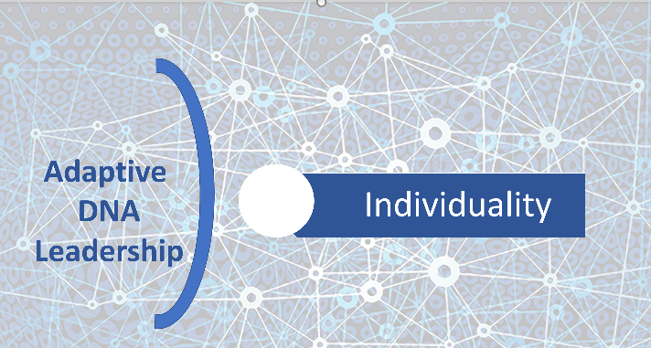
Leader Individuality
Uniqueness
Strengths
2nd domain of the new model
Notes:
Leaders must know themselves before they can connect in a meaningful way with others. Strengths-Based Leadership theory provides some guidance. “What great leaders have in common is that each truly knows his or her strengths – can call on the right strength at the right time. This explains why there is no definitive list of characteristics that describes all leaders” (Rath & Conchie, 2008, p. 13). Strength comes from each leader’s unique talents. A leader’s individuality is the second domain of this organic leadership model. Discover your very best and maximize it.

Slide 15
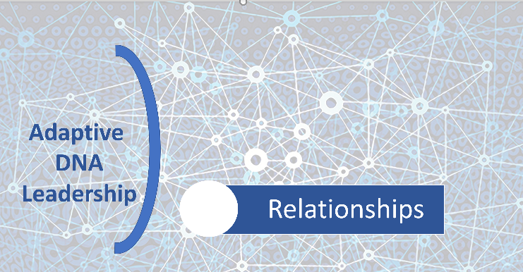
Relationships
Culture of trust
Gravitational pull
3rd domain of the new model
Secret sauce: Connectivity
Notes:
Successful leaders build cultures that are conducive to an organic leadership model. The key? Trust. Trust is everything. The third and final domain of the organic model is arguably the most complex, the most difficult to foster, and yet critically important. People and relationships. In a Gallup survey, when asked what they needed most from their leaders, followers replied trust, compassion, stability, and hope ("Successful Leadership," 2021). Numerous failed leadership experiences in the late 20th century led to a desire among many for trustworthy and transparent leadership.
Much has been written on positivity in the workplace and a culture that encourages meaningful Relationships.
Connectivity: Leading is not an individual sport. It necessitates the ability to foster and nurture teams and communities of people with shared purpose and goals. A shared aspiration can create a bond that develops into a powerful force. Greta Thunberg, a Swedish teenager, inspired an international movement by connecting with others through a shared goal of saving the environment. “She has no access to traditional levers of influence: she’s not a billionaire or a princess, a pop star or even an adult. She is an ordinary teenage girl who, in summoning the courage to speak truth to power, became the icon of a generation” (Alter, Haynes, & Worland, 2019). Thunberg’s actions led Time to name her Person of the Year in 2019. Leaders in this Age of Disruptive Evolution must create a culture that nurtures connectivity of ideas and people. This is the type of culture that is needed to tackle the “wicked” and yet to come problems of our world as well as those found within today’s organizations.

Slide 16
Notes:
A shared aspiration can create a bond that develops into a powerful force. Greta Thunberg, a Swedish teenager, inspired an international movement by connecting with others through a shared goal of saving the environment. “She has no access to traditional levers of influence: she’s not a billionaire or a princess, a pop star or even an adult. She is an ordinary teenage girl who, in summoning the courage to speak truth to power, became the icon of a generation” (Alter, Haynes, & Worland, 2019).

Slide 17
Context
Individuality
Relationships
Adaptive
DNA
Leadership
Notes:
The Model: An attempt to represent it in a 2-dimensional form. The background dots and swirls represent individuals and constellations of individuals and groups that gravitate toward one another to solve problems, innovate, and achieve goals. In other words, connectivity. They often share passions or are driven to the same issue. There is a gravitational pull that brings them together.
People often seek out a magic formula, the answer, that will transform them into effective leaders. However, it resides inside each of us. Leadership is difficult, messy, complex, and elusive. It is also amazing, joyful, hopeful, and exhilarating.
Instead of searching for the one, all-inclusive, nonexistent answer, learn about best practices and adopt the tenets of theory established through research and practice. Implement them using your own strengths, characteristics, and values. Be courageous in the face of resistance. Practice these leadership skills in everyday situations. They will help you innovate, adapt, and propel a group toward a common goal or purpose.
We live in an era of rapid evolution and transformation. Perhaps, looking back we will see this as a paradigm shift. The key is for leaders to develop an adaptive DNA so that the word “change” nearly disappears from the literature. Leaders will develop the ability to naturally adapt without conscious thought, much as we see in the natural world. In fact, the model itself is adaptive, continually morphing and recreating itself as needed.

Slide 18
Context
Individuality/
Uniqueness
People & Relationships
Connectivity
Connectivity
Adaptive DNA
Notes:
Another visual rendering of Leading with Adaptive DNA

Slide 19
Adaptive DNA
Leaders with Adaptive DNA
Develop superior contextual intelligence skills
Embrace their unique abilities and adaptive capacity.
Create organizational environments that encourage this evolutionary adaptation (adaptive culture creators).
Engage in distributed leadership: responsibility and problem solving driven downward
Build cultures based on trust and empowerment

Slide 20
Tomorrow Is Today
Grow your leadership DNA
Notes:
The journey ahead almost certainly requires navigation of turbulent waters but armed with the new leadership ideas and practices, we can lead the way. Imagine exciting possibilities for the future. Yes, the Fourth Industrial Revolution ushers in a world with messy, wicked problems and no clear answers. But it also brings an age of great opportunity and new discoveries. Embrace both and mold a leadership footprint that moves people and organizations in the direction of greatness.
I challenge each of us here today to be the leader the world needs.

Slide 21
References
Mayo, A. J., & Nohria, N. (2005). In their time: The greatest business leaders of the twentieth century. Boston, MA: Harvard Business School Publishing.
Alter, C., Haynes, S., & Worland, J. (2019). Time 2019 person of the year: Greta Thurnberg. Time.
Arena, M. & Uhl-Bien, M. (2019). The 4Ds of adaptive space. People and Strategy, 42(2).
Brown, B. (2018). Dare to lead. New York, NY: Random House
Cameron, K. S. (2012). Positive leadership: Strategies for extraordinary performance. Oakland, CA: Berrett-Koehler Publishers, Inc.
Gladis, S. (2013). Positive leadership: The game changer at work. Annandale, VA: Steve Gladis Leadership Partners
Heifetz, R. & Linsky, M. (2017). Leadership on the line: Staying alive through the dangers of change. Boston, MA: Harvard Business Review Press
Kouzes, J. M. & Posner, B. Z. (2012). The leadership challenge: How to make extraordinary things happen in organizations. San Francisco, CA Wiley Sons, Inc.
Kuhn, T. (1996). The structure of scientific revolutions (3rd edition). Chicago, IL: The University of Chicago Press.
Lichtenstein, B., Uhl-Bien, M., Marion, R., Seers, A., Orton, J. D., & Schreiber, C. (2006). Complexity leadership theory: An interactive perspective on leading in complex adaptive systems. Emergence: Complexity and Organization, 8(4).

Slide 22
References
Morgan, G. (2006). Images of organization. Thousand Oaks, CA: Sage Publications.
Morrison, K. (2010). Complexity theory, school leadership and management: Questions for theory and practice. Educational Management Administration & Leadership, 38(3), 374-393.
Schein, E. H. & Schein, P. A. (2018). Humble leadership. Oakland, CA: Berrett-Koehler Publishers, Inc.
Schwab, K. (2018). Globalization 4.0 -What does it mean? Retrieved from https://www.weforum.org/agenda/2018/11/globalization-4-what-does-it-mean-how-it-will-benefit-everyone/
Uhl-Bien, M., Marion, R. & McKelvey, B. (2007). Complexityleadership theory: Shifting leadership from the industrial age to the knowledge era. The Leadership Quarterly, 18(4), 298-318.
Vanham, P. (2019). A brief history of globalization. World Economic Forum. Retrieved from https://www.weforum.org/agenda/2019/01/how-globalization-4-0-fits-into-the-history-of-globalization/
Weinbergerr, D. (2019). Everyday chaos: Technology, complexity, and how we’re thriving in a new world. Boston, MA: Harvard Business Review Press.
Wheatley, M. J. (2006). Leadership and the new science: Discovering order in a chaotic world. San Francisco, CA: Berrett-Koehler Publishers, Inc.

Slide 23
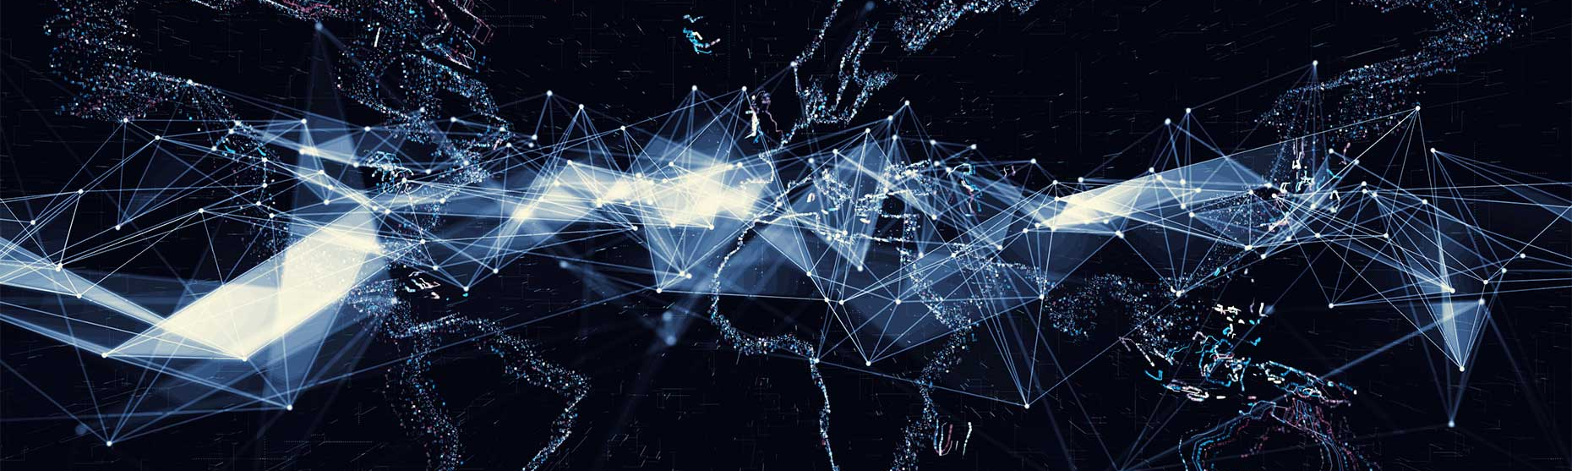
Thank You!
Coming Soon: Leading in a Disruptive World: Discovering Your Adaptive DNA
Notes:
For those of you who find this topic of interest, I encourage you to weigh in using the chat feature provided by the conference organizers. I would love to continue this conversation.
Thank you again for your time and interest. Have a great conference.

