Slide 2
Moderator for Today:
Ted Collins
Director of Marketing, Member Services, and Recruiting

Slide 3
Purpose of the Forum
Give participants the opportunity to discuss challenges in higher education, opportunities for growth, and a venue for the exchange of best practices in business and business education.

Slide 4
Ground Rules
Ways to participate:
raise your hand – we will then give you the microphone
type questions in the question area
Please be respectful when
others are speaking

Slide 5
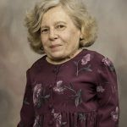
Communication and Problem-Solving in a Post-COVID World
with Joy Wyler
January 2022

Slide 6
Keys to Communication
January 2022

Slide 7
The 3 Parts of Communication
Speaking
Listening
Understanding

Slide 8
Where do we get stuck?
Speaking—language, tone, clarity of both word choice and enunciation
Listening—stop when we hear a trigger
Understanding—not even a goal

Slide 9
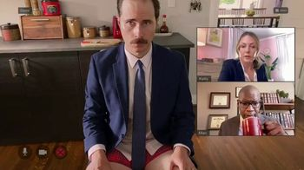
What have we lost in “virtual” communication?

Slide 10
LOST
Body language
Auditory hearing levels
The casual intimacy of office gatherings
Unstructured time
Personal connections

Slide 11
3 Keys to Communication
Curiosity
Kindness Where we will focus today
Clarity

Slide 12
Define Kindness
Kindness: the quality of being friendly, generous, and considerate.

Slide 13
Kind is considerate
Considerate = Respect
Every person deserves to be treated as a person of equal value.
Notice your biases and those you feel are “less than”.
What happens when name calling and demeaning language enters the communication?

Slide 14
Kind is generous
When people are at their worst, they need the most kindness
What is the story you don’t know about this person—or today?
Be generous when you are tempted to “assume” you know how another person thinks or where they are coming from.

Slide 15
Soft front—Strong back
Brene Brown
Do not armor-up or become defensive at the first sign of discord. Stay open and listen. That is the soft front
Staying open doesn’t mean we have to sacrifice our core values. That is the strong back.
Unfortunately, most of us don’t know what our core values are. We have a hardened front—defensive at any provocation—and a weak back that gives in when we feel threatened.

Slide 16
Kindness is a response
React vs Respond
Reactions come from our primal “lizard” brain. They are not thoughtful.
Take a breath.
Monitor your own feelings.
Process what you heard and what you want to say next.
Responses are usually kinder than reactions.

Slide 17
Kindness and being politically correct
There is a positive movement towards understanding people who are different than we are. These are people generally marginalized and oppressed compared to the advantages of white, straight, English speaking, Christian, cis-gendered especially males. There is a lot we don’t know about people with a different race, language/ethnicity, gender identification, abilities, religion, and more.

Slide 18
Kind and curious
For many years we were taught we could/should politely ASK questions we wanted to know. This put the burden of education on the oppressed people and sometimes expected them to answer questions that felt personally invasive.

Slide 19
Doing our “own work” is kind
Now, the burden is on the dominant culture to do their own research on their own time. Read a book. Watch a movie. Check the internet.
Ask a person’s name or pronunciation if you are unsure. Don’t ask “What should I call you.” Call me my name. Don’t ask questions you wouldn’t ask in the absence of “difference”.

Slide 20
Self-care is Kind
Be self-aware when you are not at your best.
Better to ask for generosity (I’m not at my best today) rather than react in ways that burn bridges, destroy trust, etc.
Know your own triggers and take an extra breath when you feel anger, shame, threatened.

Slide 21
Resources
Emotional Intelligence:
https://www.psychologytoday.com/us/tests/personality/emotional-intelligence-test
https://www.ihhp.com/free-eq-quiz/
Nonviolent Communication by Marshall Rosenberg
https://www.cnvc.org/

Slide 22
MOVING. FORWARD. TOGETHER.
Watch for upcoming information about our February Forum coming soon.

Slide 24
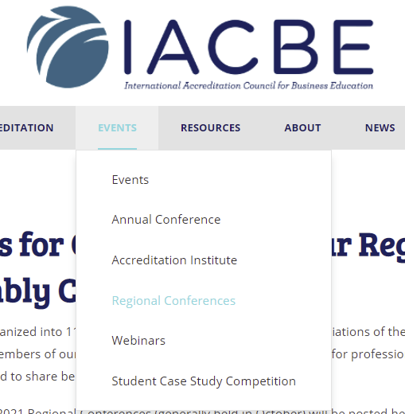
Regional Conference Registration is open!
Annual Conference April 3-8, Costa Mesa California, USA

Slide 25
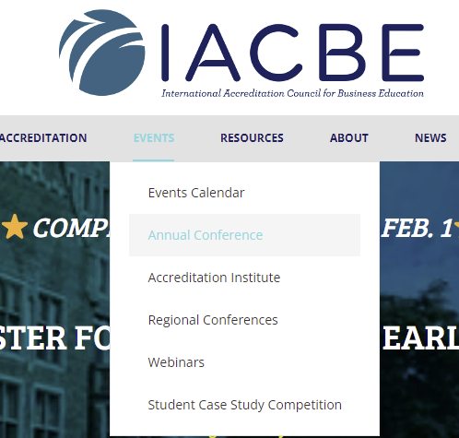
Faculty of the Year and Service Awards
IMA® Accounting Faculty of the Year
Business Faculty of the Year
John L. Green Service Award

Slide 26



Slide 27




Slide 28

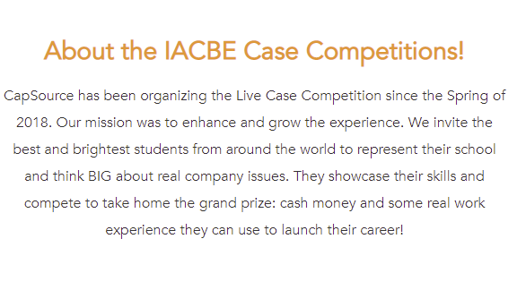
capsource.io/iacbe-acam

Slide 29
Do you have an idea for a Forum?
Something you’d like to present?
Email: iacbe@iacbe.org

