Slide 1

MOVING.FORWARD.TOGETHER.

Slide 2
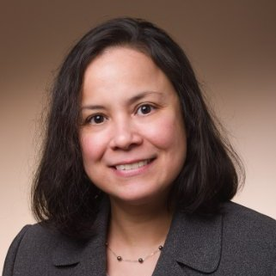
Welcome our newest staff member!
Cecilia brings with her 16 years of experience in higher education, including 13 years in compliance and accreditation management, having served as a consultant, director, and chief compliance officer. She holds a Master of Jurisprudence with a concentration in Business Law and a Certificate in Corporate Compliance from the Loyola University School of Law and is a Certified Compliance and Ethics Professional.
Cecilia Livengood, Accreditation Specialist

Slide 3

New
Self-Study Principles
Principle 1: Commitment to Integrity, Responsibility, and
Ethical Behavior
Principle 2: Quality Assessment and Advancement (OAP)
Principle 3: Strategic Planning
Principle 4: Business Curricula and Learning
Opportunities
Principle 5: Business Faculty Characteristics, Activities,
and Processes
Principle 6: Student Policies, Procedures, and Processes
Principle 7: Resources Supporting Business Programs
Principle 8: External Relationships
Principle 9: Innovation in Business Education

Slide 4
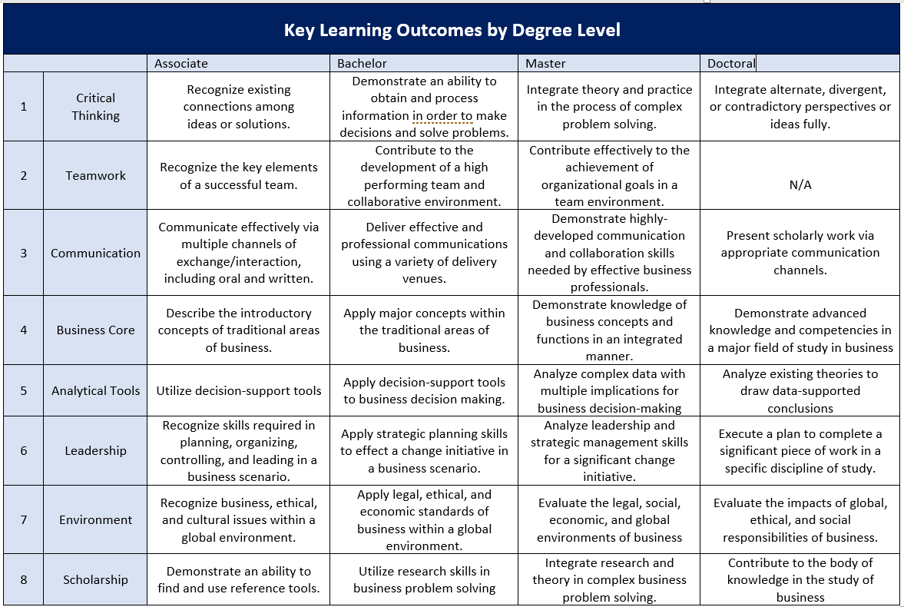
New Key Learning Objectives

Slide 5
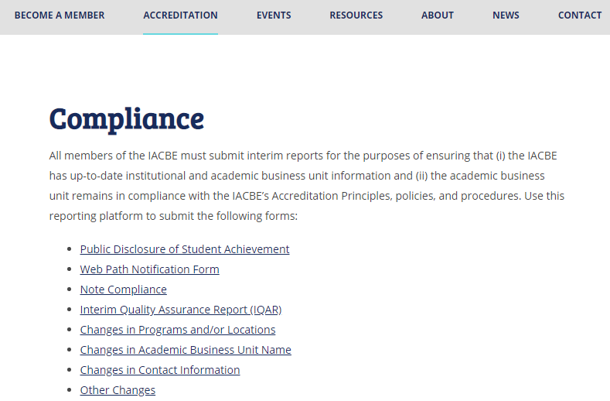


Slide 6

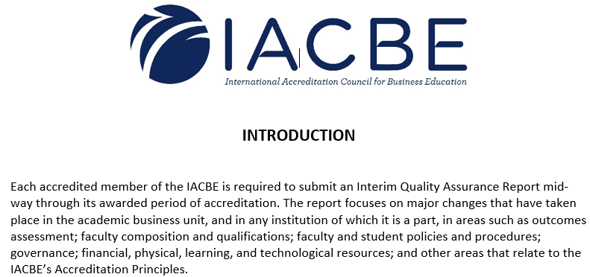

Slide 7
IQAR Due Dates are approximately mid-way through your 7-year accreditation.
(November 1st of year 4)
Reaffirmation in 2022 – IQAR due November 1, 2019
Reaffirmation in 2023 – IQAR due November 1, 2020
Reaffirmation in 2024 – IQAR due November 1, 2021
Reaffirmation in 2025 – IQAR due November 1, 2022

Slide 8


Slide 9
The Public Disclosure of Student Achievement must be posted on the home page of each academic/business unit that offers degree programs that are accredited by the IACBE. It is due November 1 of each year with results from the prior year (e.g. November 1, 2019 will include 2018-19 academic year results).
The Web Path Notification Form, showing the path to the Public Disclosure of Student Achievement is reported on an annual basis, by November 1.

Slide 10
In accordance with this guideline, schools must report at least one of the following on an annual basis for each IACBE accredited program (need not be the same measure for each program).
Attrition and retention
Graduation rates
Licensure pass rates
Job placement rates (as appropriate)
Employment advancement (as appropriate)
Acceptance into graduate programs
Successful transfer of credit

Slide 11
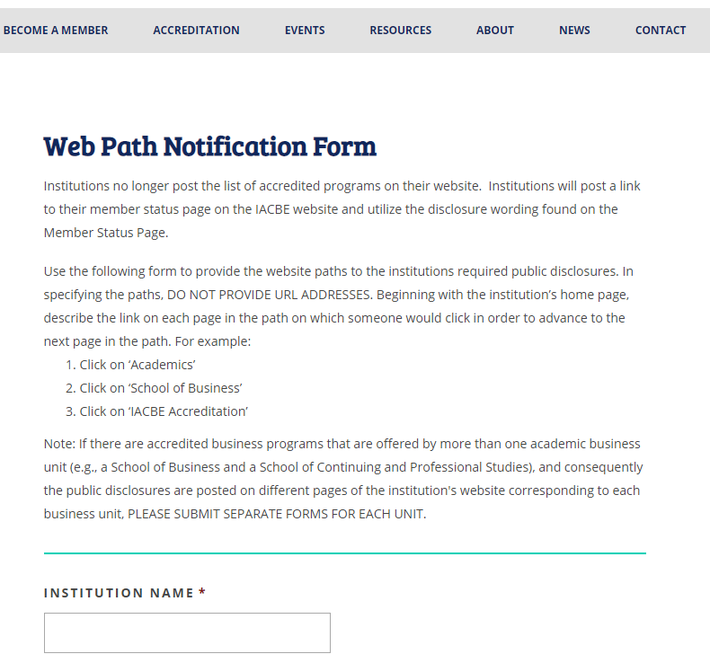

Slide 12
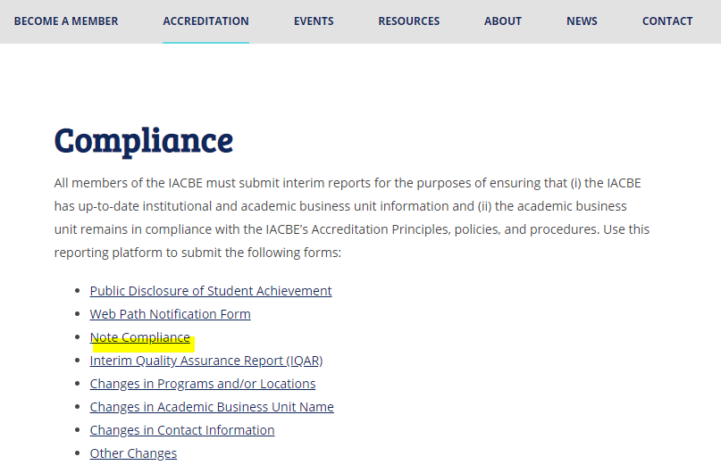

Slide 13
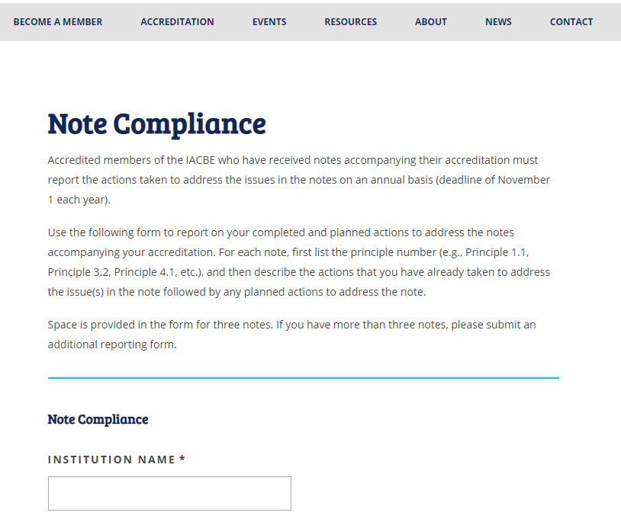

Slide 14
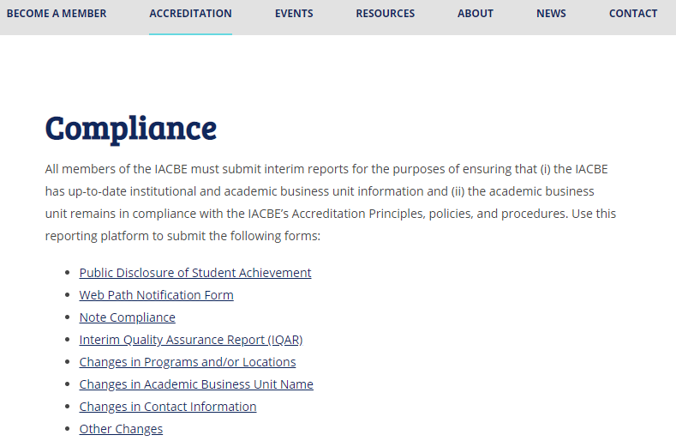

Slide 15
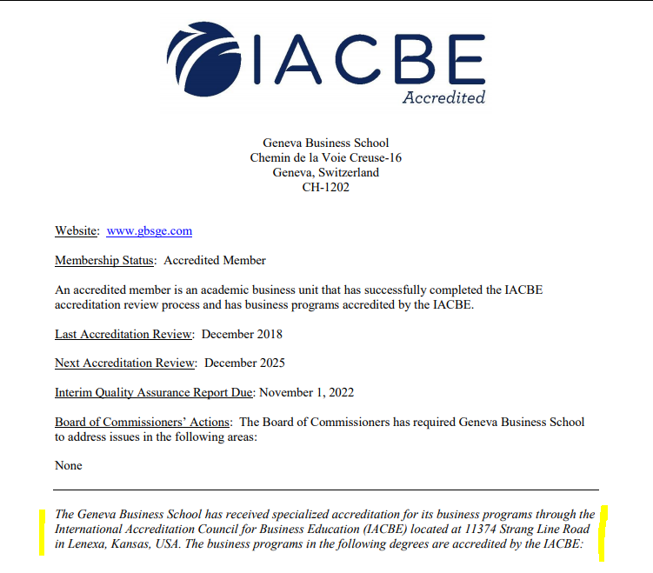
Your website must include a link to your school’s status page on the IACBE website.

Slide 16
Accreditation Institutes
(completed within 12 months prior to starting SS Year)
You may arrange for one at your school or attend one of the open Accreditation Institutes.
Upcoming Institute Dates:
January-February TBD
March 30-31, Dallas (Annual Conference)
September TBD, (Kansas City)
Notes:
In an effort to better serve our members, we will be holding the winter institute using GotoMeeting – in a virtual format.
This will help to save our members the travel and lodging expenses plus the travel days to attend the required workshops.
The workshops will be offered in a face-to-face format at the annual conference, with one workshop on Tuesday before the conference and one on Friday after the conference so that members can attend both workshops.
The goal is to use the new self-study manual in April, but that will depend on the commissioners workload at their December meeting.

Slide 17
Follow us!
Like us on Facebook
Join us on LinkedIn
Visit our website:
Events (Regionals, ACAM, Workshops, etc.)
JABE (Journal for Advancing Business Education)
Member Resource Area for:
Rubrics, Documents, Applications, Examples

