Slide 1

“MOVING.FORWARD.TOGETHER.”

Slide 2
New
Self-Study Principles
Principle 1: Commitment to Integrity, Responsibility, and Ethical Behavior
Principle 2: Quality Assessment and Advancement (OAP)
Principle 3: Strategic Planning
Principle 4: Business Curricula and Learning Opportunities
Principle 5: Business Faculty Characteristics, Activities, and Processes
Principle 6: Student Policies, Procedures, and Processes
Principle 7: Resources Supporting Business Programs
Principle 8: External Relationships
Principle 9: Innovation in Business Education

Slide 3
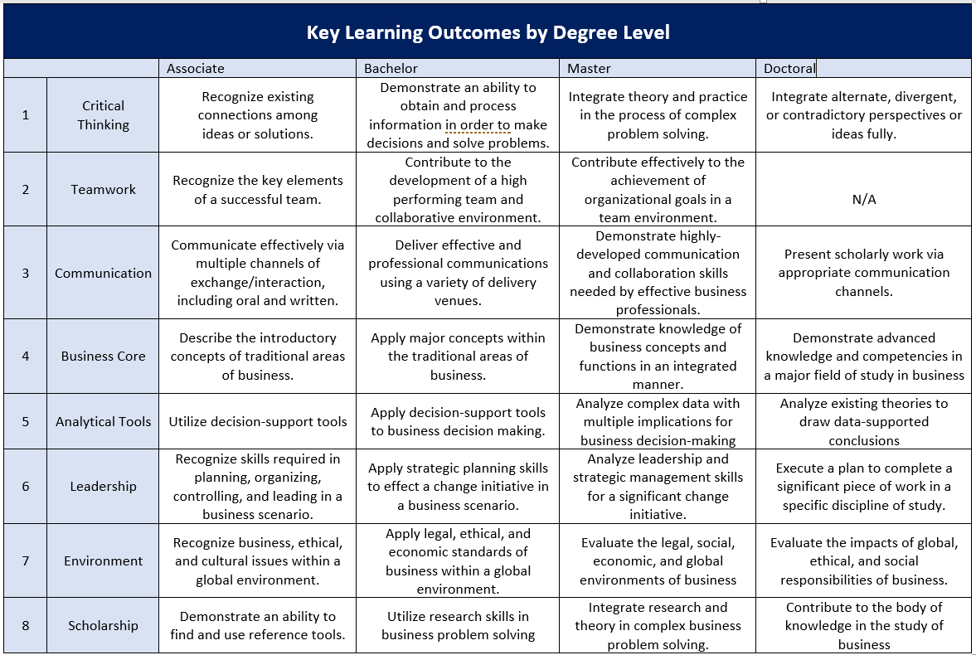
New Key Learning Objectives

Slide 4
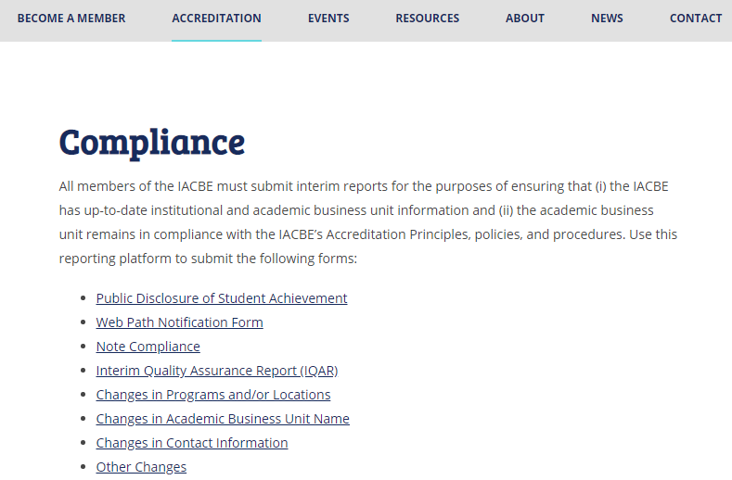

Interim Quality Assurance Report (IQUAR)

Slide 5
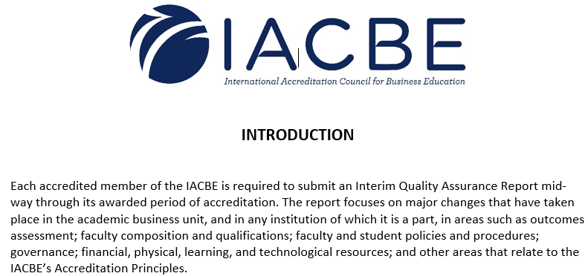


Slide 6
IQAR Due Dates are approximately mid-way through your 7-year accreditation.
(November 1st of year 4)
Reaffirmation in 2021 – OPTIONAL - Due November 1, 2018
Reaffirmation in 2022 – IQAR due November 1, 2019
Reaffirmation in 2023 – IQAR due November 1, 2020
Reaffirmation in 2024 – IQAR due November 1, 2021
Reaffirmation in 2025 – IQAR due November 1, 2022

Slide 7


Public Disclosure of Student Achievement &
Web Path Notification Form

Slide 8
The Public Disclosure of Student Achievement must be posted on the home page of each academic/business unit that offers degree programs that are accredited by the IACBE.
The Web Path Notification Form, showing the path to the Public Disclosure of Student Achievement is reported on an annual basis, by November 1.

Slide 9
In accordance with this guideline, schools must report at least one of the following on an annual basis for each IACBE accredited program (need not be the same measure for each program).
Attrition and retention
Graduation rates
Licensure pass rates
Job placement rates (as appropriate)
Employment advancement (as appropriate)
Acceptance into graduate programs
Successful transfer of credit

Slide 10
January Accreditation Institute
Hosted by: United States University| San Diego, California
Workshop Date:
January 22-24, 2019
Tuesday – 2:00 PM – 5:00 PM
Wednesday – 8:30 AM – 5:00 PM
Thursday – 8:00 AM - Noon
Early Bird Rate: $650 per attendee
*Discounted rate expires January 8th, 2019

Slide 11


Wednesday, January 16th
^{More Details Coming Soon!}

Slide 12


Slide 13


2019 Annual Conference & Assembly Meeting
Caesars Palace | April 9-11
MOVING.FORWARD.TOGETHER
New Registration Platform
Cvent Mobile App
Proposals Deadline – November 15th
Student Case Competition
Nominations for Directors & Commissioners
New Awards for Members

Slide 14

Community Colleges

Slide 15

Connect With Us

